Slide 1

Vocabulary to pre-teach
Politician
A politician is a person who is chosen or elected by people to help make laws and important decisions for a city, country, or community.
Political parties
A political party is an organised group of people who share similar ideas about how a country should be run, working together to get their members elected into government.
Concise language
Concise language means using clear, short sentences and only the words you truly need to get your point across quickly.
Factual language
Factual language is writing or speaking that uses proven facts, numbers, and clear details without adding personal feelings, opinions, or guesswork.
Neutral
Neutral means not taking sides, showing favouritism, or expressing an opinion, so that both or all sides of an issue are treated fairly and equally.
Bias
Where a news report is slanted (or unbalanced) to make one side of the story seem more important.

Slide 2

Lesson 9
Analysing bias in the news

Slide 3

Learning objective
To analyse biased language in news reporting.
Journalist training school
Journalists should only use factual and concise language in news reporting. They should not use words which convey their opinion or influence the reader to feel a certain way. Use of ‘influencing’ language is another way a report can be biased.

Slide 4

Learning outcomes:
  Explain what bias means.
  Identify examples of biased language in a news report.
  Evaluate how a writer uses language to influence their reader.

Slide 5
Whose side are they on?
Read the football match news reports.
Think about:
  Who wrote each report?
  Are the reports biased towards one team or another?
  Which key words show you which team the writer prefers?
  How can you tell who wrote the report?
  Whose side are they on?
  What does the writer want you to feel or think?
  How else might this story have been told?

Slide 6
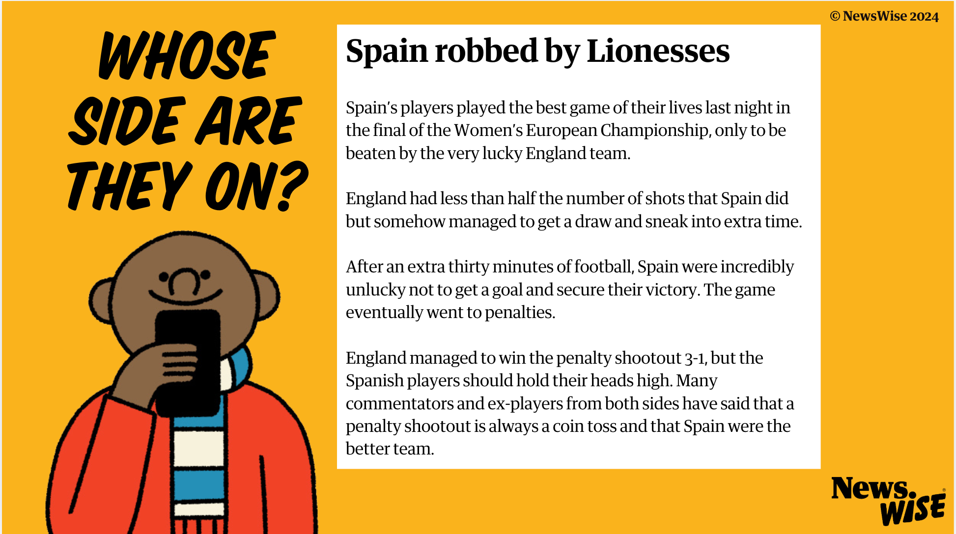

Slide 7
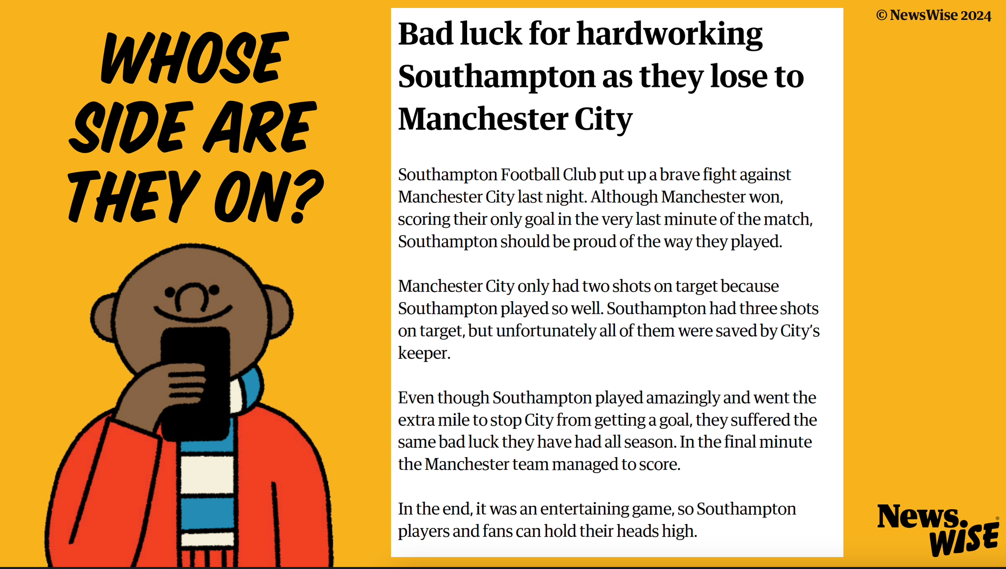

Slide 8
What is bias?

Slide 9
What is bias?
Bias is when you have a strong, unfair, preference towards or against something. In a news report, this means one side of a story can seem more important than another.

Slide 10

Bias is when you have a strong, unfair, preference towards or against something
Can you think of a time when you might have been biased?

Slide 11
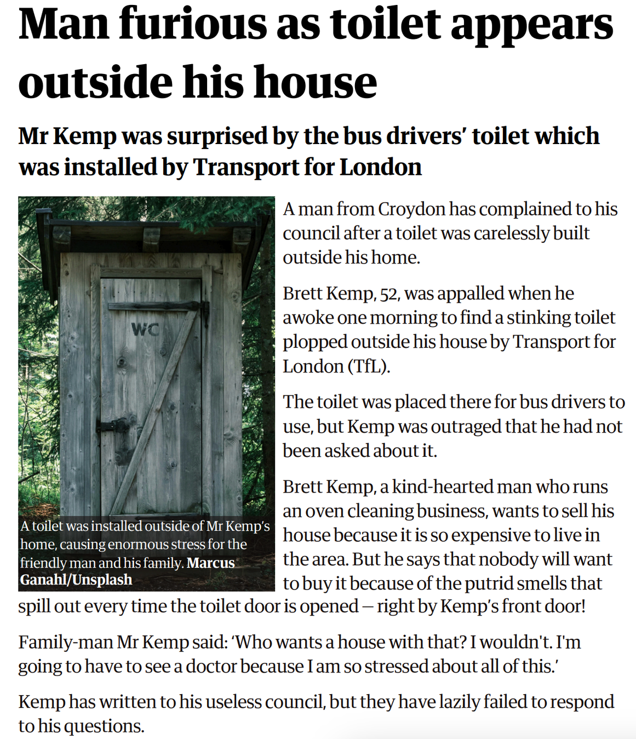
Read the news report.
  Who do you want to defend in the story?
  Whose side do you agree with?
  Who do you disagree with?
  Who do you want to criticise?
  Why do you feel this way?
  How do you think the writer has influenced you?

Slide 12
Create a word bank of all the words used to describe each person in the story.
Which words are positive and which are negative?
Do they influence how you feel about each person?

Slide 13
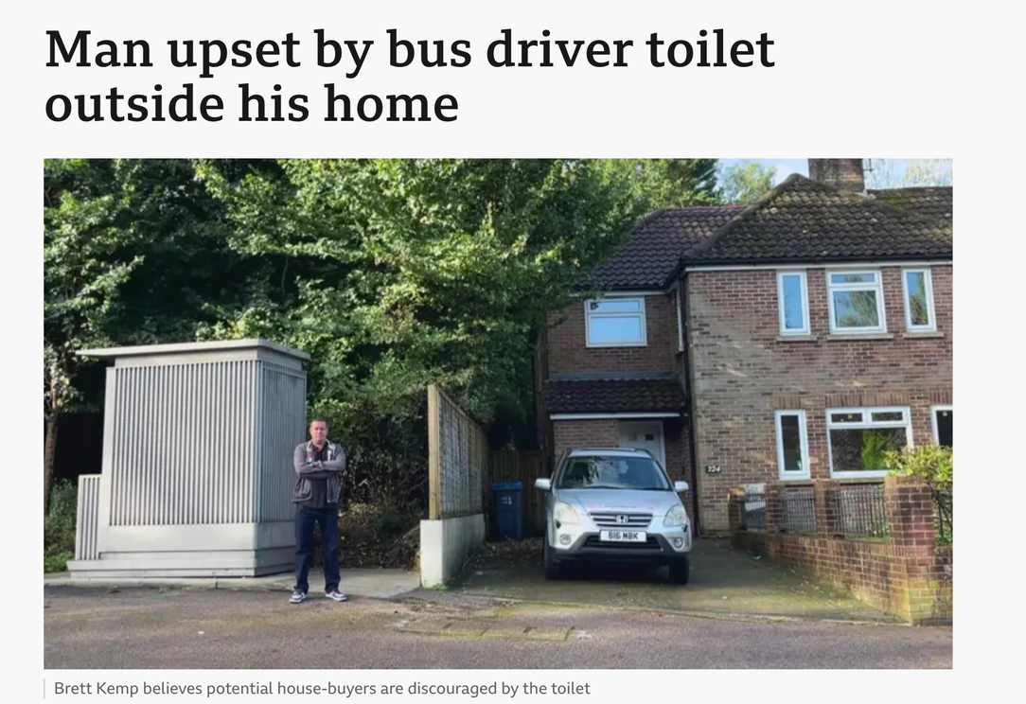

Now read a second report about the same event.
This report is an online news story.
How are they similar or different?
Which report is less biased and why?
Access the report here:
https://www.bbc.co.uk/news/articles/c80rkegmrkxo

Slide 14
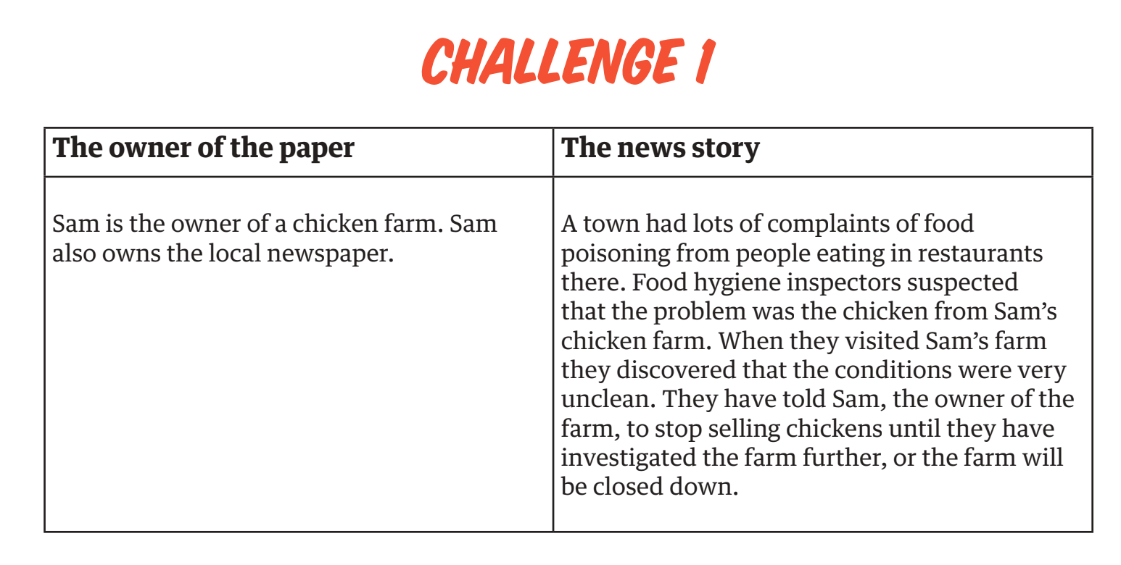
Challenge: controlling the news
  Who has power in the story?
  Which parts of the story might the person with power want to share?
  Which parts might they want to control by not sharing? Why?

Slide 15
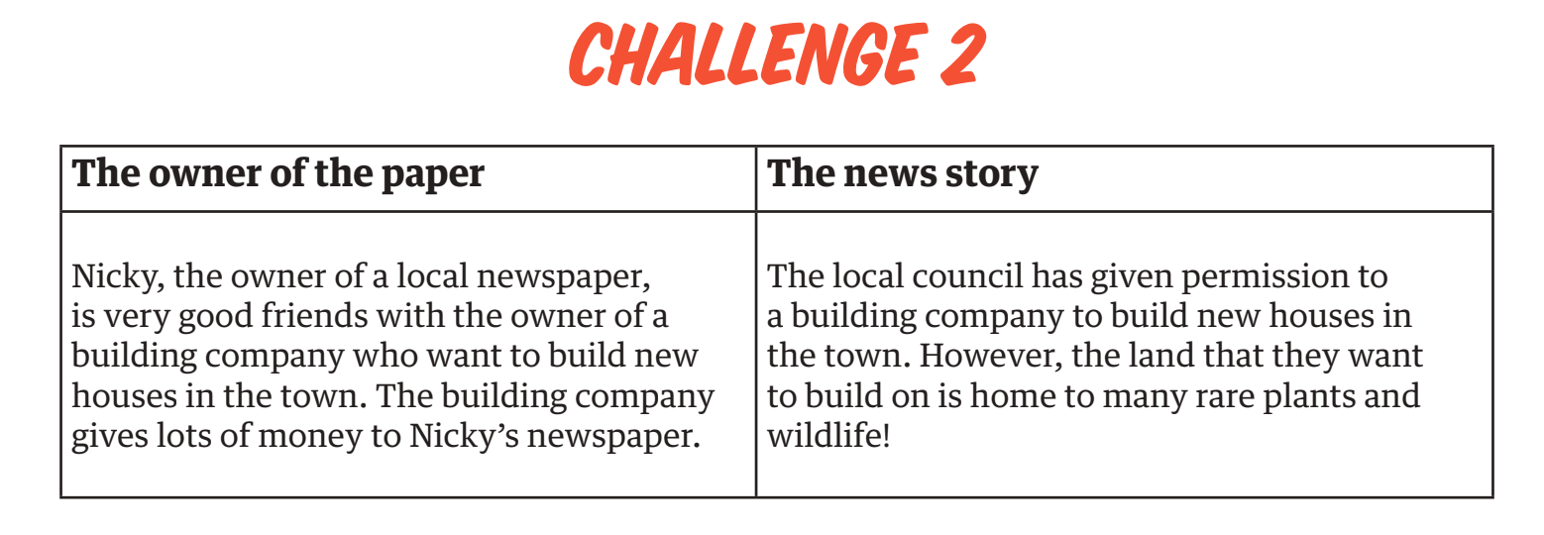
Challenge: controlling the news
  Who has power in the story?
  Which parts of the story might the person with power want to share?
  Which parts might they want to control by not sharing? Why?

Slide 16
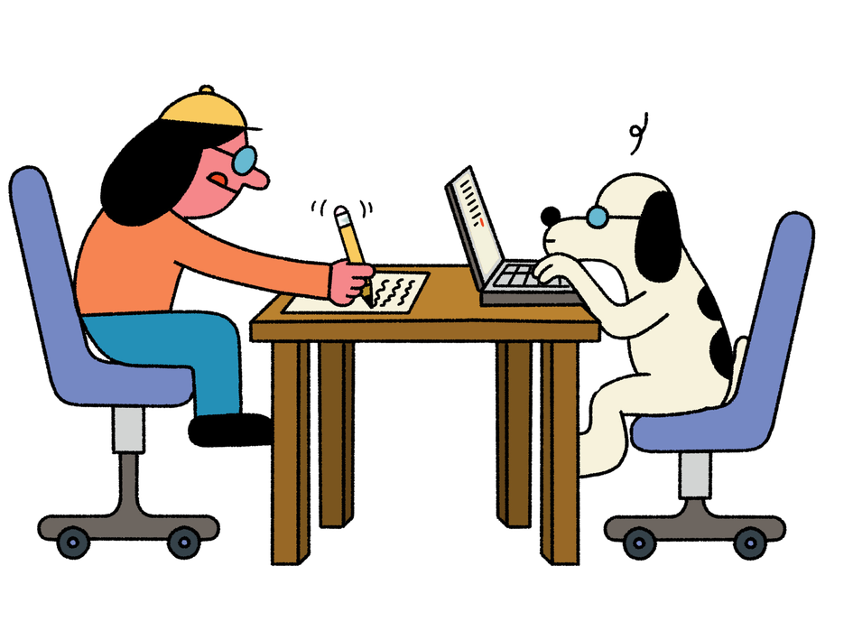
Let’s discuss
Think back to the football report from the beginning of the lesson.
How else might this story have been written?
Can you re-write the report, or a chosen section or sentence, to reflect a different perspective?

Slide 17
Let’s discuss
Why is it important to look for bias in the news?
It’s important we read multiple different news reports, even ones we disagree with, to help us understand the full story.
As journalists, we must make sure that our news reports are not biased; we have to report our stories in a fair and balanced way, even if we have strong opinions about the story.

