Slide 1

Vocabulary to pre-teach
Balance
Giving both sides of an argument in a fair way so that your audience / readers can make up their own mind.
Point of view
What an individual person thinks or feels about something.
Bias
Where a news report is slanted (or unbalanced) to make one side of the story seem more important.
Misinformation
Misinformation is information which is false or inaccurate, usually by mistake.
Accuracy
Getting all facts of the story correct - like names, dates, numbers, and quotes - so readers get the true story without any mistakes.
Infer
To figure out a hidden meaning or detail using clues and what you already know, rather than being told directly.

Slide 2

Lesson 8
Balanced News Reports

Slide 3

Learning objective
To evaluate whether a news report is balanced
Journalist training school
Journalists should contain all relevant points of view in a news report to ensure it is balanced. All sides of the story should be reported otherwise the reporting can be biased or one-sided.

Slide 4
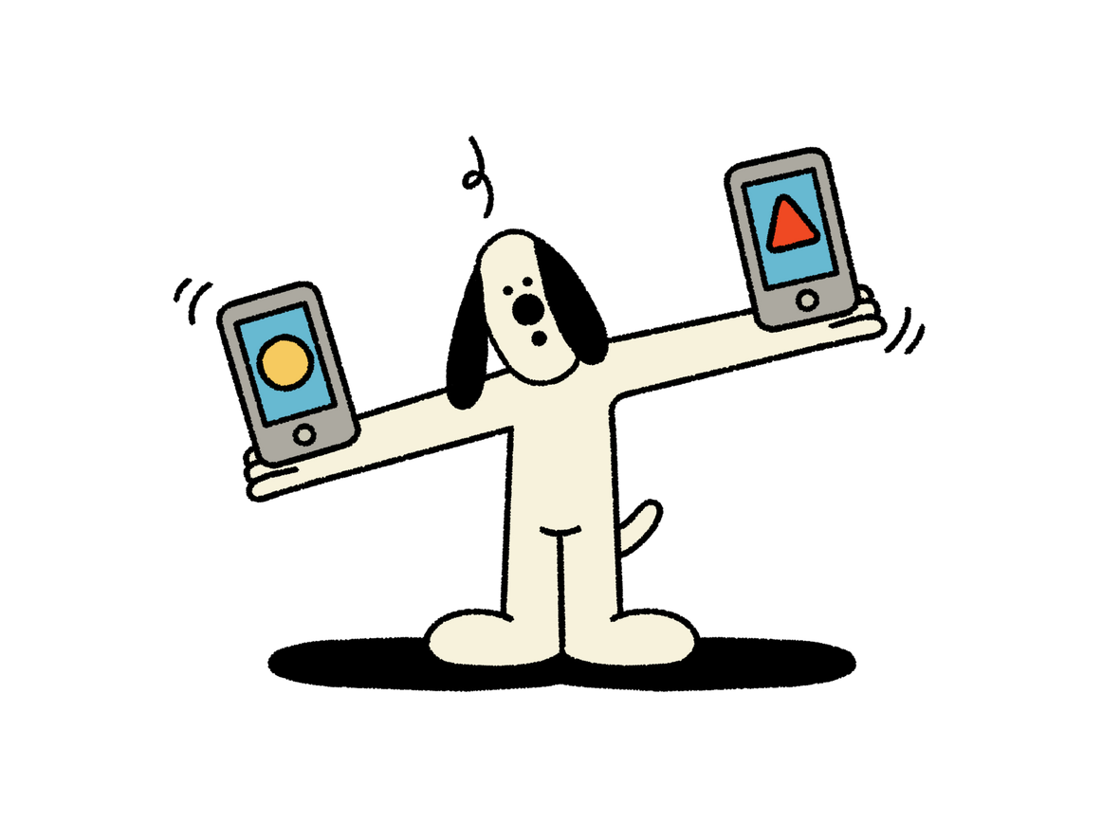
Learning outcomes:
  Identify points of view which are included within a news report.
  Infer points of view that might be missing within a news report.
  Compare points of view and consider why people’s opinions differ.

Slide 5
Whose point of view?
SCHOOL BANS HOMEWORK
What different points of view would a parent, pupil and teacher have about this headline?

Slide 6
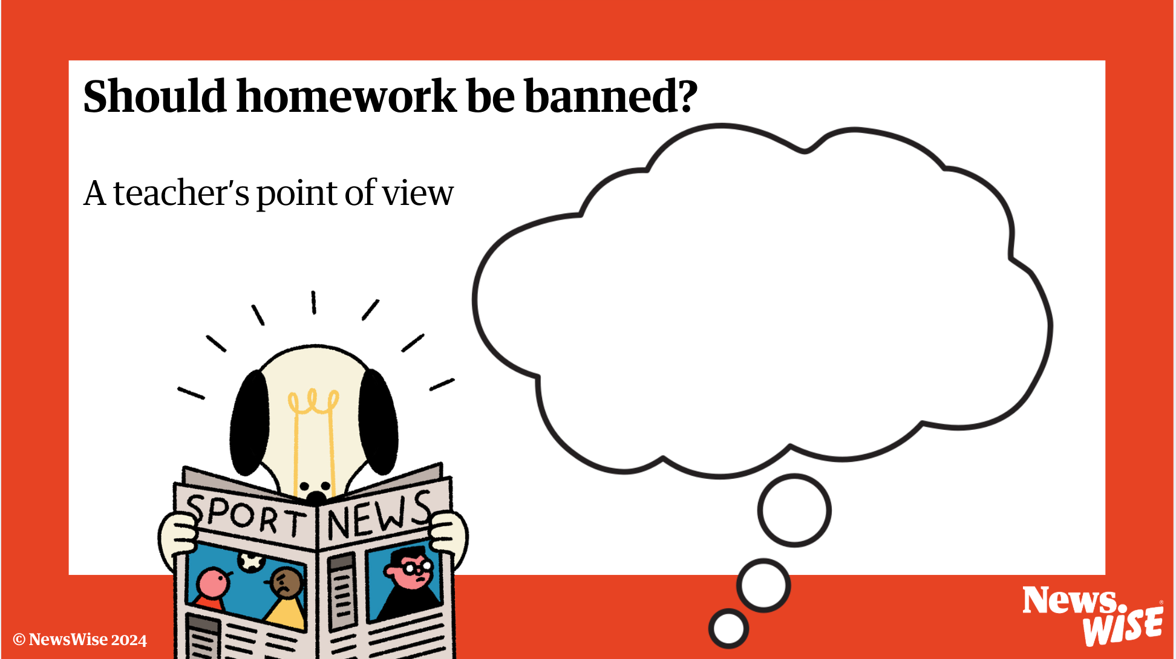


Slide 7
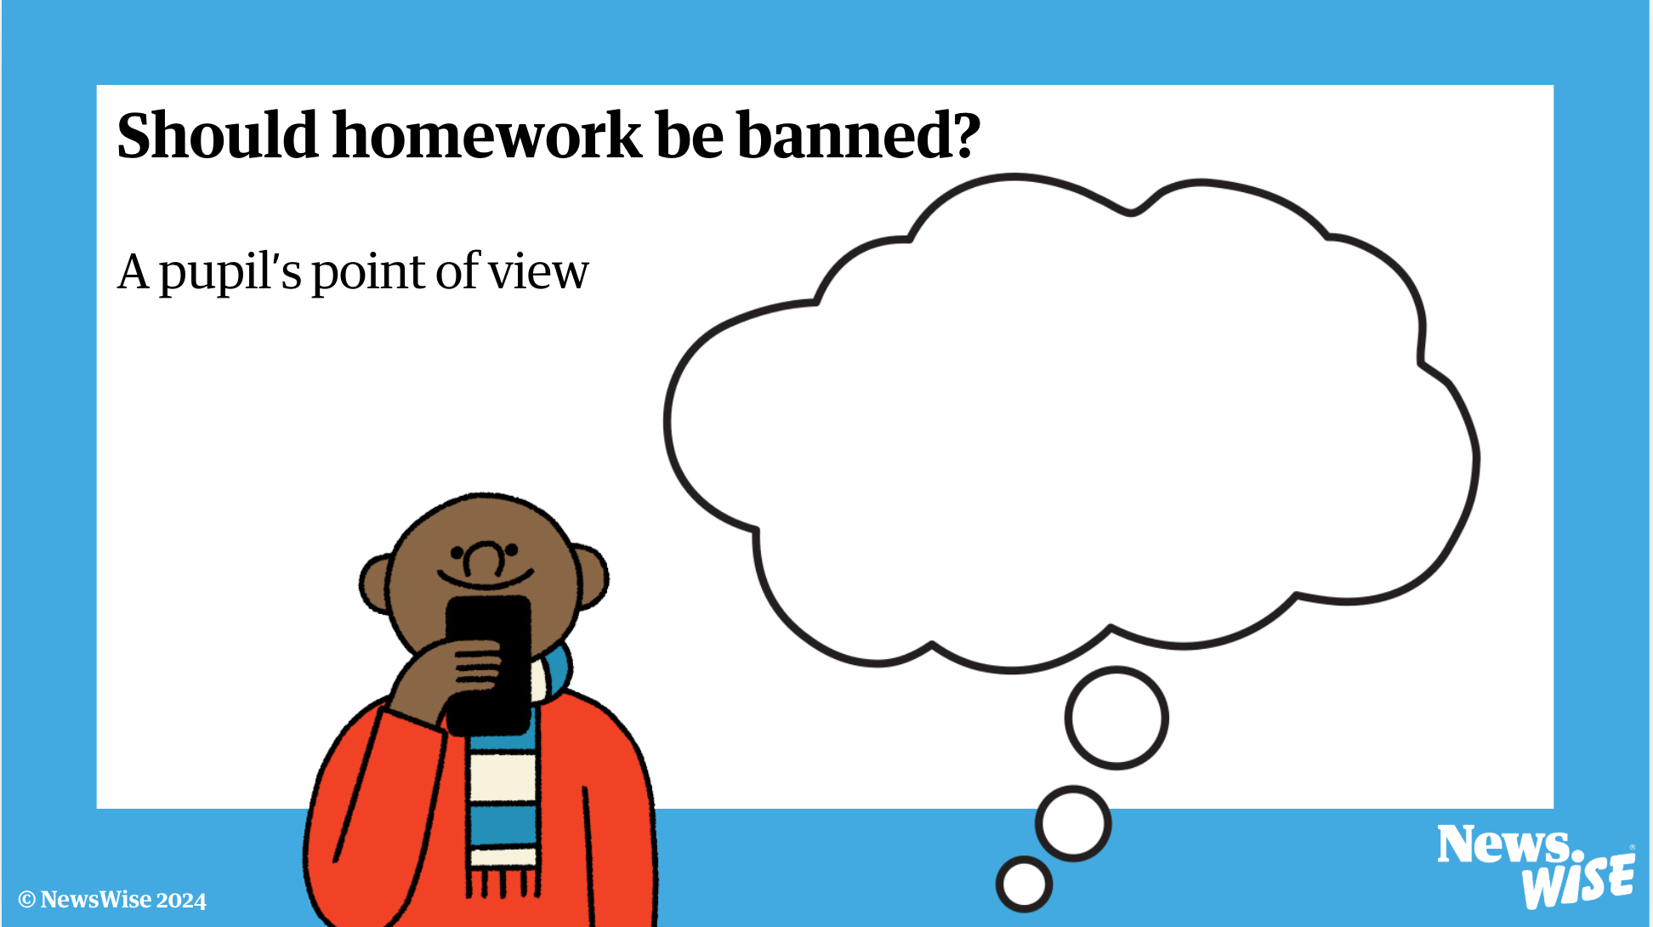

Slide 8
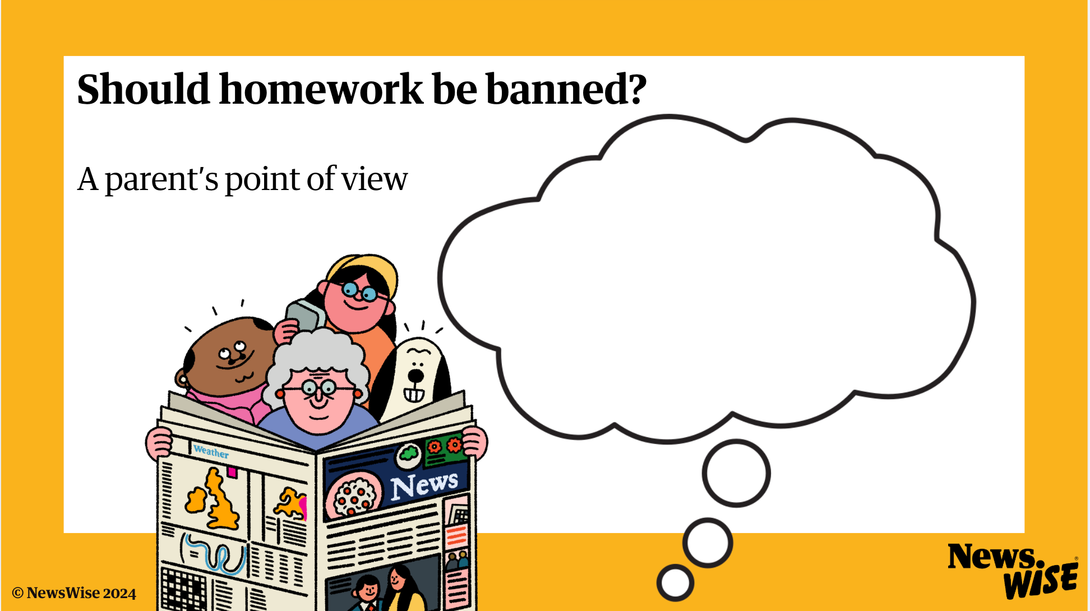

Slide 9
SCHOOL BANS HOMEWORK
  Do you think all pupils/ parents/ teachers would feel the same?
  Why might some people feel differently to others?
  Why is it important to include as many viewpoints as possible in this story?
  Whose points of view should be included to make sure the report is balanced?

Slide 10
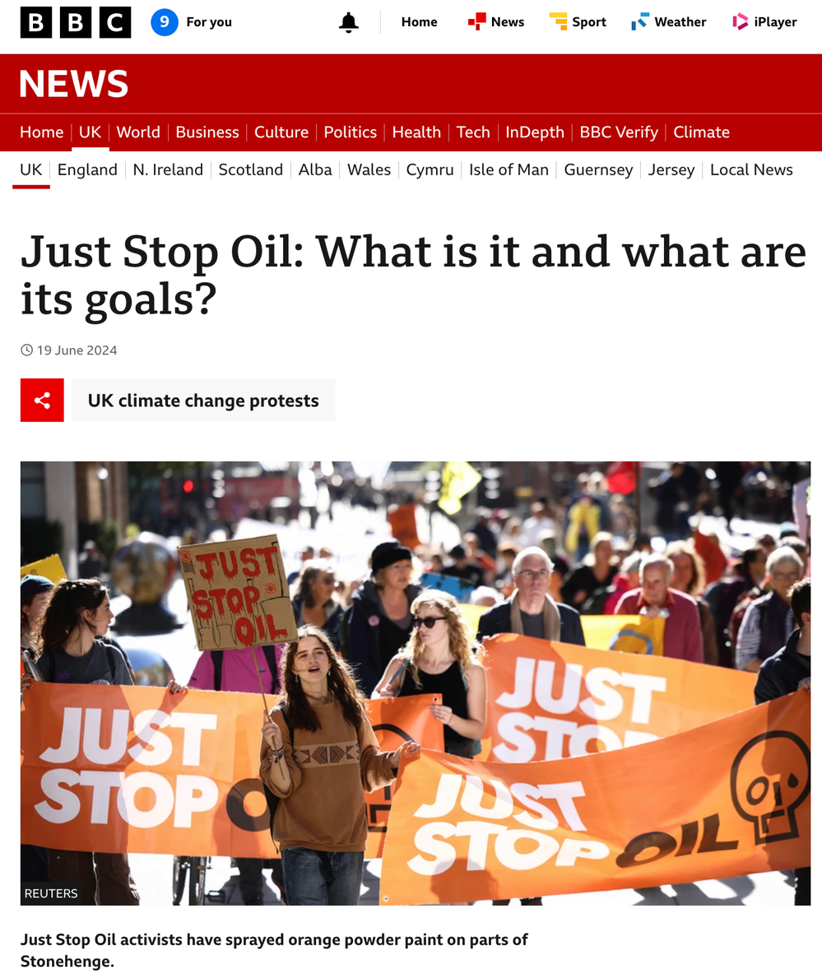
  What is the story about?
  Who are Just Stop Oil?
  What are the key points of the story?

Slide 11
Just Stop Oil protests
  What reasons might somebody have to protest?
  How might somebody be affected by a protest?
  Who might be supportive?
  Who might disapprove?
  Why might different people feel differently?

Slide 12
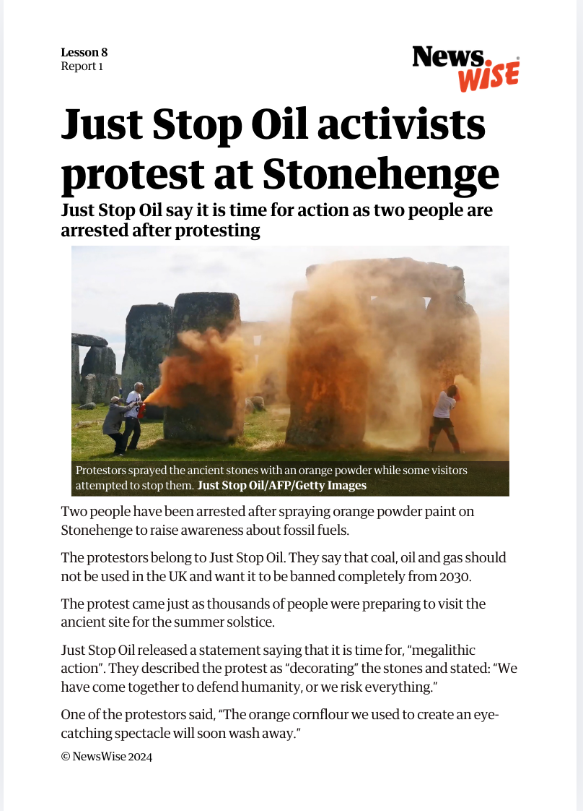
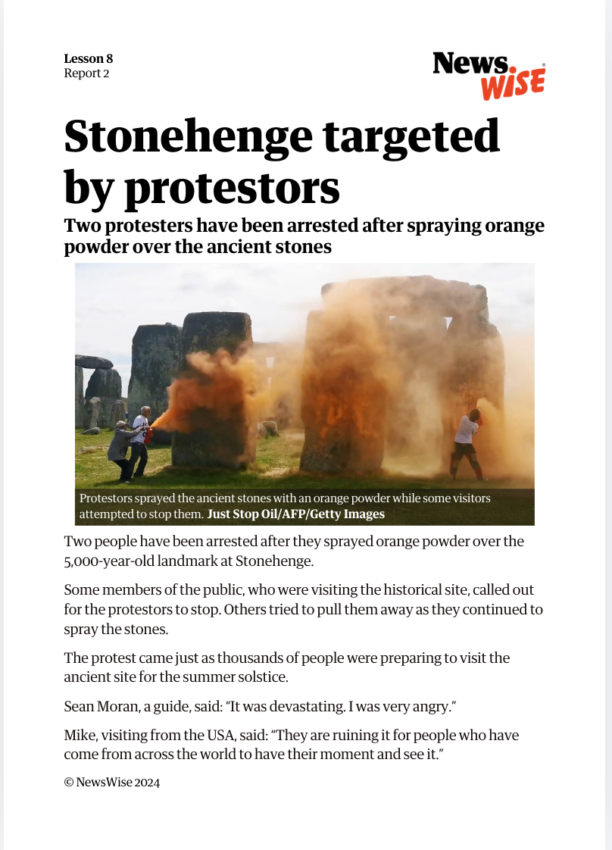
Identifying points of view
1
Read the news report
2
Decide whether you think it is balanced.
3
Can you identify whose viewpoints are heard in the story and whose are missing?

Slide 15
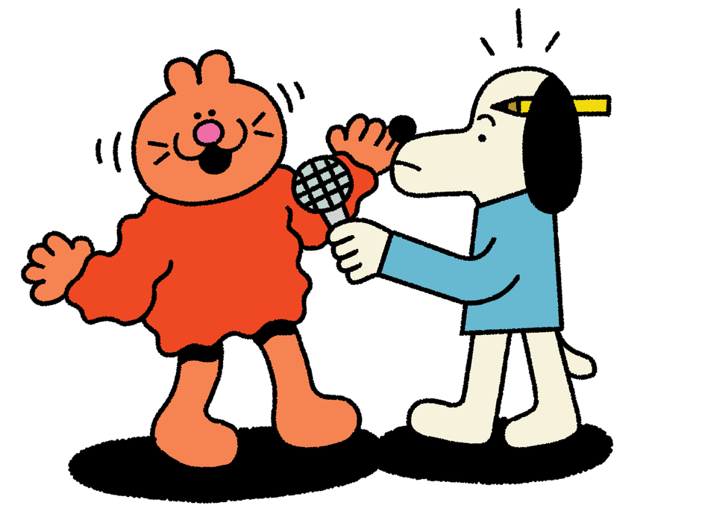
Challenge: missing viewpoints
Discuss whose views or viewpoint was missing or not represented in your news report.
  What might they think or feel about the situation?
  Why might they think or feel these things?
  Why might it be important to include their view?

Slide 16
Let’s discuss
Let’s compare the two reports
  How were they different?
  Are they balanced?
  Why/why not?
  Whose points of view were heard?
  Who else is involved in this story that you haven’t heard from?
  What might they think or feel about the situation?
  Whose side do you think the reporter is on?
  Why do you think this?
  What does the writer want you to feel or think?

Slide 17
Extension 1
Rewrite one of the protest news reports so that it is balanced.
Can you present it as a TV or radio news bulletin?

Slide 18
Extension 2
Role-play a whole-class press conference for the homework ban story from the beginning of the lesson.
Some of you will be the people involved in the story (a teacher, a pupil, a parent).
The rest of you will be reporters asking questions about how they felt about the homework ban.
Then
Write a balanced news report about the story. Include all the points of view involved.

