Slide 1

Vocabulary to pre-teach
Fact
Something that is true and definitely known about a situation. Fact is supported by evidence.
Opinion
1. A person’s view or idea about a situation.
2. A type of writing in a news publication that includes what the writer thinks about a situation, rather than just the facts.
Speculation
A guess or ‘inference’ about what has happened. Anyone can speculate about a situation, even if they weren’t there or the event hasn’t happened yet.
Rumour
A story about a situation that has not been proven, is not supported by facts and may not be true. Each time it is repeated it can change, until you cannot be sure what is true.
Source
Where a news story has come from. For example, a source could be an official report, a social media post, a press conference, a named person or an unnamed (anonymous) person such as ‘an insider’ or ‘a neighbour’.

Slide 2

Lesson 7
Identifying the difference between fact and opinion

Slide 3

Learning objective
To distinguish between fact and opinion
Journalist training school
Journalists must not include their own opinions in a news report. They can include the opinions of those involved in the story, but must not report them as fact. Therefore, journalists must be able to tell the difference between fact and opinion, as well as speculation and rumour.

Slide 4
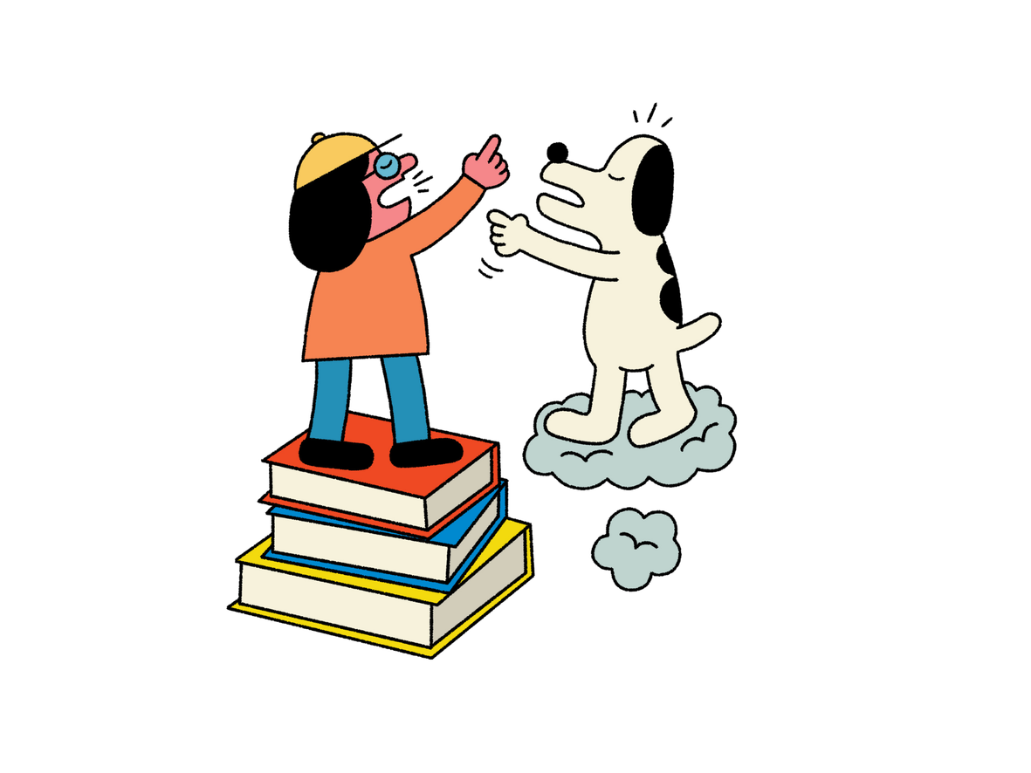
Learning outcomes:
  Explain the difference between news reports and opinion pieces.
  Use language clues to analyse whether a statement is
fact or opinion (also including speculation and rumour).
  Summarise a news story using the key facts.

Slide 5
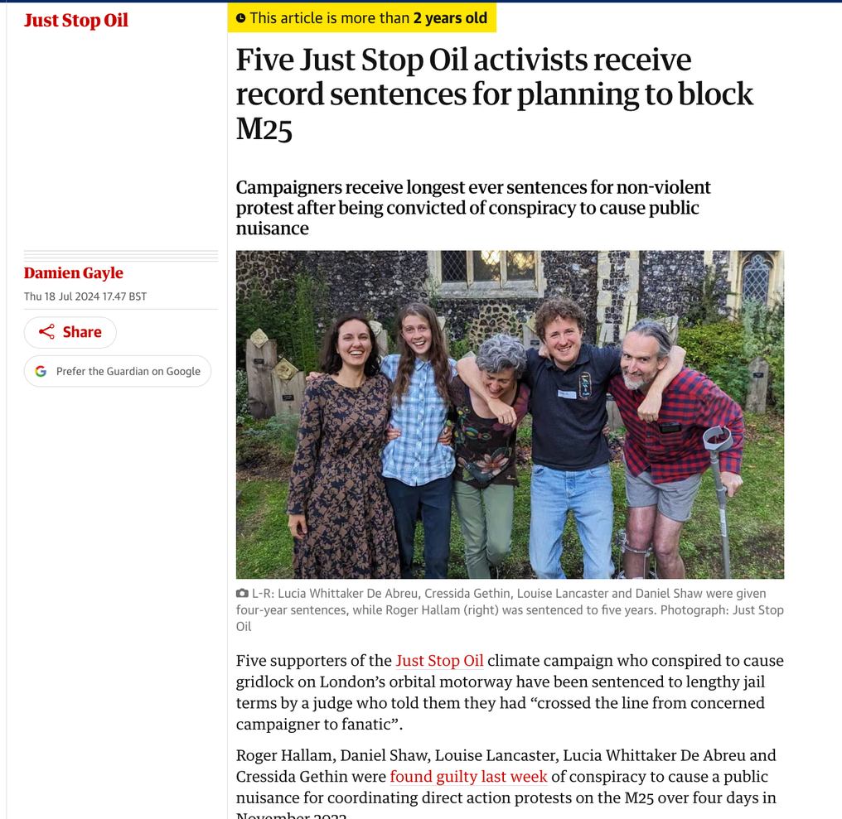

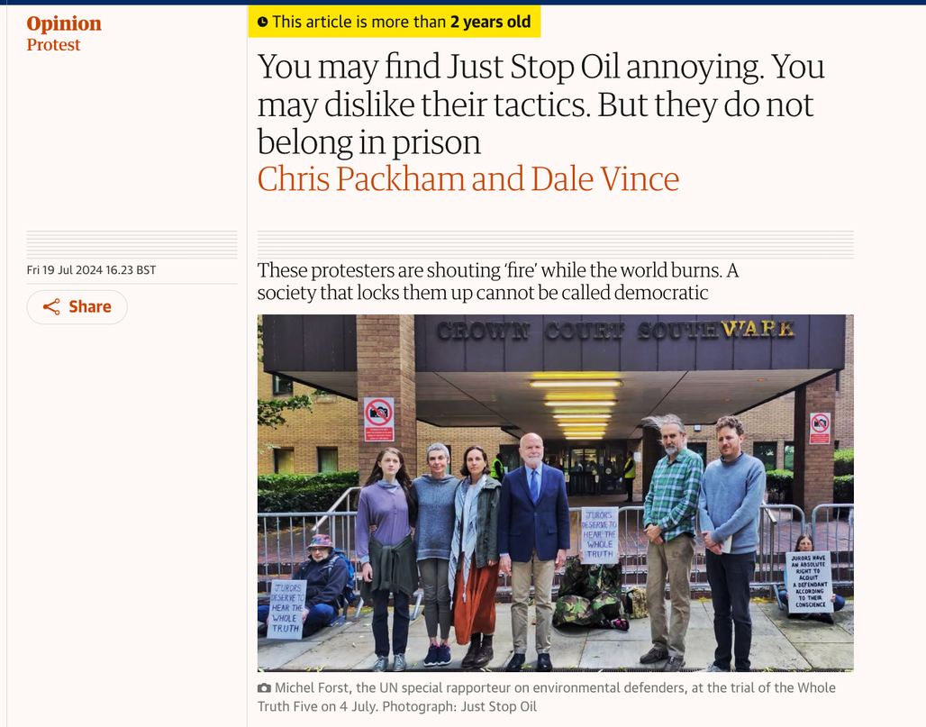
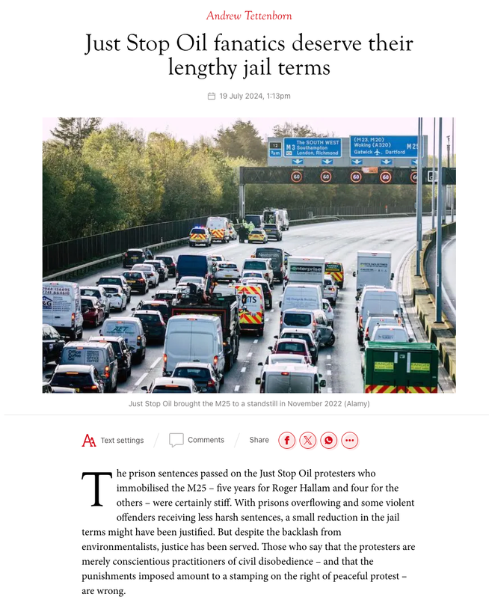

News report or opinion?
20mph speed limits in Wales
Just stop oil protesters given record sentences
Notes:
See the links to news reports and opinion pieces on slides 5/6/7/8 and 9.
Choose the story that your class will like best and add excerpts to these slides.
When choosing excerpts, be sure that one clearly shows factual reporting and one clearly shows the writer’s opinion. (Refer back to the Core Knowledge and Skills section of the lesson plan if you are unsure about this.)
You should also check the language used in these reports. They are all aimed at adults, so you may need to edit them to make them accessible for your pupils.
Just Stop Oil protestors given record sentences
News: https://www.theguardian.com/environment/article/2024/jul/18/five-just-stop-oil-supporters-jailed-over-protest-that-blocked-m25
Opinion:
https://www.theguardian.com/commentisfree/article/2024/jul/19/just-stop-oil-tactics-prison-chris-packham
https://www.spectator.co.uk/article/just-stop-oil-fanatics-deserve-their-lengthy-jail-terms/

Slide 6
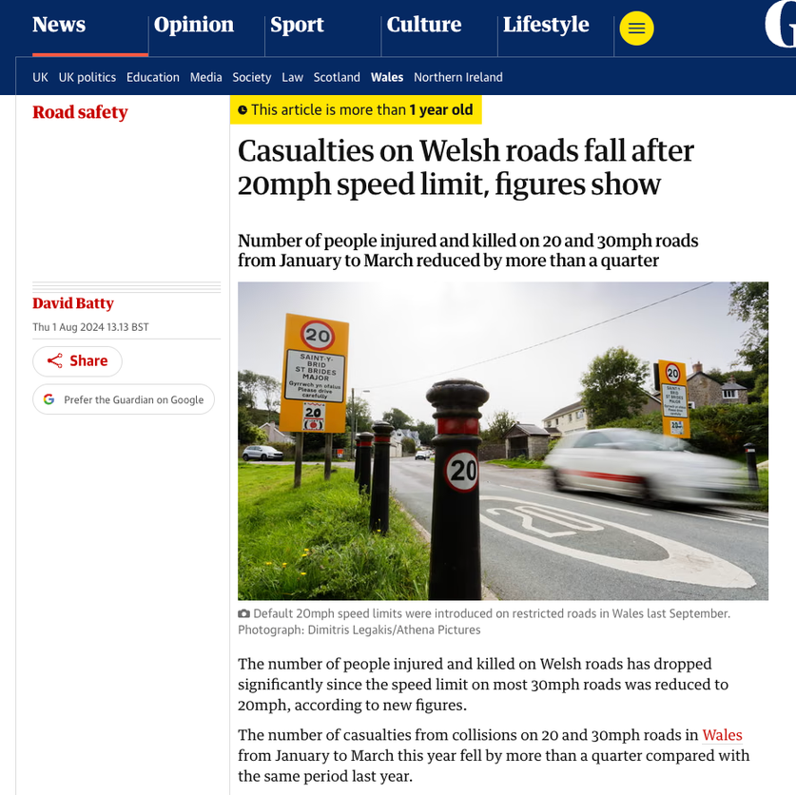
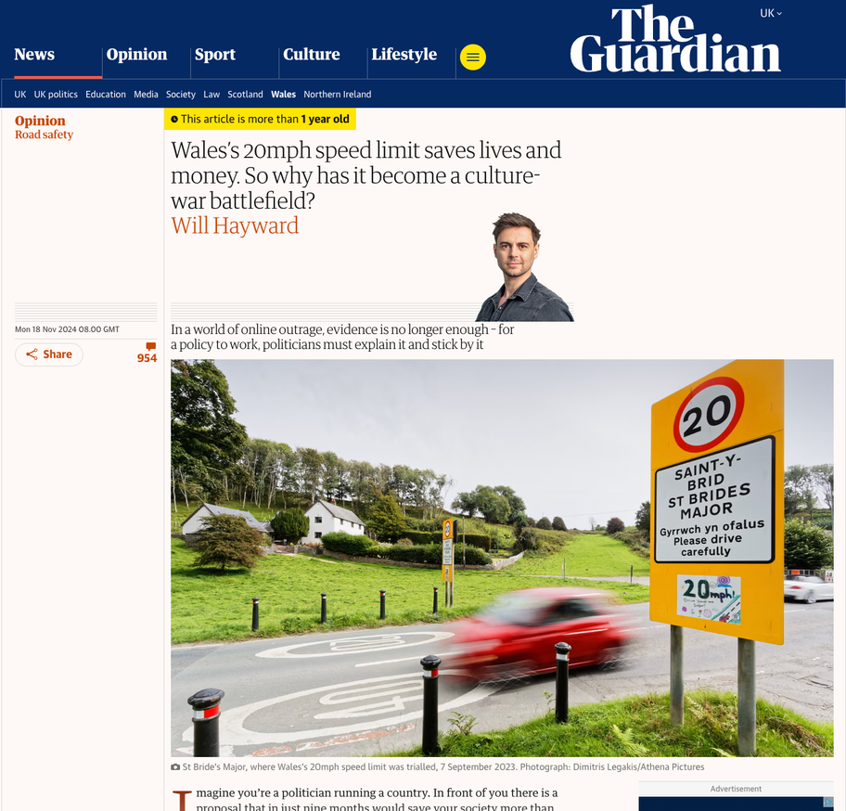
News report or opinion?
20mph speed limits in Wales
Notes:
20mph speed limits in Wales
News: https://www.theguardian.com/world/article/2024/aug/01/casualties-on-welsh-roads-fall-after-20mph-speed-limit-figures-show
Opinion: https://www.theguardian.com/commentisfree/2024/nov/18/wales-20mph-speed-limit-lives-money-policy

Slide 7
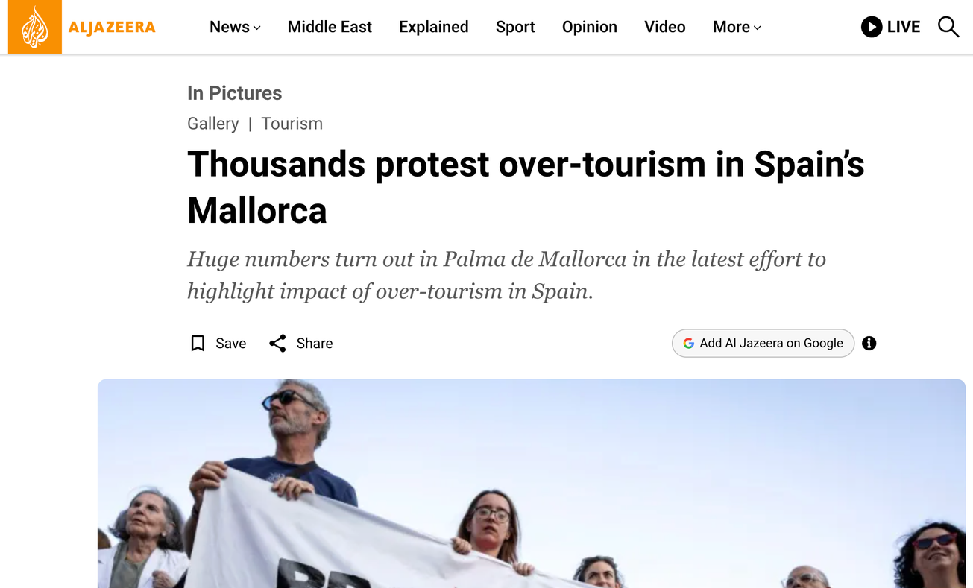
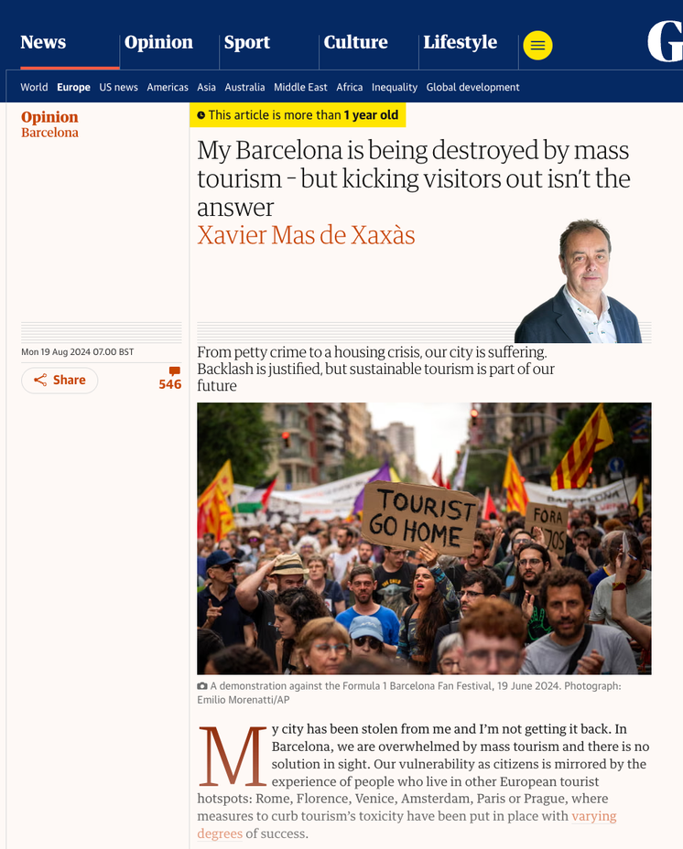
News report or opinion?
Overtourism protests in Spain
Notes:
Overtourism protests in Spain
News: https://www.aljazeera.com/gallery/2024/7/22/thousands-protest-over-tourism-in-spains-mallorca
Opinion:
https://www.theguardian.com/commentisfree/article/2024/aug/19/barcelona-mass-tourism-visitors-city-industry

Slide 8
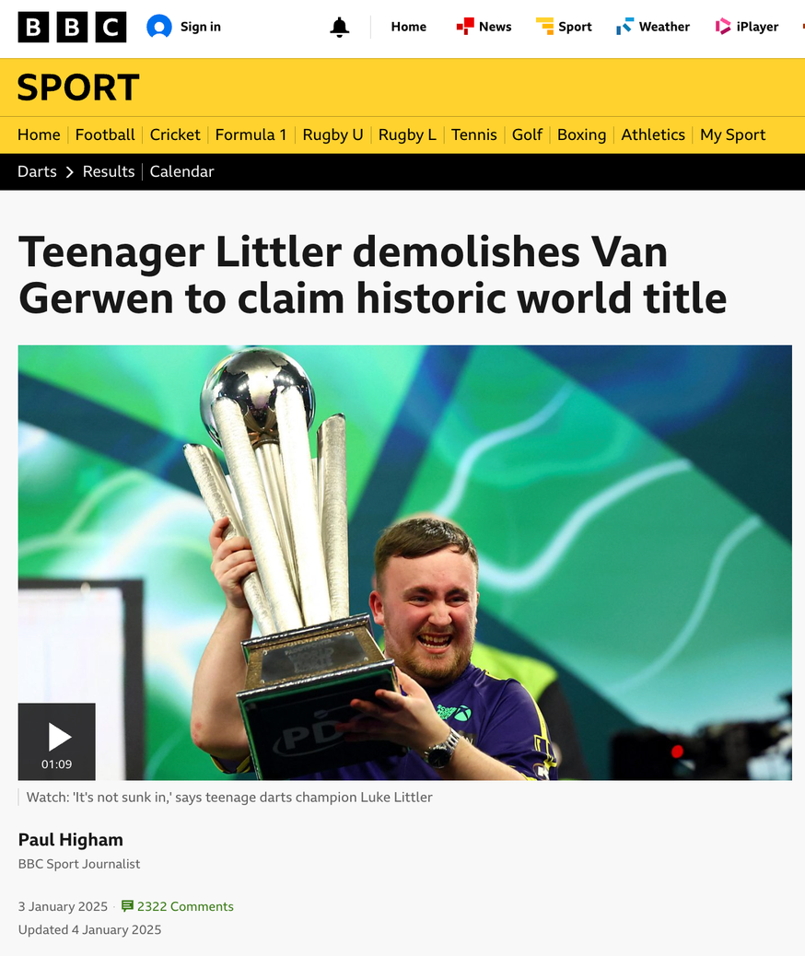
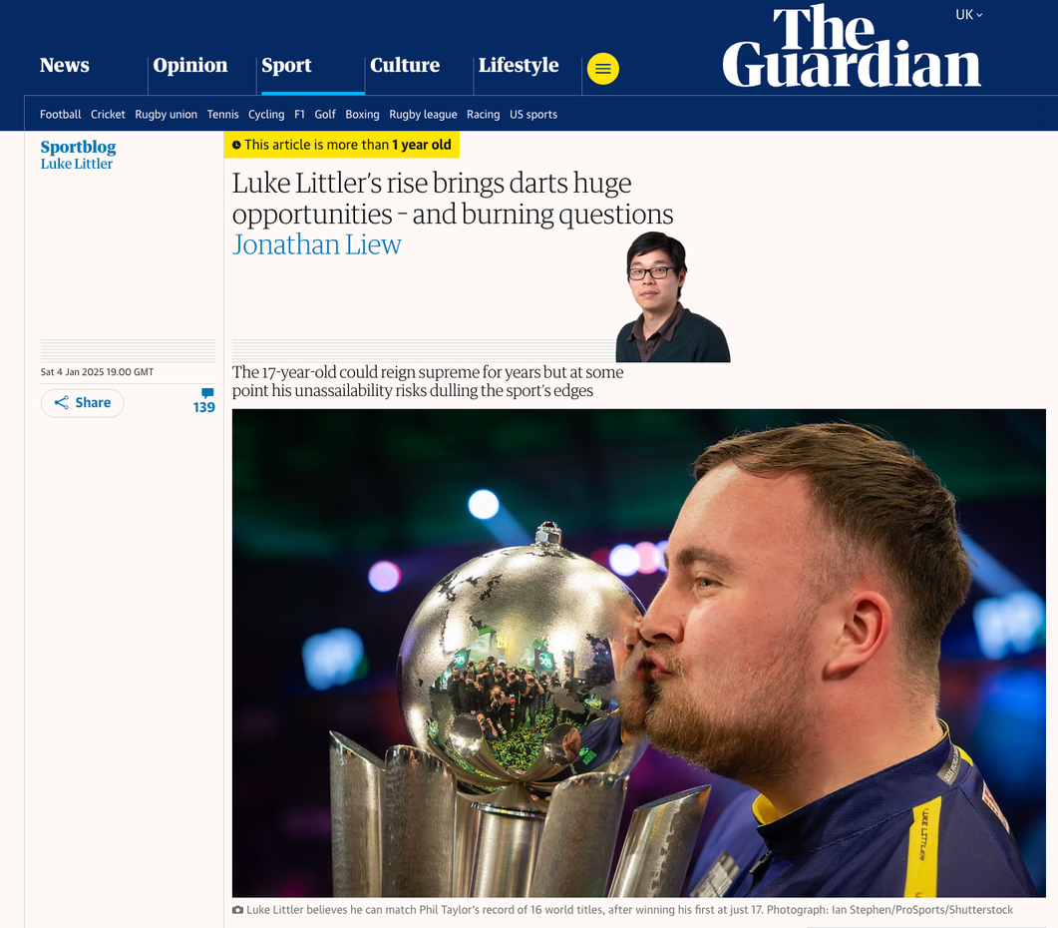

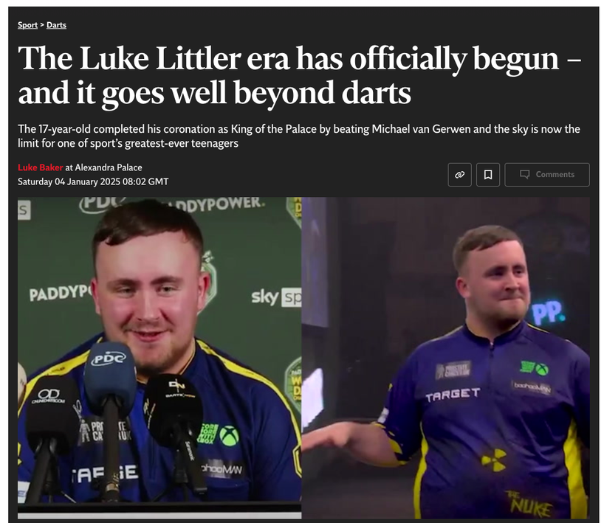
News report or opinion?
Luke Littler wins darts world championship
Notes:
Luke Littler wins darts world championship
News:
https://www.bbc.co.uk/sport/darts/articles/clyx7403y9ko
Opinion:
https://www.theguardian.com/sport/blog/2025/jan/04/luke-littler-darts-domination-pdc-world-championships

Slide 9
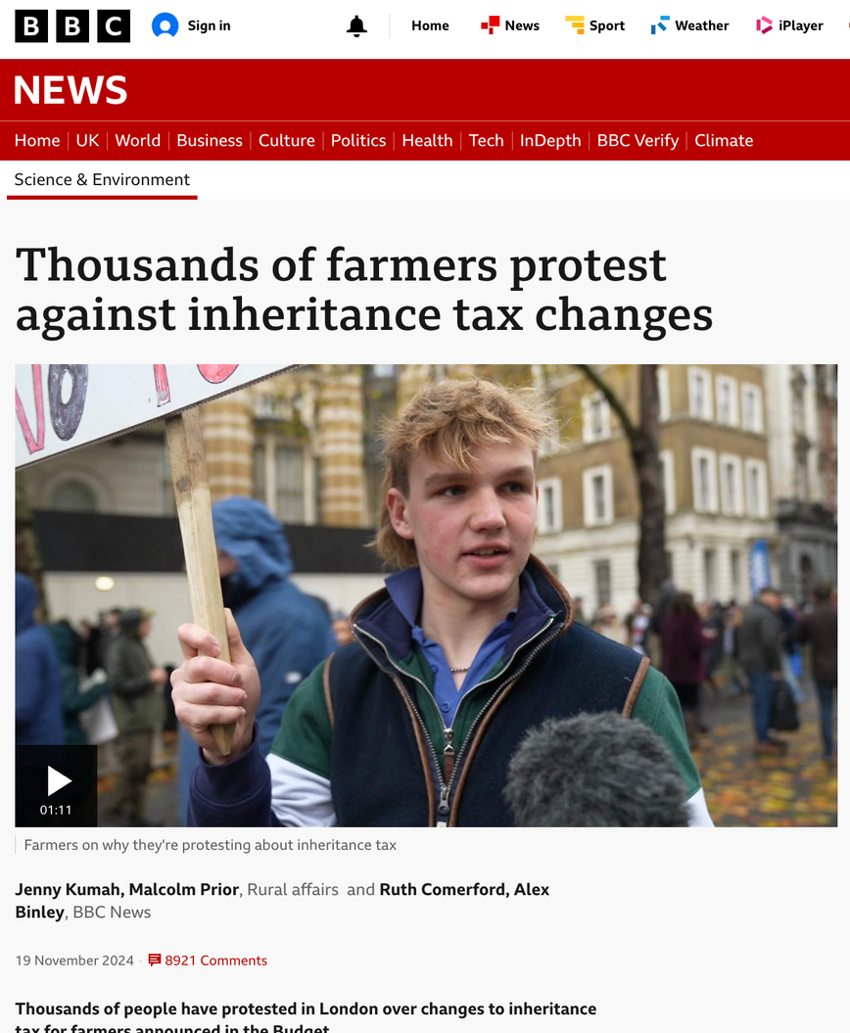
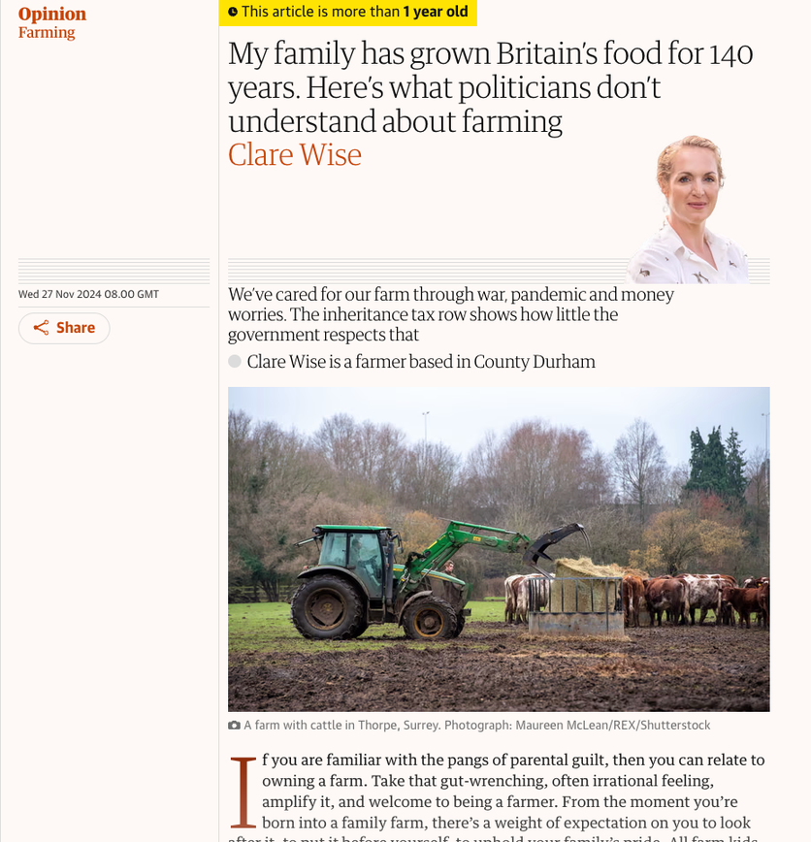
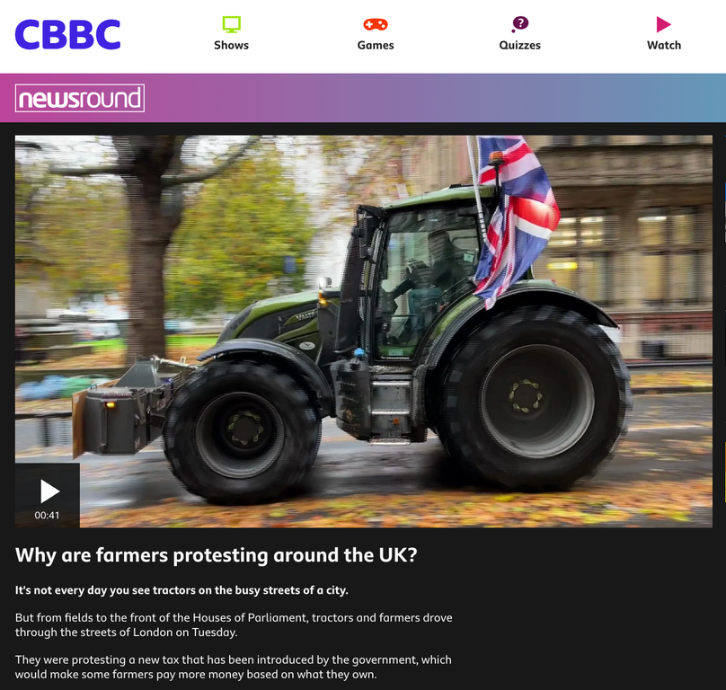
News report or opinion?
Farmers protest against increased taxes
Notes:
Farmers protest against increased taxes
News: https://www.bbc.co.uk/news/articles/czj71zyy934o
https://www.bbc.co.uk/newsround/videos/c78dkzd017yo (A helpful video explainer if you are planning to use this one!)
Opinion:
https://www.theguardian.com/commentisfree/2024/nov/27/britain-farming-family-farm-inheritance-tax

Slide 10

News report or opinion?

Slide 11
  How did you know?
  Were there any words or phrases that helped you?
Challenge:
  Can you find an example of an opinion in the news report paragraph?
  What is different about this compared to the opinion piece?

Slide 12

Why do news publications also publish opinion pieces?
Notes:
Just Stop Oil protestors given record sentences
News: https://www.theguardian.com/environment/article/2024/jul/18/five-just-stop-oil-supporters-jailed-over-protest-that-blocked-m25
Opinion:
https://www.theguardian.com/commentisfree/article/2024/jul/19/just-stop-oil-tactics-prison-chris-packham
https://www.spectator.co.uk/article/just-stop-oil-fanatics-deserve-their-lengthy-jail-terms/
20mph speed limits in Wales
News: https://www.theguardian.com/world/article/2024/aug/01/casualties-on-welsh-roads-fall-after-20mph-speed-limit-figures-show
Opinion: https://www.theguardian.com/commentisfree/2024/nov/18/wales-20mph-speed-limit-lives-money-policy
Overtourism protests in Spain
News: https://www.aljazeera.com/gallery/2024/7/22/thousands-protest-over-tourism-in-spains-mallorca
Opinion:
https://www.theguardian.com/commentisfree/article/2024/aug/19/barcelona-mass-tourism-visitors-city-industry
Luke Littler wins darts world championship
News:
https://www.bbc.co.uk/sport/darts/articles/clyx7403y9ko
Opinion:
https://www.theguardian.com/sport/blog/2025/jan/04/luke-littler-darts-domination-pdc-world-championships
Farmers protest against increased taxes
News: https://www.bbc.co.uk/news/articles/czj71zyy934o
https://www.bbc.co.uk/newsround/videos/c78dkzd017yo (A helpful video explainer if you are planning to use this one!)
Opinion:
https://www.theguardian.com/commentisfree/2024/nov/27/britain-farming-family-farm-inheritance-tax

Slide 13

Remember!
Opinion pieces differ to news reports, which must be
truthful and only include other people’s opinions.
Having your own opinions about news is important, but the main thing
to remember is that when writing a news report, you don’t report your
opinions as facts.
Notes:
The links below are for the stories that each of these statements are based on. These are for your reference only and it is not expected that these be shared with your class.
New discount shop: https://www.kidderminstershuttle.co.uk/news/24608786.kidderminster-new-shop-brands4less-opens-town-centre/
Woman fined £500: https://www.bbc.co.uk/news/articles/c9qvvpe9rw4o
UK elects new prime minister:
https://www.bbc.co.uk/newsround/articles/cxx2pd3r538o
Climate protester sentenced to five years:
https://www.theguardian.com/environment/article/2024/jul/18/five-just-stop-oil-supporters-jailed-over-protest-that-blocked-m25
Rare Roman mosaic found:
https://www.bbc.co.uk/newsround/articles/ceq599eqxdro

Slide 14
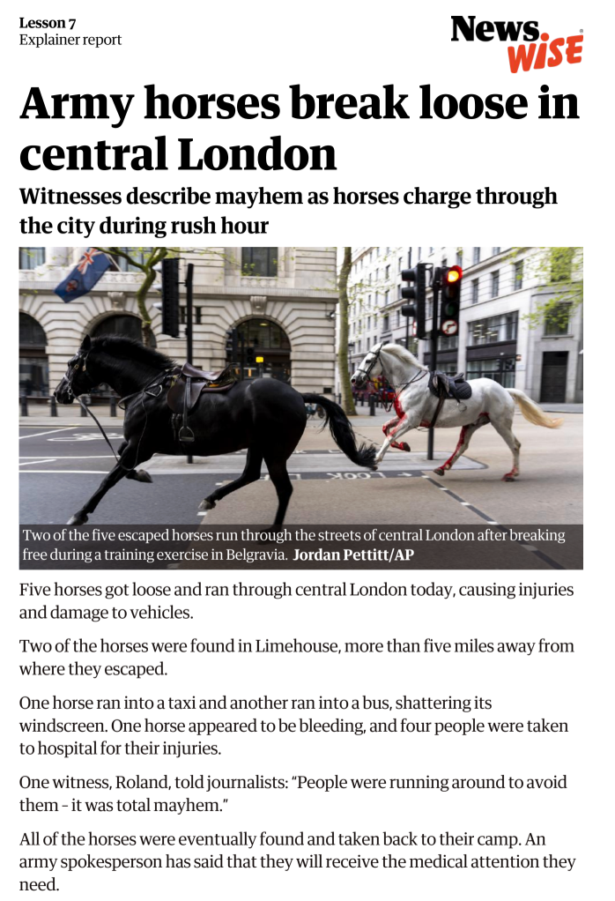
Story explainer
Can you summarise
the story using the 5Ws?
Who
WHAT
WHEN
WHERE
WHY
Notes:
Pupils vote on whether each headline is real or fake, making a ‘gut reaction’ decision. (Don’t reveal the answers yet!).
• What do you think about this story headline?
• Is it easy to tell if a story is real or fake (especially if we only read it quickly)?
• Did you have enough information to make an informed decision?
• How might people react to each of these headlines?
Important note: All of these stories appeared in the news and are therefore real news or real ‘fake news’. For your information we have included the source below. If you decide to view these stories online in the classroom, be aware that advertising and other stories may pop up. It is therefore best to select the relevant sections and prepare these as a teaching resource to ensure safe use in the classroom. When researching stories at home, pupils and parents should be made aware that online news portals may include adult content. Please note that we cannot be responsible for other content and advertising on these websites.
REAL:
• Boy smashes 3,500 year old vase at museum, BBC, August 2024 -
https://www.bbc.co.uk/news/articles/ckg2j2y20epo
• Library cards given to newborn babies in Cornwall, BBC, August 2024 -
https://www.bbc.co.uk/news/articles/cz7338v2qn3o
• Seal steals dinghy for sunbathing sessions, BBC, August 2024 -
https://www.bbc.co.uk/news/articles/c2kjdg3d3v0o
FAKE:
• Anne Frank's diary actually written by American man, factcheck by Full Fact, March 2024 -
https://fullfact.org/online/anne-frank-diary-ballpoint-pen-meyer-levin-false-claim/
• Energy drink increases chances of disease, factcheck by Full Fact, June 2024 -
https://fullfact.org/health/energy-drinks-aspartame-kidneys-liver/
• Expensive cars floating on boats during floods in Dubai, factcheck by Full Fact, April 2024 -
https://fullfact.org/online/luxury-car-boat-dubai-flood/

Slide 15
Nav has been reading a news story about some military horses that escaped and ran through London. Nav sent some messages to friends to try and find out more.
Can you work out which of the messages are:
(information that is true and trustworty)
  Facts
  Opinions
  Rumours
  Speculation
(someone’s thoughts or feelings about the situation
(stories that may not be true and have no evidence
(guesses about what happened and why it happened

Slide 16
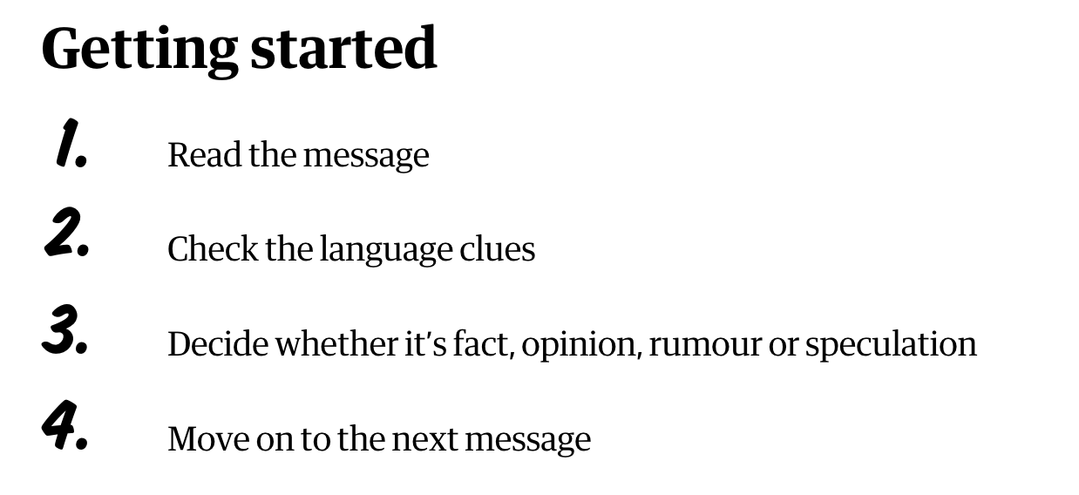
Rumour has it

Slide 17
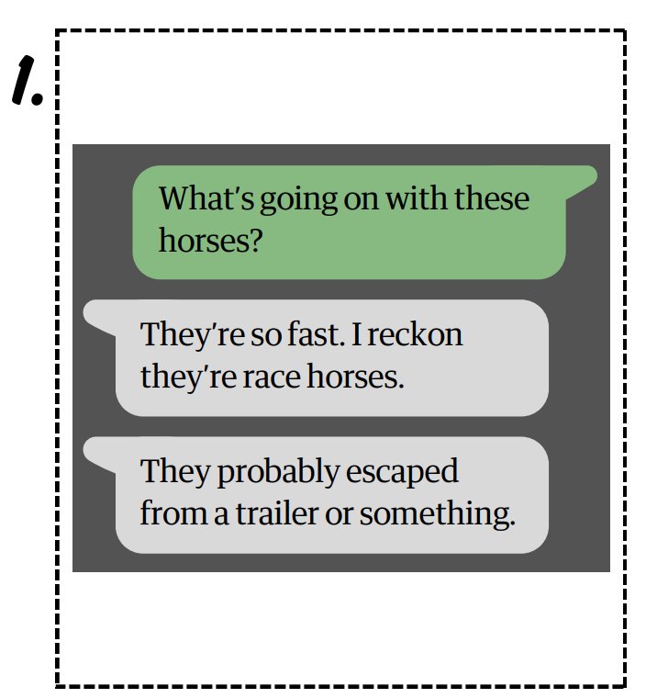
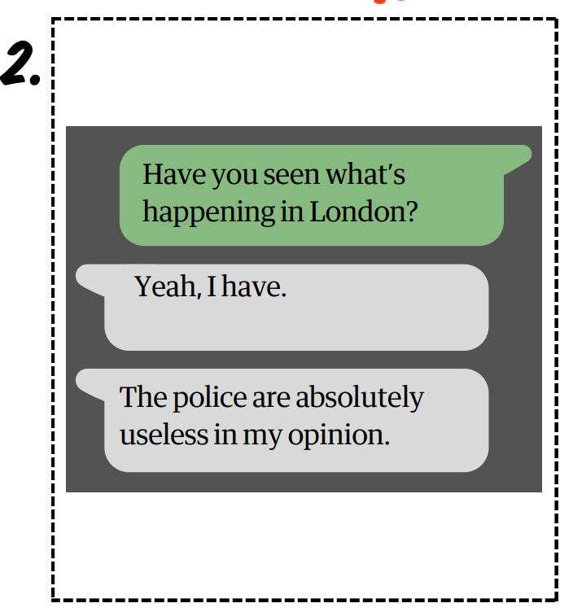
1
2

Slide 18
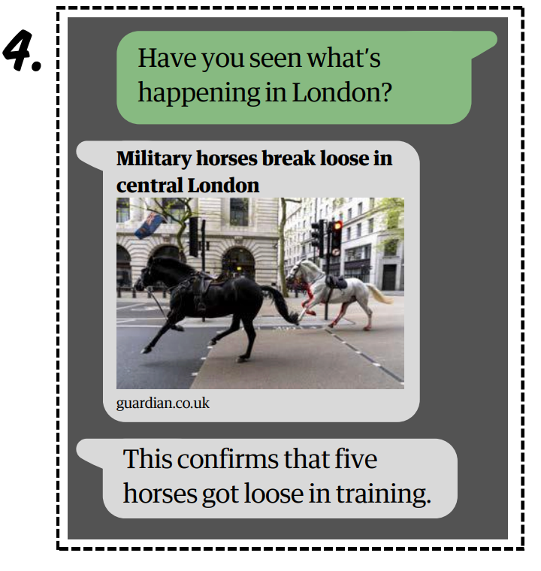
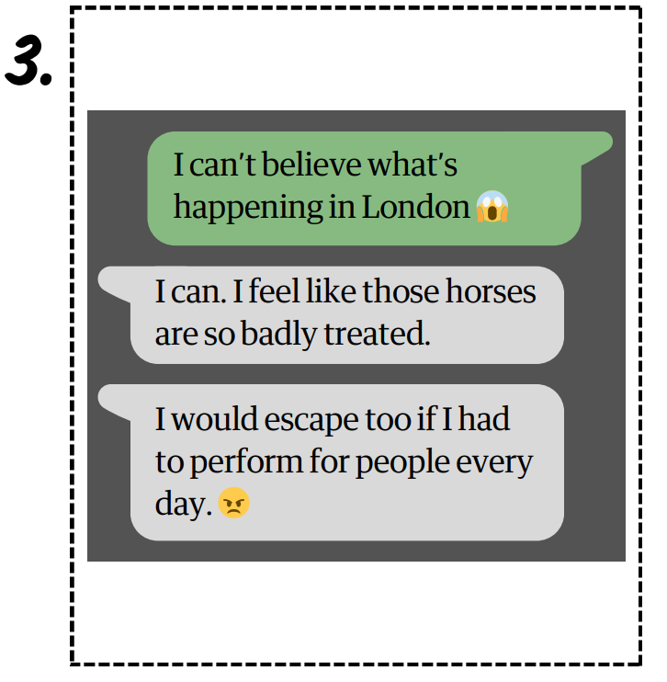
4
3

Slide 19
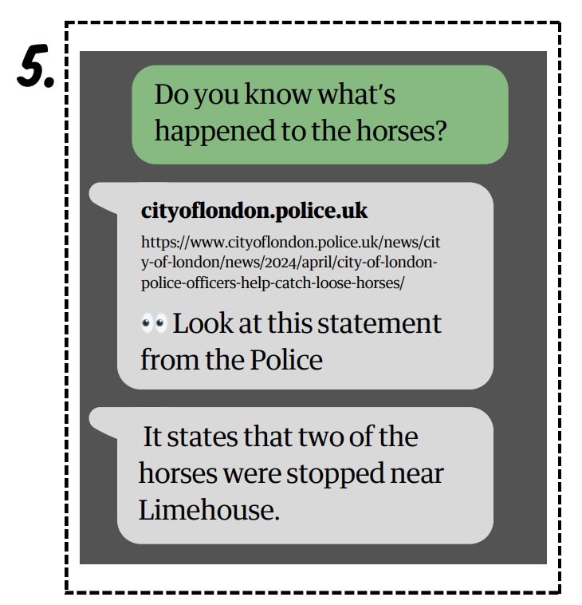
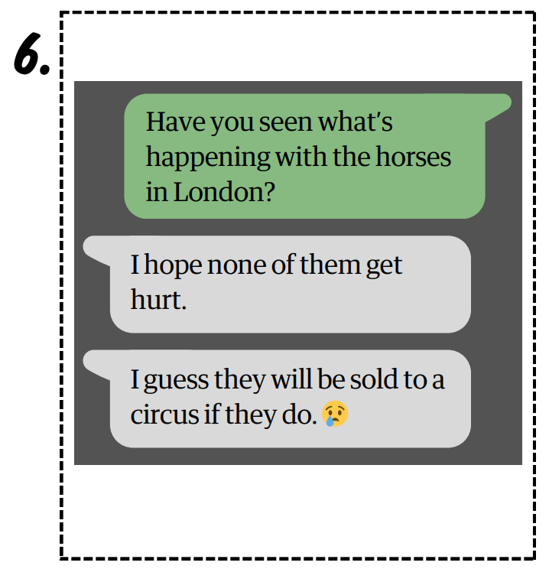
5
6

Slide 20
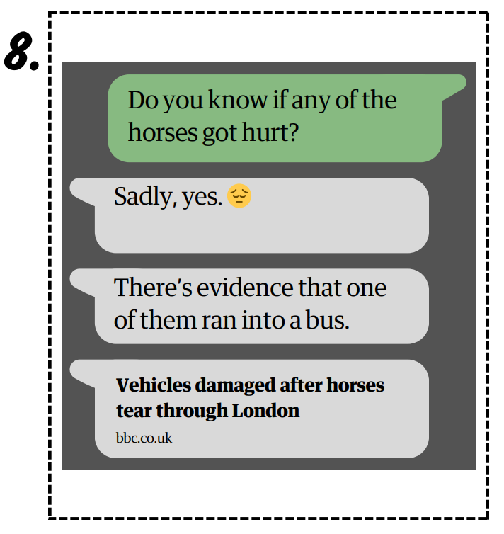
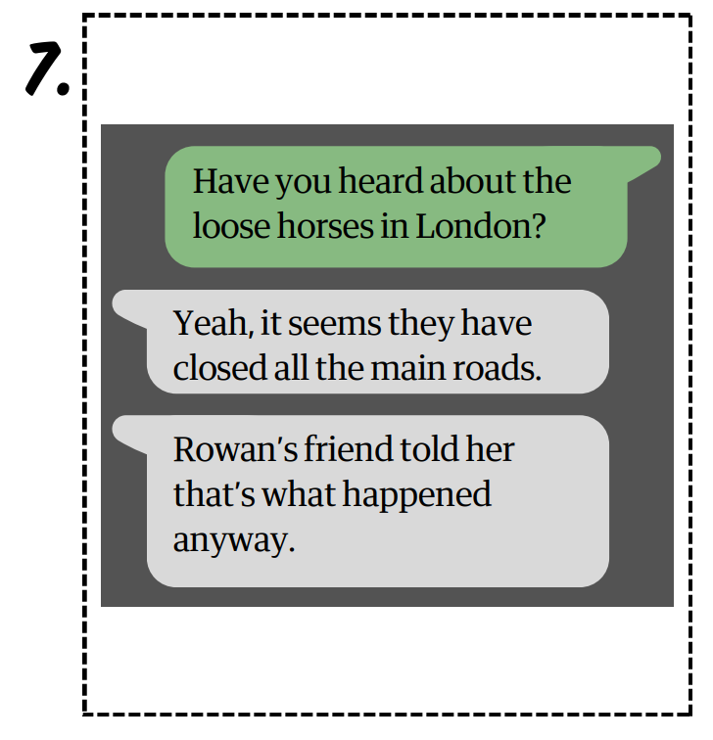
8
7

Slide 21

Language of fact
It is proven that...
We have demonstrated...
It is evident that...
Evidence shows...
...have discovered...
Nav verified/confirmed...
Newshound stated...
Notes:
The links below are for the stories that each of these statements are based on. These are for your reference only and it is not expected that these be shared with your class.
New discount shop: https://www.kidderminstershuttle.co.uk/news/24608786.kidderminster-new-shop-brands4less-opens-town-centre/
Woman fined £500: https://www.bbc.co.uk/news/articles/c9qvvpe9rw4o
UK elects new prime minister:
https://www.bbc.co.uk/newsround/articles/cxx2pd3r538o
Climate protester sentenced to five years:
https://www.theguardian.com/environment/article/2024/jul/18/five-just-stop-oil-supporters-jailed-over-protest-that-blocked-m25
Rare Roman mosaic found:
https://www.bbc.co.uk/newsround/articles/ceq599eqxdro

Slide 22
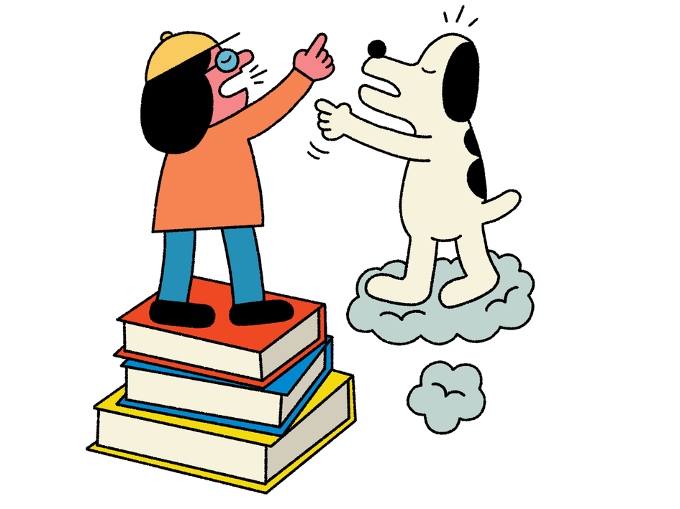
Language of opinion
She suggested that...
Nav thinks...
Newshound believes...
Her opinion/idea is that...
I feel...
I like/don’t like...
He argued that...
Notes:
The links below are for the stories that each of these statements are based on. These are for your reference only and it is not expected that these be shared with your class.
New discount shop: https://www.kidderminstershuttle.co.uk/news/24608786.kidderminster-new-shop-brands4less-opens-town-centre/
Woman fined £500: https://www.bbc.co.uk/news/articles/c9qvvpe9rw4o
UK elects new prime minister:
https://www.bbc.co.uk/newsround/articles/cxx2pd3r538o
Climate protester sentenced to five years:
https://www.theguardian.com/environment/article/2024/jul/18/five-just-stop-oil-supporters-jailed-over-protest-that-blocked-m25
Rare Roman mosaic found:
https://www.bbc.co.uk/newsround/articles/ceq599eqxdro

Slide 23

Language of speculation
Nav guessed that...
I bet that...
Perhaps...
Probably...
He predicts that...
They suspect that...
Nav reckons...
I wonder if...
Notes:
The links below are for the stories that each of these statements are based on. These are for your reference only and it is not expected that these be shared with your class.
New discount shop: https://www.kidderminstershuttle.co.uk/news/24608786.kidderminster-new-shop-brands4less-opens-town-centre/
Woman fined £500: https://www.bbc.co.uk/news/articles/c9qvvpe9rw4o
UK elects new prime minister:
https://www.bbc.co.uk/newsround/articles/cxx2pd3r538o
Climate protester sentenced to five years:
https://www.theguardian.com/environment/article/2024/jul/18/five-just-stop-oil-supporters-jailed-over-protest-that-blocked-m25
Rare Roman mosaic found:
https://www.bbc.co.uk/newsround/articles/ceq599eqxdro

Slide 24

Language of rumour
Apparently...
Allegedly...
Reportedly...
Supposedly...
It is rumoured that...
I heard that...
It has been said/reported that...
It appears that...
It seems that...
Notes:
The links below are for the stories that each of these statements are based on. These are for your reference only and it is not expected that these be shared with your class.
New discount shop: https://www.kidderminstershuttle.co.uk/news/24608786.kidderminster-new-shop-brands4less-opens-town-centre/
Woman fined £500: https://www.bbc.co.uk/news/articles/c9qvvpe9rw4o
UK elects new prime minister:
https://www.bbc.co.uk/newsround/articles/cxx2pd3r538o
Climate protester sentenced to five years:
https://www.theguardian.com/environment/article/2024/jul/18/five-just-stop-oil-supporters-jailed-over-protest-that-blocked-m25
Rare Roman mosaic found:
https://www.bbc.co.uk/newsround/articles/ceq599eqxdro

Slide 25
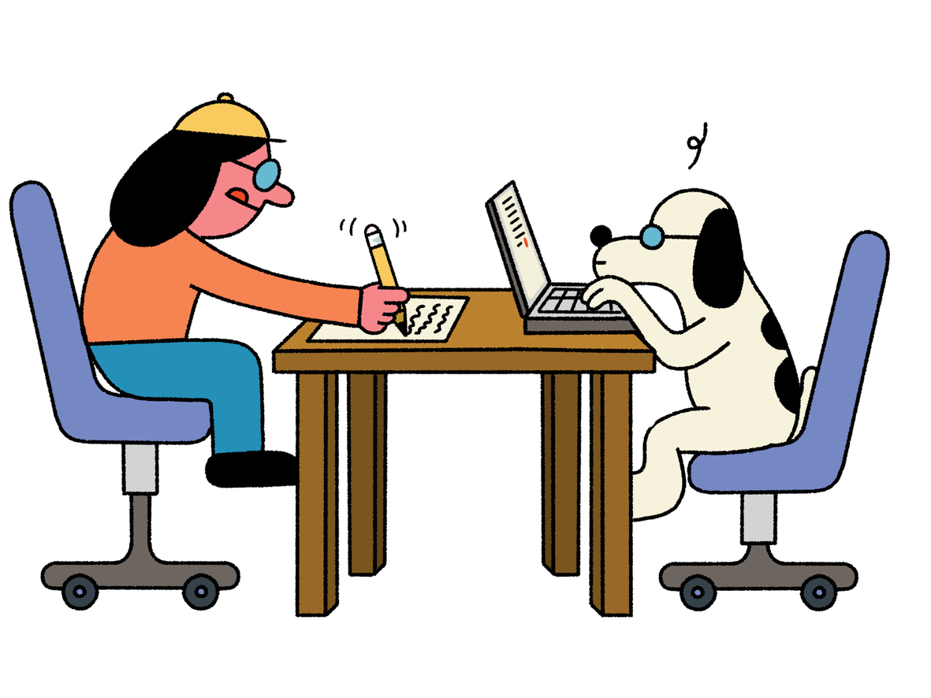
Time to become a reporter...
Can you write a news headline and a summary (using the 5Ws), stating the facts of what actually happened in the news story?
You could do this by writing them down or you
could perform news bulletins in role as a TV or radio reporter.

Slide 26
Let’s discuss
Let’s think back to the news story we looked at during the starter. Can you write either a fact or an opinion statement about it?
Challenge:
Can you write a speculation or a rumour statement?

Slide 27
Let’s discuss
Find a pair and swap your statement with your partner.
Using the language clues, can you figure out what kind of statment your partner has written?
  How can you tell the difference?
  What kind of language clues can we look out for?
  Why is it important to be able to tell the difference between fact and opinion when online?
  What would happen if a journalist reported a speculation or rumour as fact?
Challenge:

Slide 28
Extension
Can you read a news story and then write your own opinion piece in response to it?

