Slide 1

Vocabulary to pre-teach
Online targeting
When websites and apps pay attention to what you click on so they can show you ads, videos, and games they think you will like best.
Algorithm
A step-by-step set of instructions or ‘formula’ for solving a problem.
Filter bubble
When someone only sees information that they already agree with or like. Filter bubbles can be caused by algorithms that predict what someone will be interested in.
Search history
A list saved by your device or web browser that remembers every single website you have visited and every topic you have searched for online.
Advert
An advert (short for advertisement) is a picture, message, or short video made by a company to tell you about a product, service, or idea so you will buy or try it.
Personalised adverts
Personalised adverts are special adverts chosen just for you based on what you have searched for, watched, or clicked on in the past online.

Slide 2

Lesson 6
Understanding that news is targeted

Slide 3

Learning objective
To understand that online news is targeted to the reader
Journalist training school
Journalists need to make sure they are getting information from a wide range of sources so that they are not just seeing one side of a story, and so that they know as much as possible about what is happening in the world.

Slide 4
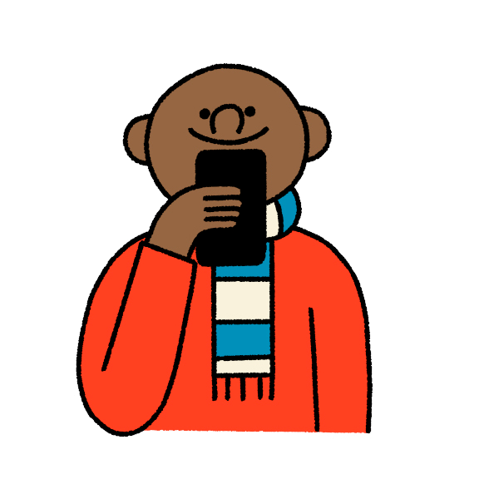
Learning outcomes:
  Identify how to recognise online targeting.
  Recognise that companies (including news providers) use information about people to target them with content they are more likely to engage with.
  Explain how someone’s online choices (such as their search history and profile) affect the type of information targeted at them.
  Describe how online targeting can be used to influence
someone’s beliefs, actions and choices.

Slide 5


Character profiles
  1. If this person were searching the internet or using social media, what sorts of news stories (or advertising) would pop up?
  2. Would they all see the same content? Why/why not?
Notes:
The links below are for the stories that each of these statements are based on. These are for your reference only and it is not expected that these be shared with your class.
New discount shop: https://www.kidderminstershuttle.co.uk/news/24608786.kidderminster-new-shop-brands4less-opens-town-centre/
Woman fined £500: https://www.bbc.co.uk/news/articles/c9qvvpe9rw4o
UK elects new prime minister:
https://www.bbc.co.uk/newsround/articles/cxx2pd3r538o
Climate protester sentenced to five years:
https://www.theguardian.com/environment/article/2024/jul/18/five-just-stop-oil-supporters-jailed-over-protest-that-blocked-m25
Rare Roman mosaic found:
https://www.bbc.co.uk/newsround/articles/ceq599eqxdro

Slide 6
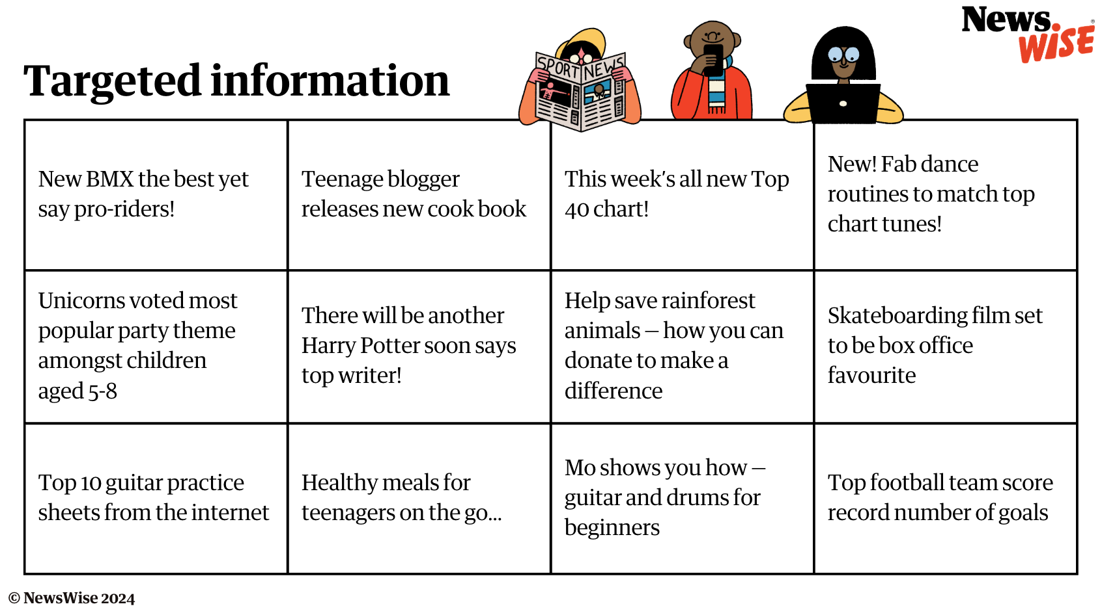
Can you sort this targeted information?
Which character would see each piece of information first? Why?

Slide 7
Challenge!
Choose 6 targeted information cards and create a profile of someone who would recieve this set of information

Slide 8

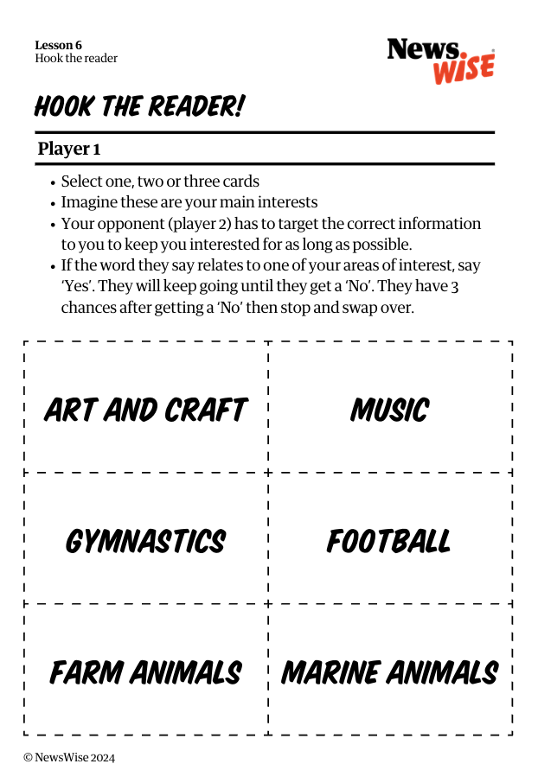
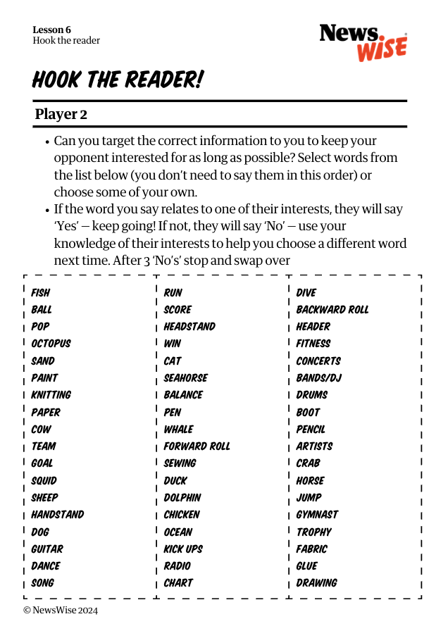
Let’s play Hook the reader...
Player 1 is a website or algorithm
Player 2 is an internet user
Player 1's aim is to keep player 2's attention for as long as possible
This is what websites and algorithms do!

Slide 9
Can you think of any problems with only ever reading, hearing or seeing things from the same
sources or about the same subjects?

Slide 10

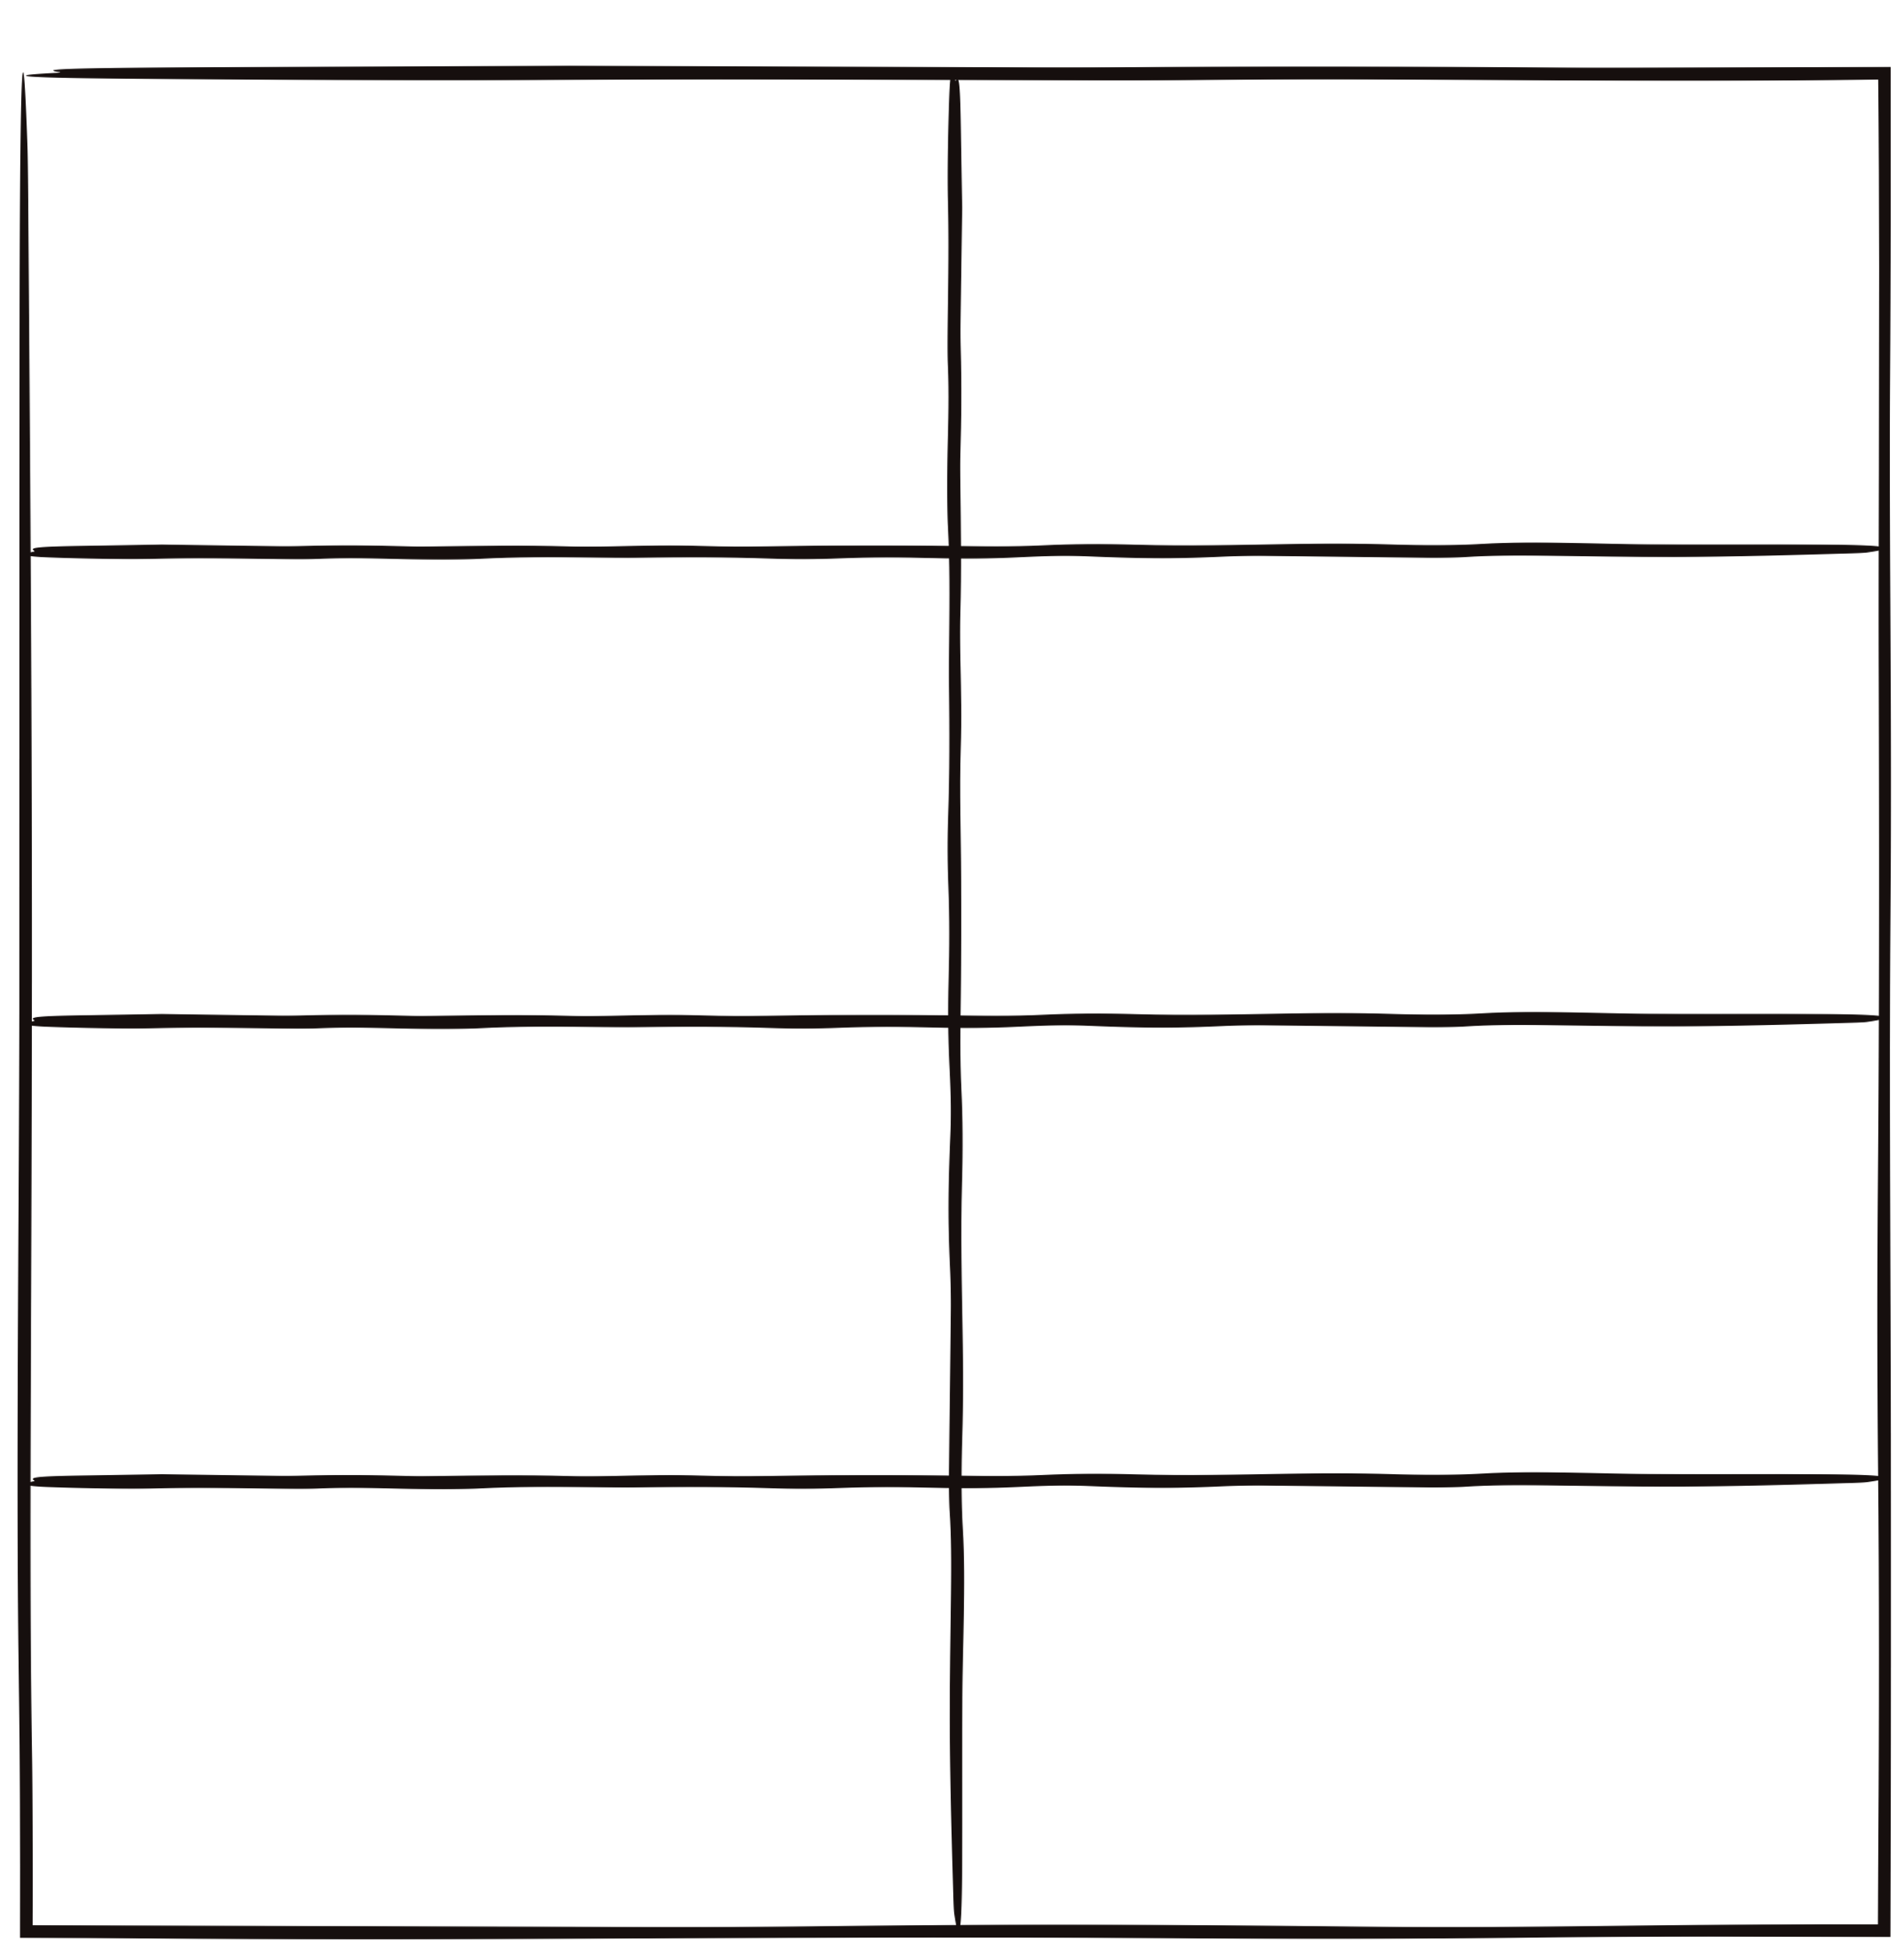








Content Cards
1
sun
circle
Time to sort ourselves into groups: one group per symbol.
smiley
face
star
Imagine each symbol represents a news topic
arrow
triangle
eg
  who to vote for in an election
  a football team
  new toy/trend
moon
lightning

Slide 11
Content Cards
2
Collect all the cards with your symbol
This demonstrates a filter bubble – the internet thinks you like triangles, so is giving you more triangles!

Slide 12
Content Cards
3
There is another symbol on your cards! The extra symbol is related to but not the same as the main symbol.
  How might this influence someone?
  What else might it make someone want to do?
  Why do organisations do this? How do you feel about this?
  How can we ‘burst’ the bubble?
Imagine each symbol represents a news topic, eg who to vote for in an election, a particular football team or the newest toy/trend.

Slide 13

Let’s discuss
Make a list of 5 things to remember when searching online.
Draw around a hand, enlarge it and record the 5 things to remember on each of the fingers!

Slide 14
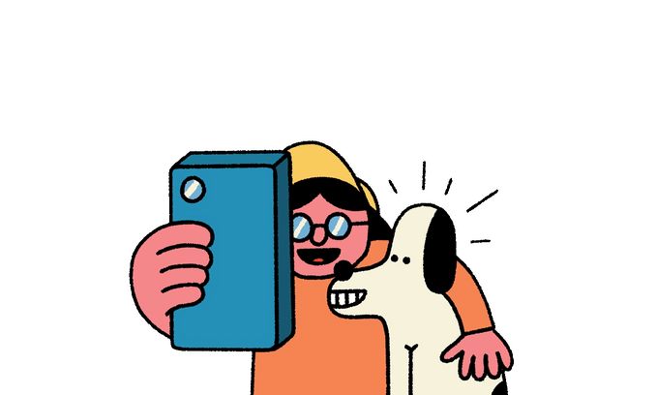

Extension 1
Make a short guide for an article in the school newsletter about using search engines and how individuals receive news and information targeted at their interests.
What do users need to know and do?

Slide 15
Extension 2
1
Look at the screengrab of a Google news search result
2
  Which results are shown first and why?
  Do you recognise any of the sources?
  Why do you think certain results come closer to the top of the page?
  Is it useful to have the results ranked in this way?
  Are there any problems with it?

