Slide 1

Vocabulary to pre-teach
Headline
A phrase that summarises the main point of the article. Headlines are in large print and aim to catch the attention of the reader.
Miscaptioning
Giving a photo or image a wrong or false caption.
Forced perspective
A camera technique which makes objects appear larger or smaller than they actually are.
Image manipulation
When a photo or image is changed using editing software.
Social media
Websites and applications which enable users to create and share content or to speak to people online (eg TikTok, Instagram, Snapchat, Facebook).
Fake news
News which is not true, or does not include all of the facts.
Trustworthy
Something that you can believe is real or reliable.
Regulation
Controlled by rules and regulations, ensuring news organisations uphold high standards of journalism.
Reliability
When something is trusted, dependable and consistent.

Slide 2

Lesson 5
Spotting fake news

Slide 3


Learning objective
To identify fake news and its consequences
Journalist training school
A journalist’s main aim is to report the truth. They need to be good fake news detectives so that they don’t report fake news themselves!

Slide 4
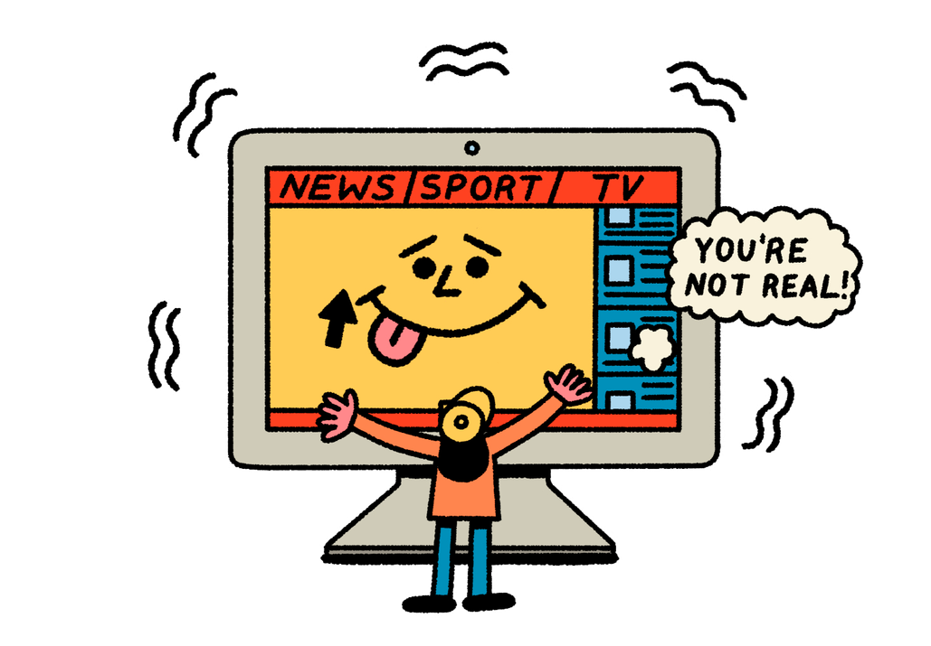
Learning outcomes:
  Explain what fake news is and why it is created.
  Identify what questions to ask and what checks to make to decide whether a news report is fake or real.
  Infer how a fake news story may affect someone’s emotions and behaviour.
  Give reasons why fake news can be harmful.

Slide 5

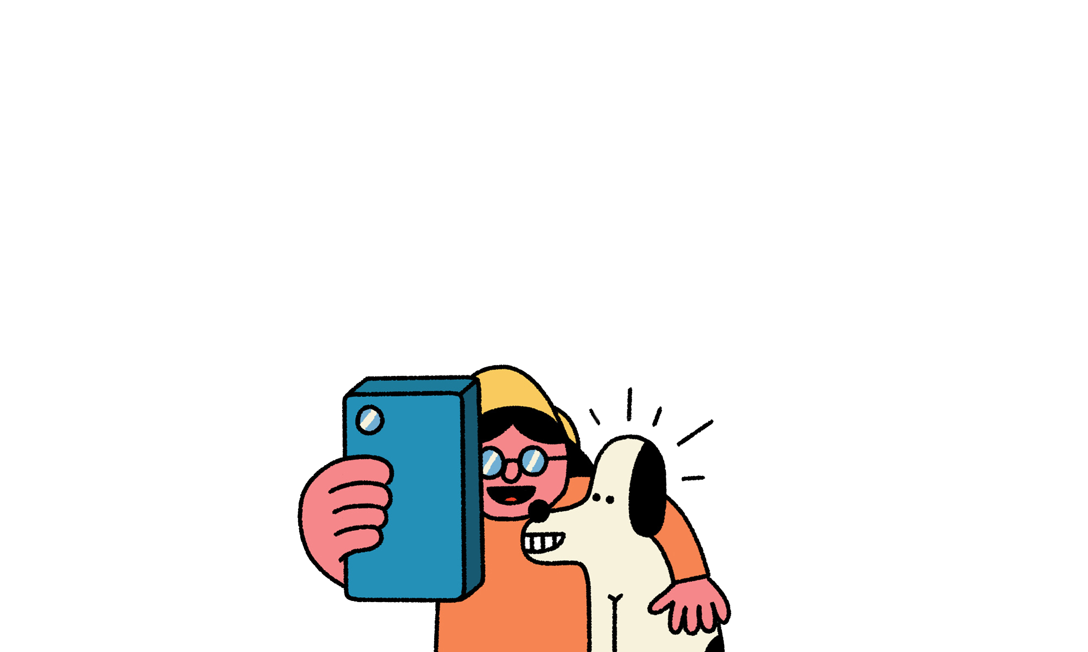
Nav is reading a news story. Nav wants to know if the story is ‘fake news’.
Is this fake news?
  What does Nav mean?
  If it is fake news, does it matter? Why or why not?
  What will help Nav to decide?
  What should Nav do about it?
Notes:
The links below are for the stories that each of these statements are based on. These are for your reference only and it is not expected that these be shared with your class.
New discount shop: https://www.kidderminstershuttle.co.uk/news/24608786.kidderminster-new-shop-brands4less-opens-town-centre/
Woman fined £500: https://www.bbc.co.uk/news/articles/c9qvvpe9rw4o
UK elects new prime minister:
https://www.bbc.co.uk/newsround/articles/cxx2pd3r538o
Climate protester sentenced to five years:
https://www.theguardian.com/environment/article/2024/jul/18/five-just-stop-oil-supporters-jailed-over-protest-that-blocked-m25
Rare Roman mosaic found:
https://www.bbc.co.uk/newsround/articles/ceq599eqxdro

Slide 6


Get ready to vote!

Slide 7

Boy smashes 3,500 year old vase at museum
Fake or real?
Notes:
Pupils vote on whether each headline is real or fake, making a ‘gut reaction’ decision. (Don’t reveal the answers yet!).
• What do you think about this story headline?
• Is it easy to tell if a story is real or fake (especially if we only read it quickly)?
• Did you have enough information to make an informed decision?
• How might people react to each of these headlines?
Important note: All of these stories appeared in the news and are therefore real news or real ‘fake news’. For your information we have included the source below. If you decide to view these stories online in the classroom, be aware that advertising and other stories may pop up. It is therefore best to select the relevant sections and prepare these as a teaching resource to ensure safe use in the classroom. When researching stories at home, pupils and parents should be made aware that online news portals may include adult content. Please note that we cannot be responsible for other content and advertising on these websites.
REAL:
• Boy smashes 3,500 year old vase at museum, BBC, August 2024 -
https://www.bbc.co.uk/news/articles/ckg2j2y20epo
• Library cards given to newborn babies in Cornwall, BBC, August 2024 -
https://www.bbc.co.uk/news/articles/cz7338v2qn3o
• Seal steals dinghy for sunbathing sessions, BBC, August 2024 -
https://www.bbc.co.uk/news/articles/c2kjdg3d3v0o
FAKE:
• Anne Frank's diary actually written by American man, factcheck by Full Fact, March 2024 -
https://fullfact.org/online/anne-frank-diary-ballpoint-pen-meyer-levin-false-claim/
• Energy drink increases chances of disease, factcheck by Full Fact, June 2024 -
https://fullfact.org/health/energy-drinks-aspartame-kidneys-liver/
• Expensive cars floating on boats during floods in Dubai, factcheck by Full Fact, April 2024 -
https://fullfact.org/online/luxury-car-boat-dubai-flood/

Slide 8
Anne Frank’s
diary actually written by American man
Fake or real?

Slide 9
Library cards
given to newborn babies in Cornwall
Fake or real?

Slide 10
Energy drink increases chances of disease
Fake or real?

Slide 11
Expensive cars floating on boats during floods in Dubai
Fake or real?

Slide 12
Seal steals dinghy
for sunbathing sessions
Fake or real?

Slide 13
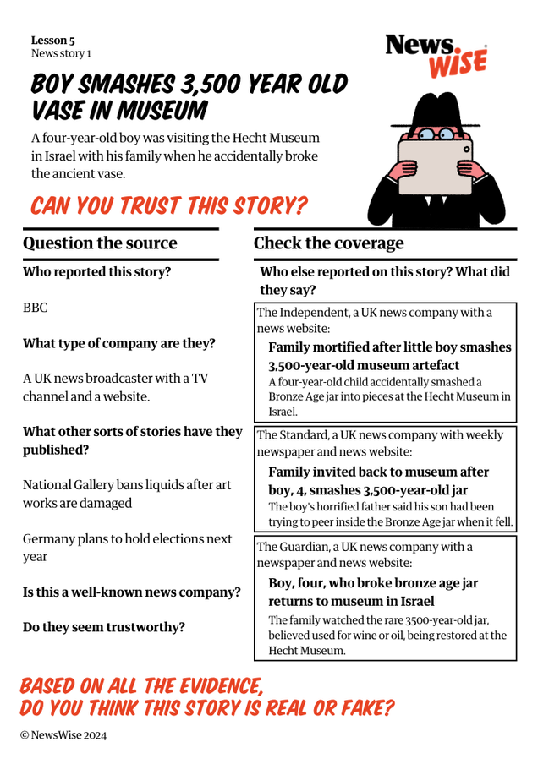
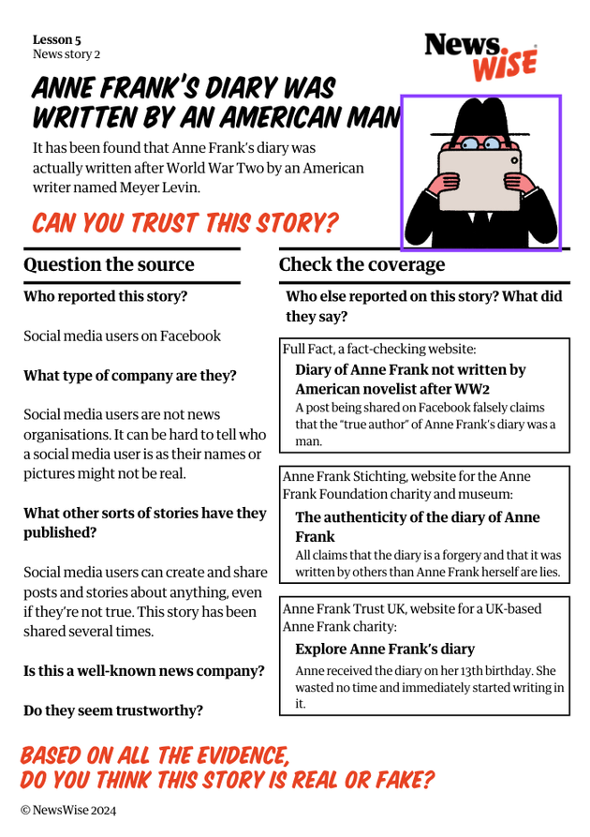
Are you ready to investigate whether the following stories are fake or real?

Slide 14
We must remember to:
1
2
Question the source
Check the coverage

Slide 15

Trusted sources of news
These are some examples of well known news companies that most people trust to tell the truth:
BBC
ITV
Sky News
Channel 4
The Guardian
The Times
First News
New York Times
The Times
Newsround
The Week Junior
Notes:
The links below are for the stories that each of these statements are based on. These are for your reference only and it is not expected that these be shared with your class.
New discount shop: https://www.kidderminstershuttle.co.uk/news/24608786.kidderminster-new-shop-brands4less-opens-town-centre/
Woman fined £500: https://www.bbc.co.uk/news/articles/c9qvvpe9rw4o
UK elects new prime minister:
https://www.bbc.co.uk/newsround/articles/cxx2pd3r538o
Climate protester sentenced to five years:
https://www.theguardian.com/environment/article/2024/jul/18/five-just-stop-oil-supporters-jailed-over-protest-that-blocked-m25
Rare Roman mosaic found:
https://www.bbc.co.uk/newsround/articles/ceq599eqxdro

Slide 16
Fake news clue words
If you see any of these words connected to a news story, it is a clue that it is not true!
fake
hoax
false
misleading
parody
satirical
fiction
myth
fact check
“No, this did not happen!”
Notes:
The links below are for the stories that each of these statements are based on. These are for your reference only and it is not expected that these be shared with your class.
New discount shop: https://www.kidderminstershuttle.co.uk/news/24608786.kidderminster-new-shop-brands4less-opens-town-centre/
Woman fined £500: https://www.bbc.co.uk/news/articles/c9qvvpe9rw4o
UK elects new prime minister:
https://www.bbc.co.uk/newsround/articles/cxx2pd3r538o
Climate protester sentenced to five years:
https://www.theguardian.com/environment/article/2024/jul/18/five-just-stop-oil-supporters-jailed-over-protest-that-blocked-m25
Rare Roman mosaic found:
https://www.bbc.co.uk/newsround/articles/ceq599eqxdro

Slide 17
What clues helped you to identify the fake news?
What clues showed that you could trust the real story?

Slide 18
Choose two of the following fake news stories to read and answer these questions...
  How might someone feel reading this story?
  How does the article try to make the reader feel an extreme emotion?
  What would happen if someone believed this story?
  Could it affect how they think or act?
  How could it affect their actions?
  What is the motivation of the story/writer?
  Why has this story been made up?
  What type of fake news might cause harm?
Body

Slide 19

ALIEN ARRIVAL? HUGE BLACK UFO SPOTTED IN TEXAS
Does this creepy image convince you that aliens are coming? This picture taken by a man on the outskirts of a small Texan town, show a large black object gliding above the Earth.
The man said: “It was so weird! I was driving home one evening and a dark shadow appeared over my car. I got out and saw the UFO flying right above me. I quickly managed to take a photo, but within a matter of seconds, the object turned and flew off. I couldn’t quite believe it! There’s no doubt that it was a UFO!”
Notes:
The links below are for the stories that each of these statements are based on. These are for your reference only and it is not expected that these be shared with your class.
New discount shop: https://www.kidderminstershuttle.co.uk/news/24608786.kidderminster-new-shop-brands4less-opens-town-centre/
Woman fined £500: https://www.bbc.co.uk/news/articles/c9qvvpe9rw4o
UK elects new prime minister:
https://www.bbc.co.uk/newsround/articles/cxx2pd3r538o
Climate protester sentenced to five years:
https://www.theguardian.com/environment/article/2024/jul/18/five-just-stop-oil-supporters-jailed-over-protest-that-blocked-m25
Rare Roman mosaic found:
https://www.bbc.co.uk/newsround/articles/ceq599eqxdro

Slide 20
SHOCK REVEAL: PRIME MINISTER SPENT MILLIONS OF GOVERNMENT MONEY ON LUXURY HOLIDAY AND MORE!!!
The Prime Minister of the UK has spent over £1 million of the government’s money on a luxury villa in the Caribbean and 1st class flights to go on holiday!
An anonymous source revealed this yesterday, only one week before the UK election is set to take place! This is only the start; who knows what else the prime minister has been spending our money on!
Notes:
The links below are for the stories that each of these statements are based on. These are for your reference only and it is not expected that these be shared with your class.
New discount shop: https://www.kidderminstershuttle.co.uk/news/24608786.kidderminster-new-shop-brands4less-opens-town-centre/
Woman fined £500: https://www.bbc.co.uk/news/articles/c9qvvpe9rw4o
UK elects new prime minister:
https://www.bbc.co.uk/newsround/articles/cxx2pd3r538o
Climate protester sentenced to five years:
https://www.theguardian.com/environment/article/2024/jul/18/five-just-stop-oil-supporters-jailed-over-protest-that-blocked-m25
Rare Roman mosaic found:
https://www.bbc.co.uk/newsround/articles/ceq599eqxdro

Slide 21
NEWSWISE ROVERS COACH CLAIMS: “FOOTBALL HAS NO PLACE FOR WOMEN!”
Robert Smith, the coach of local football team NewsWise Rovers, has caused outrage saying there was “no place” at his football club for women.
Footballer Sarah Li posted on social media: “How dare he? Women footballers have as much right as men to play here. You can catch women’s football on television now, so why can’t we watch women play at our local club? We should boycott the club until he changes his mind” #sexist #women #womensfootballisgreat
Notes:
The links below are for the stories that each of these statements are based on. These are for your reference only and it is not expected that these be shared with your class.
New discount shop: https://www.kidderminstershuttle.co.uk/news/24608786.kidderminster-new-shop-brands4less-opens-town-centre/
Woman fined £500: https://www.bbc.co.uk/news/articles/c9qvvpe9rw4o
UK elects new prime minister:
https://www.bbc.co.uk/newsround/articles/cxx2pd3r538o
Climate protester sentenced to five years:
https://www.theguardian.com/environment/article/2024/jul/18/five-just-stop-oil-supporters-jailed-over-protest-that-blocked-m25
Rare Roman mosaic found:
https://www.bbc.co.uk/newsround/articles/ceq599eqxdro

Slide 22
YOU WON’T BELIEVE WHAT A ZOO DID TO THESE TWO-DAY-OLD TIGER CUBS!!
Visitors to a UK zoo have reported that two newly born tiger cubs have been torn away from their mother at only two days old!
One tourist said: “The mother tiger looked so distressed. She was scraping at the bars of her cage and crying. We could hear the cubs yelping! It was awful!”
An animal rights group has arrived outside the zoo this evening, demanding that it be closed down. “This is an outrage,” one of the protestors said, “We think the cubs may have been sold off to a fur company. Those poor cubs. I can’t believe a zoo let this happen!”
Notes:
The links below are for the stories that each of these statements are based on. These are for your reference only and it is not expected that these be shared with your class.
New discount shop: https://www.kidderminstershuttle.co.uk/news/24608786.kidderminster-new-shop-brands4less-opens-town-centre/
Woman fined £500: https://www.bbc.co.uk/news/articles/c9qvvpe9rw4o
UK elects new prime minister:
https://www.bbc.co.uk/newsround/articles/cxx2pd3r538o
Climate protester sentenced to five years:
https://www.theguardian.com/environment/article/2024/jul/18/five-just-stop-oil-supporters-jailed-over-protest-that-blocked-m25
Rare Roman mosaic found:
https://www.bbc.co.uk/newsround/articles/ceq599eqxdro

Slide 23

Let’s discuss
Where can we get trustworthy news from?
Create a class list of reliable sources where we can find trustworthy and real information.

Slide 24
Stop!
Fake or real quiz answers on the next slide...
Notes:
Stop here!
Come back here for the plenary, when you're ready to reveal the answers...

Slide 25
Boy smashes 3,500 year old vase at museum
Fake or real?
Notes:
The answers...
REAL
• Boy smashes 3,500 year old vase at museum, BBC, August 2024 -
https://www.bbc.co.uk/news/articles/ckg2j2y20epo
Important note: All of these stories appeared in the news and are therefore real news or real ‘fake news’. For your information we have included the source below. If you decide to view these stories online in the classroom, be aware that advertising and other stories may pop up. It is therefore best to select the relevant sections and prepare these as a teaching resource to ensure safe use in the classroom. When researching stories at home, pupils and parents should be made aware that online news portals may include adult content. Please note that we cannot be responsible for other content and advertising on these websites.

Slide 26
Anne Frank’s
diary actually written by American man
Fake or real?
Notes:
FAKE:
• Anne Frank's diary actually written by American man, factcheck by Full Fact, March 2024 -
https://fullfact.org/online/anne-frank-diary-ballpoint-pen-meyer-levin-false-claim/
Important note: All of these stories appeared in the news and are therefore real news or real ‘fake news’. For your information we have included the source below. If you decide to view these stories online in the classroom, be aware that advertising and other stories may pop up. It is therefore best to select the relevant sections and prepare these as a teaching resource to ensure safe use in the classroom. When researching stories at home, pupils and parents should be made aware that online news portals may include adult content. Please note that we cannot be responsible for other content and advertising on these websites.

Slide 27
Library cards
given to newborn babies in Cornwall
Fake or real?
Notes:
REAL:
• Library cards given to newborn babies in Cornwall, BBC, August 2024 -
https://www.bbc.co.uk/news/articles/cz7338v2qn3o
Important note: All of these stories appeared in the news and are therefore real news or real ‘fake news’. For your information we have included the source below. If you decide to view these stories online in the classroom, be aware that advertising and other stories may pop up. It is therefore best to select the relevant sections and prepare these as a teaching resource to ensure safe use in the classroom. When researching stories at home, pupils and parents should be made aware that online news portals may include adult content. Please note that we cannot be responsible for other content and advertising on these websites.

Slide 28
Energy drink increases chances of disease
Fake or real?
Notes:
FAKE
• Energy drink increases chances of disease, factcheck by Full Fact, June 2024 -
https://fullfact.org/health/energy-drinks-aspartame-kidneys-liver/
Important note: All of these stories appeared in the news and are therefore real news or real ‘fake news’. For your information we have included the source below. If you decide to view these stories online in the classroom, be aware that advertising and other stories may pop up. It is therefore best to select the relevant sections and prepare these as a teaching resource to ensure safe use in the classroom. When researching stories at home, pupils and parents should be made aware that online news portals may include adult content. Please note that we cannot be responsible for other content and advertising on these websites.

Slide 29
Expensive cars floating on boats during floods in Dubai
Fake or real?
Notes:
FAKE
• Expensive cars floating on boats during floods in Dubai, factcheck by Full Fact, April 2024 -
https://fullfact.org/online/luxury-car-boat-dubai-flood/
Important note: All of these stories appeared in the news and are therefore real news or real ‘fake news’. For your information we have included the source below. If you decide to view these stories online in the classroom, be aware that advertising and other stories may pop up. It is therefore best to select the relevant sections and prepare these as a teaching resource to ensure safe use in the classroom. When researching stories at home, pupils and parents should be made aware that online news portals may include adult content. Please note that we cannot be responsible for other content and advertising on these websites.

Slide 30
Seal steals dinghy
for sunbathing sessions
Fake or real?
Notes:
REAL
• Seal steals dinghy for sunbathing sessions, BBC, August 2024 -
https://www.bbc.co.uk/news/articles/c2kjdg3d3v0o
Important note: All of these stories appeared in the news and are therefore real news or real ‘fake news’. For your information we have included the source below. If you decide to view these stories online in the classroom, be aware that advertising and other stories may pop up. It is therefore best to select the relevant sections and prepare these as a teaching resource to ensure safe use in the classroom. When researching stories at home, pupils and parents should be made aware that online news portals may include adult content. Please note that we cannot be responsible for other content and advertising on these websites.

Slide 31
Extension 1
Create a fake news detective toolkit for other children in school to use.

Slide 32
Extension 2
Challenge everyone else in school! Run a fake or real quiz in assembly.

Slide 33
Extension 3
Use your News Navigator to investigate a news story with your family.

Slide 34
Extension 4
Reading a fake story.
Create a comic strip or a storyboard to show the fake news rection chain.
Feeling an extreme emotion.
Use the emotional and action responses to help.
Developing a thought pattern or taking action.

Slide 35
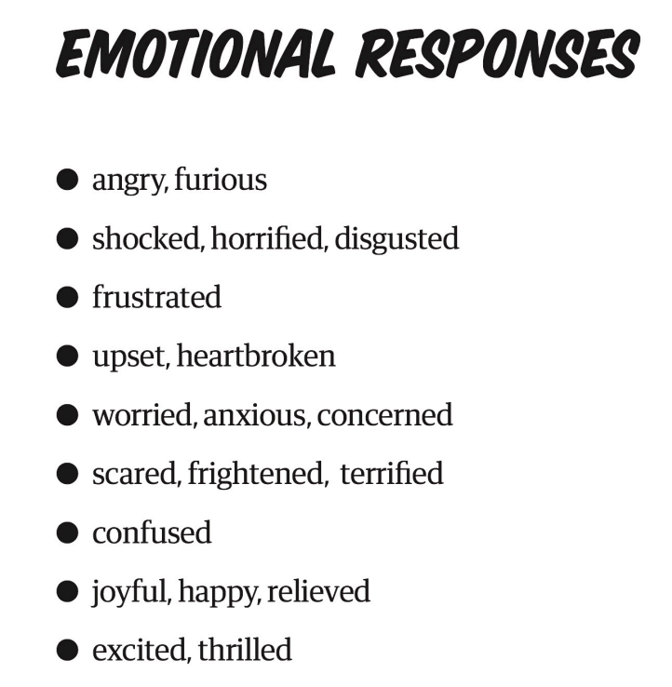
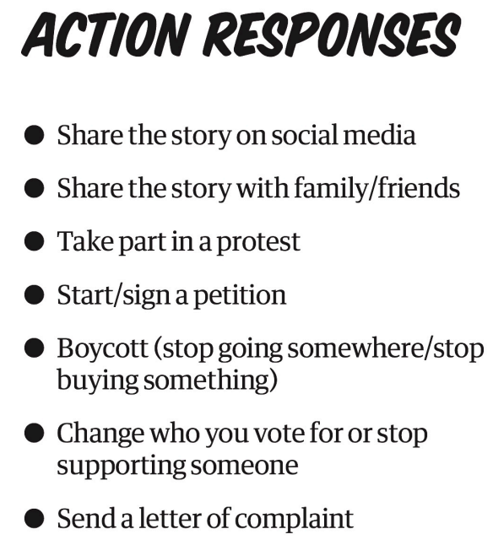
Extension 4
Emotional and action responses

Slide 36
Extension 5
Don’t trust pictures on the internet!
Lots of pictures online are not what they say they are!
Here are three common things that might have happened to photos on the internet.

Slide 37
Don’t trust pictures on the internet!
Miscaptioning
Miscaptioning is pretending that a photo shows something that it doesn’t.
For example, the caption might change the date or place, or pretend it shows a specific event when the photo actually shows something different or was taken elsewhere or at a different time.

Slide 38
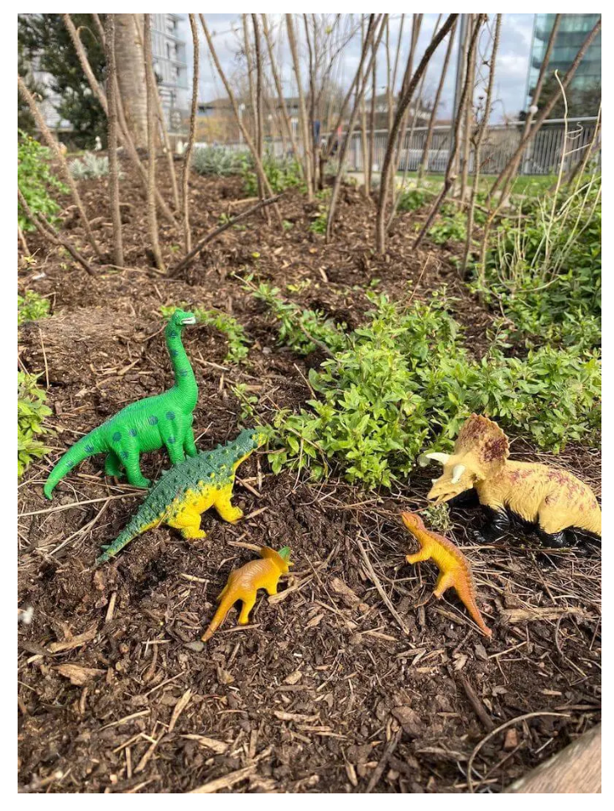
Challenge!
Caption competition: what descriptions can you think of that would change the meaning of this photo?
This photo of plastic toy dinosaurs would be much more strange if the caption was: "New species of tiny dinosaur discovered!"
What might happen if people believed the false caption?
Why could this be a problem?

Slide 39
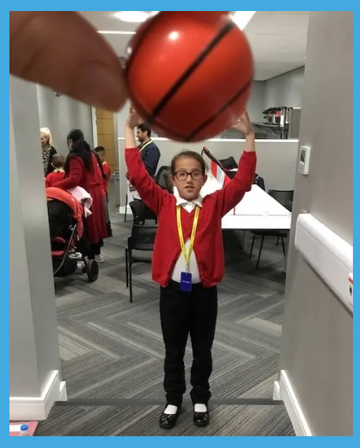
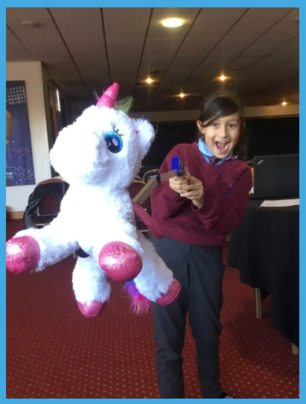
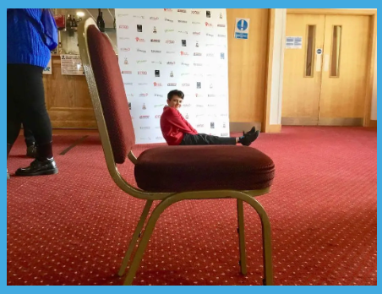
Don’t trust pictures on the internet!
Forced perspective
Forced perspective is making something look bigger or smaller than it really is by placing it nearer or further away from the camera.

Slide 40

Challenge!
Demonstrate how you shouldn’t trust pictures on the internet by showing how forced perspective pictures are made.
1
Take your forced perspective photo: make sure that the object/person you want to look big is close to the camera, and the object/person you want to look small is far away!
2
Take a photo of the object and person together showing their actual sizes to explain how the trick was done.

Slide 41
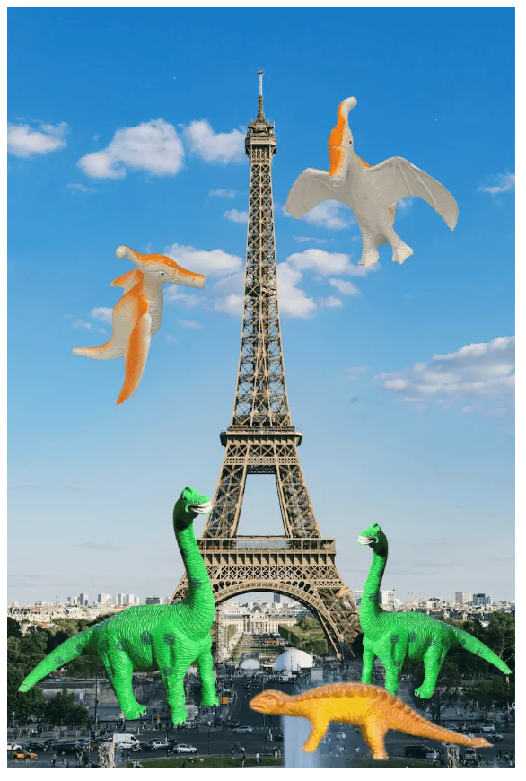
Don’t trust pictures on the internet!
Photo manipulation
Pictures can be manipulated by using editing software such as Photoshop to change the image in some way.
Part of the picture could be moved around, made bigger or smaller, or erased altogether. Or someone could 'cut out' an element from one picture and superimpose (put it on top of) a completely different picture, like our dinosaurs at the Eiffel Tower.

Slide 42
Photo manipulation
Why do people edit photos?
Sometimes, people use editing software to change the way a photograph looks for artistic reasons; they are just making the image look better, not trying to deceive anyone.
Other times, someone might edit a photo to try to fool people into believing something untrue.

Slide 43
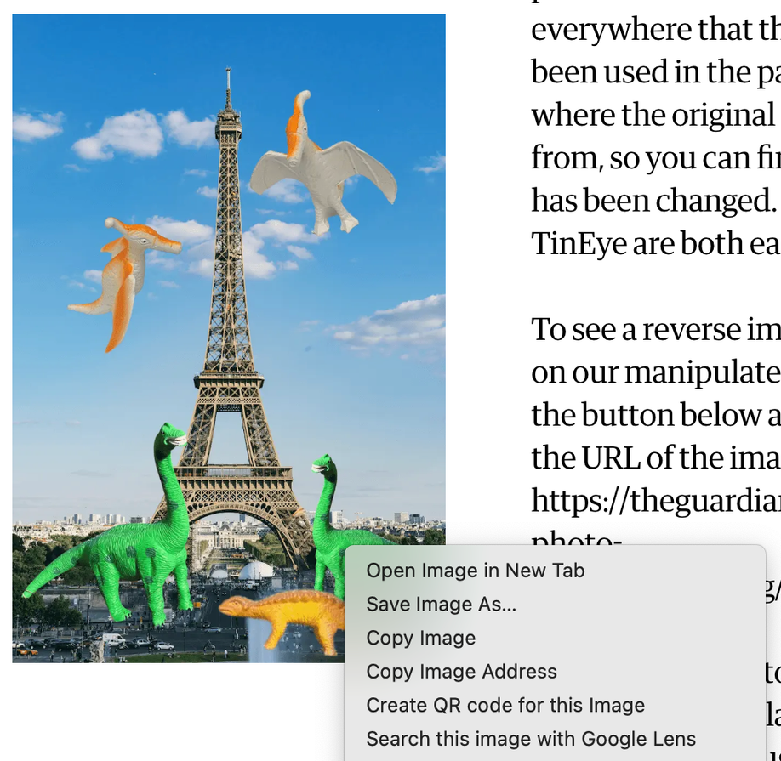

Photo manipulation
Reverse image search
To check a photo you are not sure about you can do a reverse image search. You should always do this with a teacher or parent! This will show you everywhere that the image has been used in the past, including where the original photo comes from, so you can find out if it has been changed. Google and TinEye are both easy to use.

