Slide 1

Vocabulary to pre-teach
Citizen
A member of a country or place.
Accountability
Taking responsibility for your actions and choices.
Chronological
When something is in time order, or the order in which it happened.
Perspective
This is a point of view about something which has happened.
Power
Power is the capacity or ability to direct or change something.
Responsibility
Responsibility is about having a duty to take care of something.
Justice
News can restore justice or help to fix unfairness in society.
Scandal
A scandal is an action or event that causes public shock or disapproval.
Government
A system or group of people with the power to make laws in a country.

Slide 2

Story-specific vocabulary to pre-teach
This lesson is based on a news story which includes lots of vocabulary which may be new to your pupils. The lesson resources include story explainers to help your pupils understand the issue.
Toxic
Something which is harmful to our health.
Recycling plant
A factory where used materials are sorted, ready to potentially be used for other purposes.
Hazardous waste
Items that have been thrown away or not used anymore that could damage our health.
Lead
A toxic metal.
Cadmium
A metal which is highly toxic.
Arsenic
A chemical which is highly toxic
Zinc
A metal used in lots of different things we use every day. It is not toxic.
Pollution
Anything that makes where we live, the earth or the air dirty or unsafe.
Landfill
A place where waste and rubbish is taken. A hole in the ground that is filled with waste.

Slide 3

Lesson 4
Holding power to account

Slide 4

Learning objective
To understand how news can challenge
power
Journalist training school
Sometimes journalists can make a difference to peoples’ lives by reporting stories that the public didn’t know about before, exposing the truth and, in turn, challenging power.

Slide 5
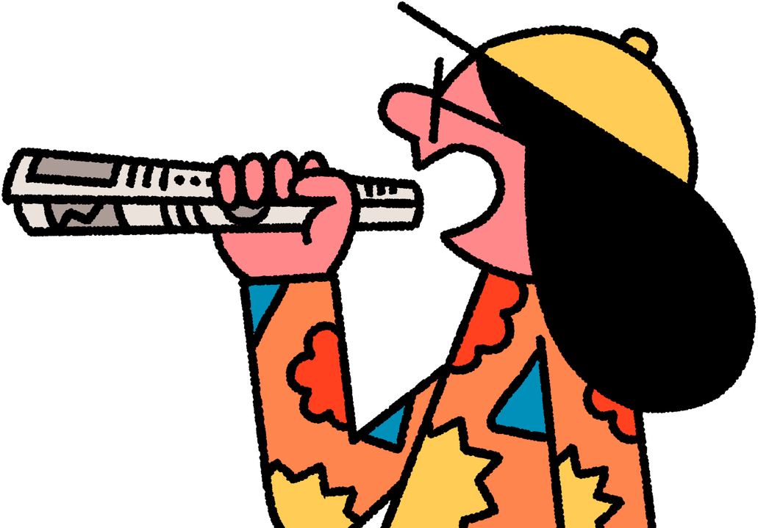
Learning outcomes:
  Define what power means.
  Explain why it is sometimes important to challenge power.
  Identify how the Zinc Nacional reporting changed how people in power acted.
  Describe the different effects the news reporting had on the people involved.

Slide 6
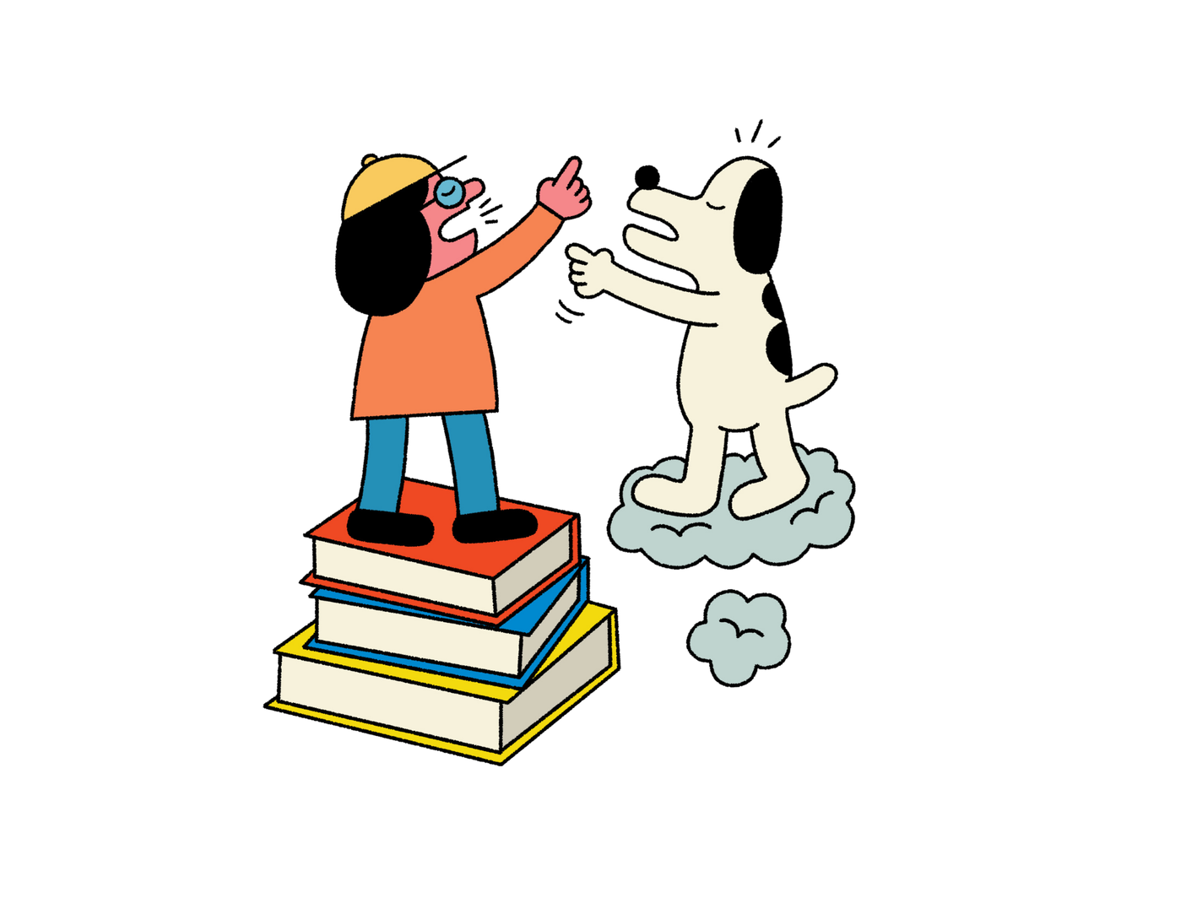
What is power?

Slide 7
Powerful people role-play
1
Act out your scenario with your partner. You will both play different people with different amounts of power.
2
Think about these questions:
  Who has more power and why?
  Who was affected by their actions?
  Is the person in power acting fairly? Why/why not?
  Could they be challenged and, if so, how?

Slide 8
Scenarios
Person 1: The Prime Minister
Person 2: MP in charge of Education
The prime minister does not like sport so has decided there will be no more PE in schools.
Person 1: The owner of a big supermarket
Person 2: Supermarket customer(s)
The owner of the supermarket wants to stop fruit getting bruised by using lots of plastic packaging to protect it.
Person 1: The rich owner of a big company
Person 2: School headteacher(s)
The owner of the company has decided to use some of their money to send free books to local schools.

Slide 9
Discuss
Let’s create a class definition of power
  Can ‘powerful’ people be anyone and anywhere?
  Is it good to be powerful?
  When is it important to challenge power?

Slide 10
The Zinc Nacional story
Watch the Explainer video about how
hazardous waste is produced in the steel industry.
https://youtube.com/shorts/J1VG6wT79bs?feature=share
How does the story make you feel?
Did the situation seem fair? Why or why not?
Why do you think journalists chose to report the story?

Slide 11
People affected by the story
Let’s look at the people affected by the story.
Who do you think had the most or least power and why?
What do you think needs to change?
Notes:
The links below are for the stories that each of these statements are based on. These are for your reference only and it is not expected that these be shared with your class.
New discount shop: https://www.kidderminstershuttle.co.uk/news/24608786.kidderminster-new-shop-brands4less-opens-town-centre/
Woman fined £500: https://www.bbc.co.uk/news/articles/c9qvvpe9rw4o
UK elects new prime minister:
https://www.bbc.co.uk/newsround/articles/cxx2pd3r538o
Climate protester sentenced to five years:
https://www.theguardian.com/environment/article/2024/jul/18/five-just-stop-oil-supporters-jailed-over-protest-that-blocked-m25
Rare Roman mosaic found:
https://www.bbc.co.uk/newsround/articles/ceq599eqxdro

Slide 12
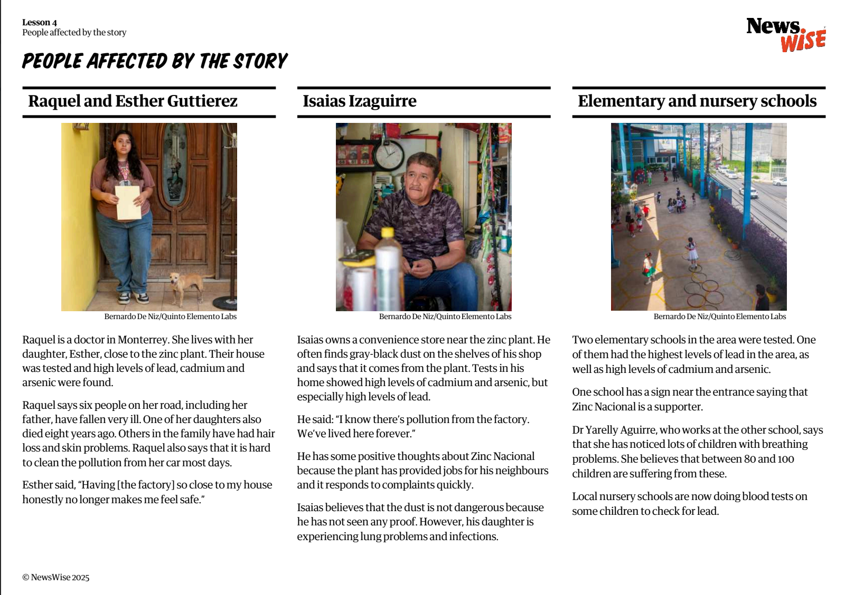

Slide 13

Who has the power?
1
Read the summaries of events and arrange them in chronological order (the order that they happened).
2
For each stage of the story, think about these questions:
Who has the most and least power and why?
What is power?
Who has power?
Is power good or bad?
How can journalists challenge power?
Why is it important to challenge people in power?

Slide 14
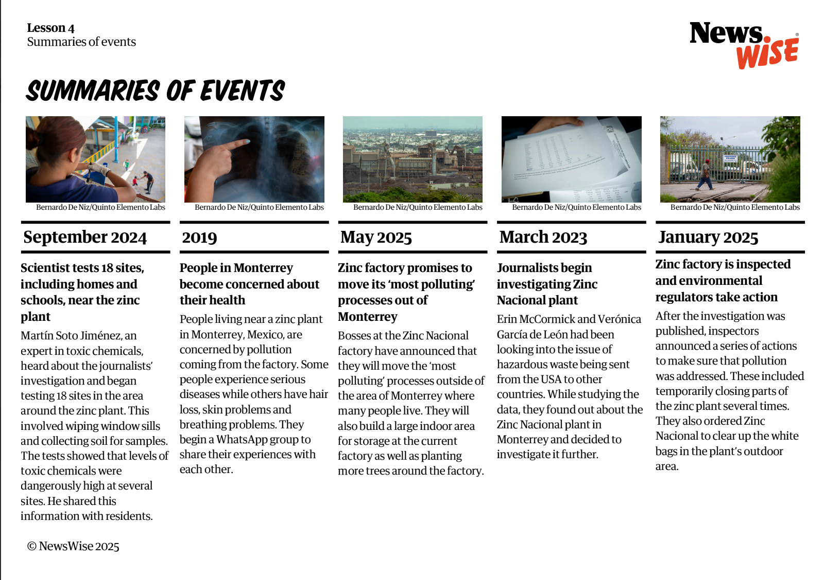

Slide 15

Who has the power?
Who began with power and who ends with power?
Why did this happen?
How did the news reports help to bring about change?
How was power challenged?
Has the issue been resolved completely, or does more need to be done?

Slide 16
Let’s discuss
Think back to the role-play scenarios from the
beginning of the lesson.
  Are there examples where power is being used positively?
  What might happen if these scenarios were reported in the news?
Notes:
The links below are for the stories that each of these statements are based on. These are for your reference only and it is not expected that these be shared with your class.
Cottrell Boyce named children's laureate:
https://www.theguardian.com/books/article/2024/jul/02/frank-cottrell-boyce-new-childrens-laureate
Local theatre closes down:
https://www.bbc.co.uk/news/articles/cy9xp5x5ekgo
Bafta awards for children's TV:
https://www.theguardian.com/tv-and-radio/2024/sep/22/cbeebies-at-the-baftas-awards-aim-to-revive-magic-of-kids-tv
Taylor Swift donates to charity:
https://www.theguardian.com/music/2024/oct/10/taylor-swift-donates-5m-hurricane-relief-efforts-helene-milton
Art installation with 125 inflatable penguins:
https://www.theguardian.com/artanddesign/2024/oct/10/frieze-london-art-fair-penguins

Slide 17
Extension 1
Think back to the Zinc Nacional story. Write, record or film your own explainer about the hazardous waste scandal for pupils in your school.

Slide 18
Extension 2
Imagine you are one of the people living near the Zinc National factory.
Write about their feelings and experiences, thinking about how they changed from before the news reporting began to after. How did their lives change?
You could also pretend you are a journalist and interview your classmates in a hot seat.

Slide 19

Extension 3
Watch the Meet the journalists video and discuss why the story was important and needed to be fact checked so thoroughly.
  Why was this an important story to tell?
  Why was it important that the journalists told the story accurately?
  What might happen if a journalist did not check the facts in their story like Erin and Verónica did?

