Slide 1

Vocabulary to pre-teach
Consent
When someone gives permission or agreement for something to happen.
Viewpoints
A viewpoint is a point of view or opinion about something.

Slide 2

Lesson 3
Managing feelings
about news

Slide 3

Learning objective
To consider the impact of news stories
on feelings and emotions
Journalist training school
Journalists must be aware that their news reports can affect people’s emotions. They must also understand the importance of respecting people’s personal information.

Slide 4
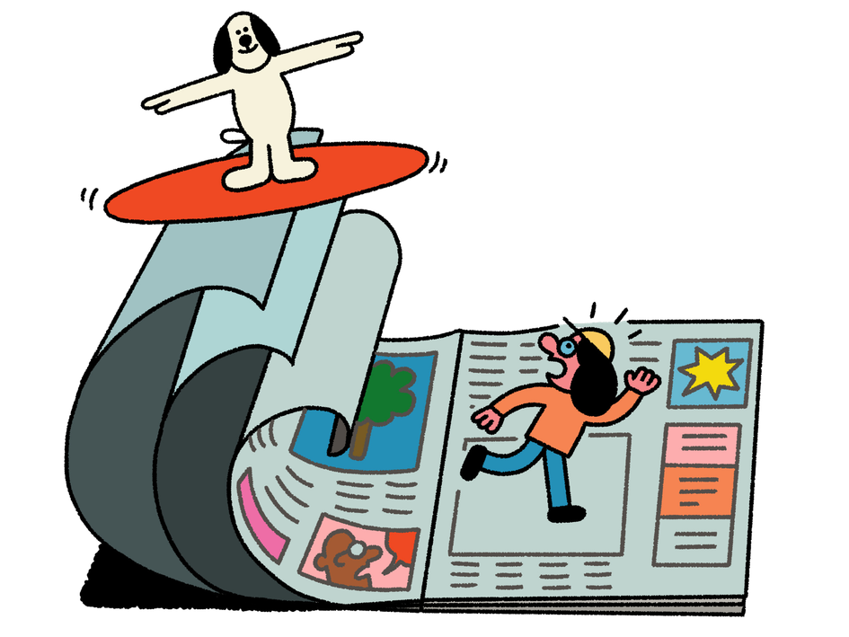
Learning outcomes:
  Describe how news stories can affect people’s feelings.
  Suggest ways to manage emotional responses when interacting with the news.
  Recognise why it is not appropriate to share personal (private) information as news.
  Explain how to report concerns, ask for support or advice in relation to news stories.

Slide 5
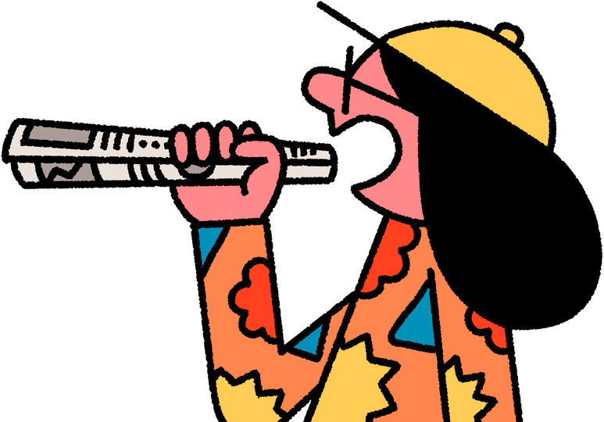
How do you feel about the news?
Listen to some statements and decide whether you:
strongly agree
agree
neither agree or disagree
disagree
strongly disagree

Slide 6
How much do you agree that...
  Reading/watching/hearing the news makes people feel depressed.
  Mostly the news makes the world seem like a bad place.
  News has the power to make people feel positive and uplifted.
  News should be about everyday people’s lives.
  It is okay to share news about people without asking them first.

Slide 7
Discussion
Different news stories generate different emotions and feelings. You could feel excited or pleased; angry or upset; shocked or devastated, or something else.
With a partner, talk about:
  What types of news stories might make you feel different emotions.
  Do some news stories make you feel more than one emotion?
  What types of news stories can affect emotions the most?

Slide 8

Read each scenario.
Can you infer (work out) how each person might be feeling?
Why might they be feeling this way?
Do you think other people might feel different emotions or react differently? Why?

Slide 9
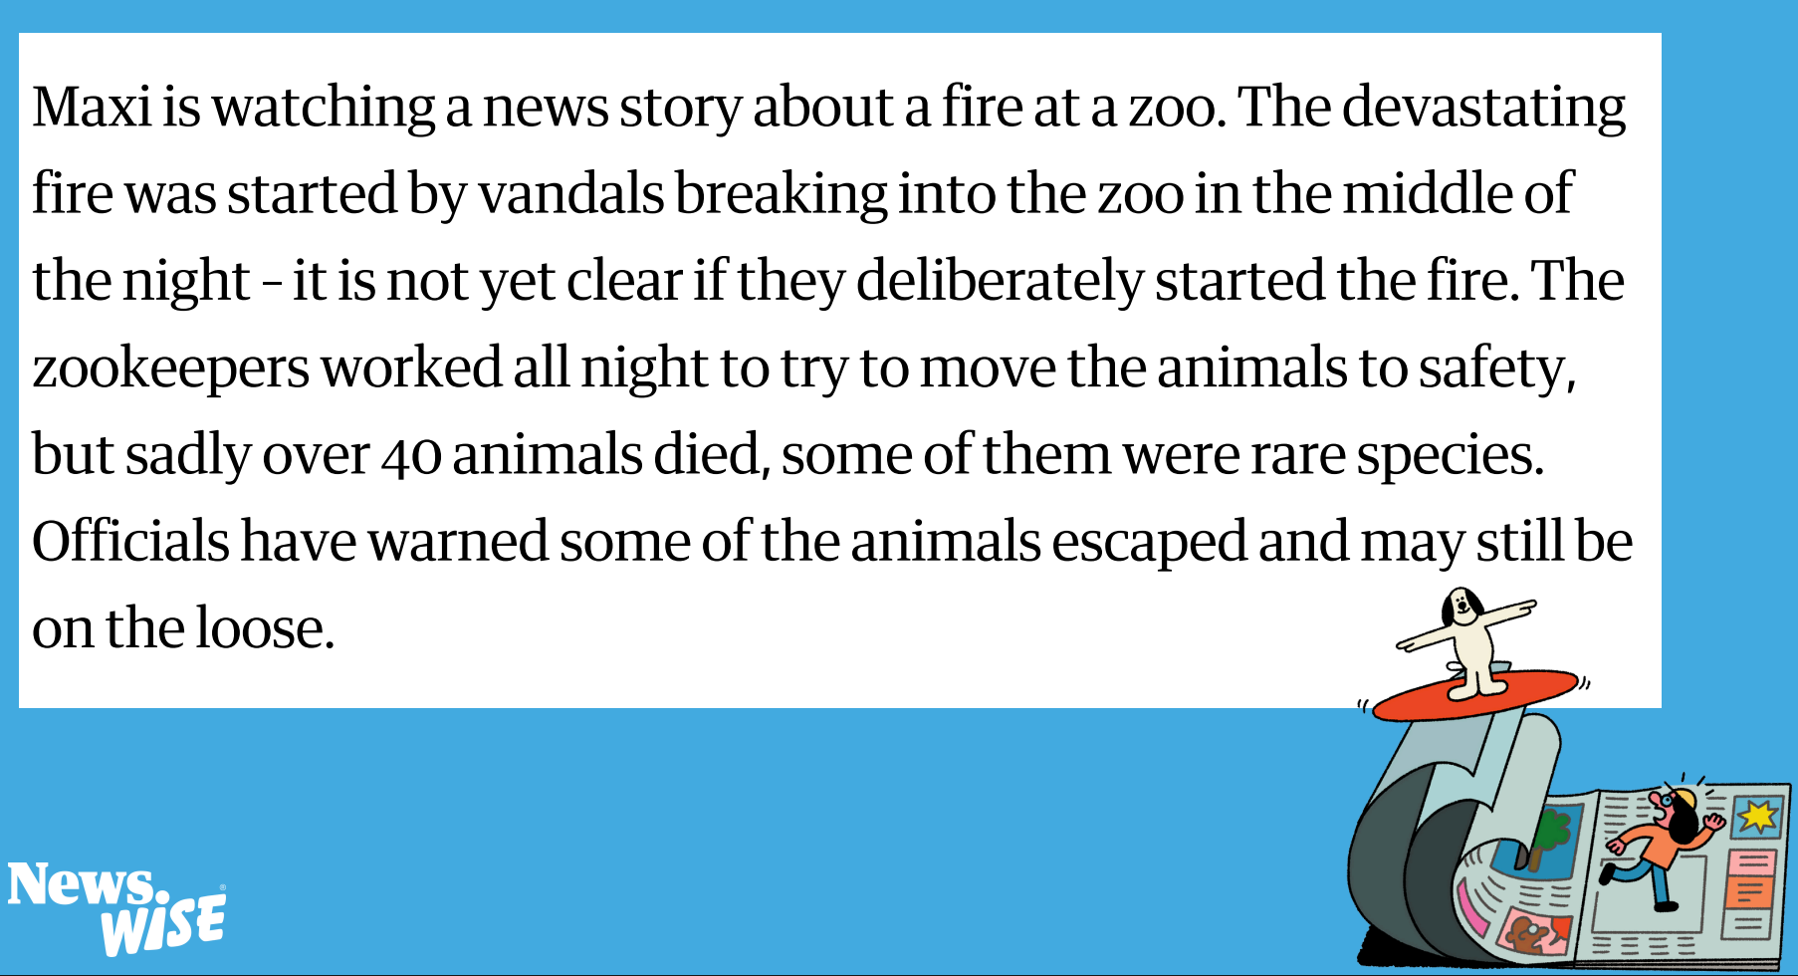

Slide 10
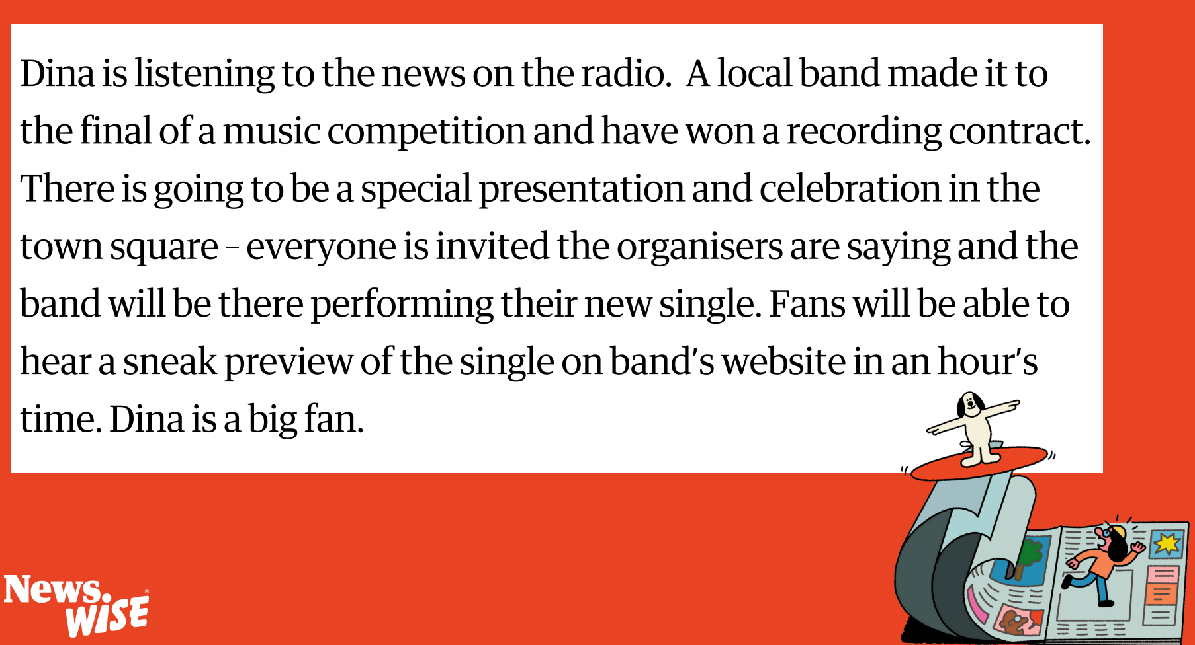
Notes:
The links below are for the stories that each of these statements are based on. These are for your reference only and it is not expected that these be shared with your class.
New discount shop: https://www.kidderminstershuttle.co.uk/news/24608786.kidderminster-new-shop-brands4less-opens-town-centre/
Woman fined £500: https://www.bbc.co.uk/news/articles/c9qvvpe9rw4o
UK elects new prime minister:
https://www.bbc.co.uk/newsround/articles/cxx2pd3r538o
Climate protester sentenced to five years:
https://www.theguardian.com/environment/article/2024/jul/18/five-just-stop-oil-supporters-jailed-over-protest-that-blocked-m25
Rare Roman mosaic found:
https://www.bbc.co.uk/newsround/articles/ceq599eqxdro

Slide 11
Zane is reading about thousands of people being forced to leave their home because of a flood. The flash flood happened unexpectedly with gallons of water washed into houses, shops and factories. The people have lost most of their belongings and now have nowhere to shelter or live. It will take many months to re-build their homes – they are cold, tired and scared. Charities are air-lifting food to remote areas.

Slide 12
If someone is feeling upset or worried about a news story, what should they do?
Notes:
The links below are for the stories that each of these statements are based on. These are for your reference only and it is not expected that these be shared with your class.
Cottrell Boyce named children's laureate:
https://www.theguardian.com/books/article/2024/jul/02/frank-cottrell-boyce-new-childrens-laureate
Local theatre closes down:
https://www.bbc.co.uk/news/articles/cy9xp5x5ekgo
Bafta awards for children's TV:
https://www.theguardian.com/tv-and-radio/2024/sep/22/cbeebies-at-the-baftas-awards-aim-to-revive-magic-of-kids-tv
Taylor Swift donates to charity:
https://www.theguardian.com/music/2024/oct/10/taylor-swift-donates-5m-hurricane-relief-efforts-helene-milton
Art installation with 125 inflatable penguins:
https://www.theguardian.com/artanddesign/2024/oct/10/frieze-london-art-fair-penguins

Slide 13
Which of these would help, and which would not help?
Talking to a friend.
Trying to forget it.
Watching the news.
Writing about the story.
Reading the same story over and over.
Doing something else instead.
Reading a different story.
Telling everyone else about it.
Reading more about the same story.
Talking to a trusted adult.
Look for advice on the Childline website.

Slide 14

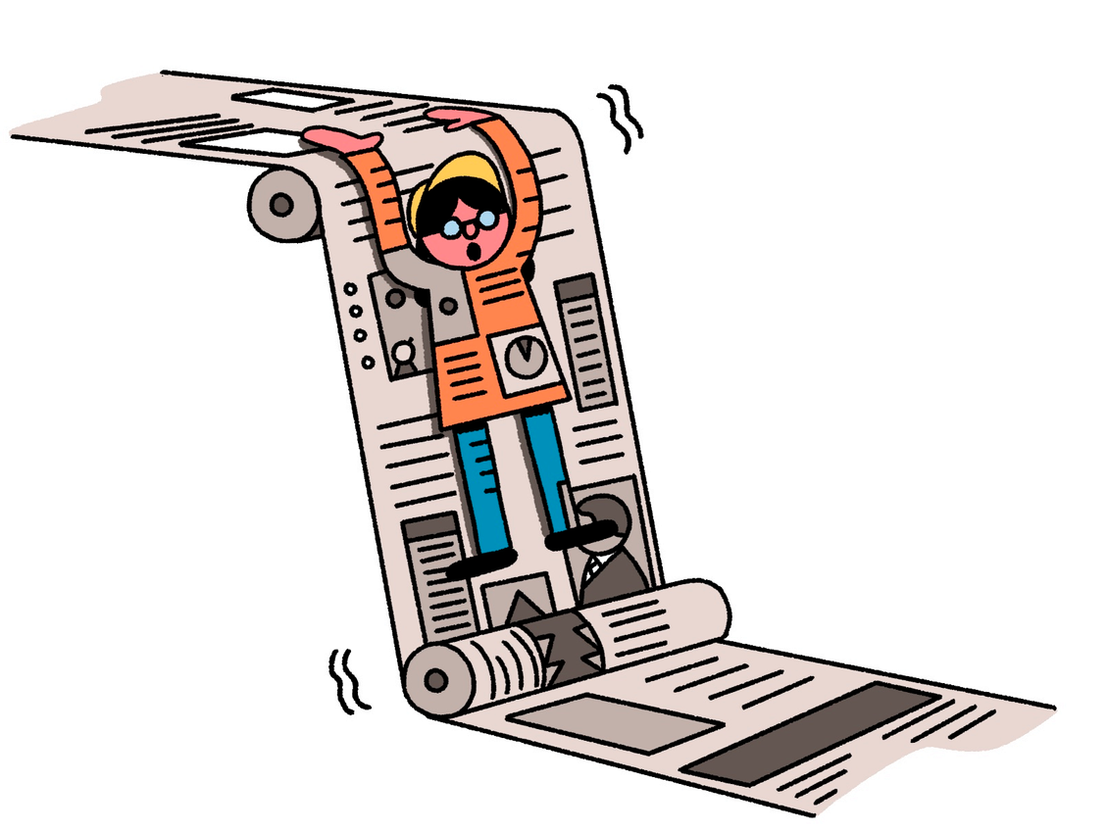
1
Read Nav’s story
2
Think about these questions...

Slide 15
Questions to think about
  Was it fair to share this information about Nav in a news story?
  What effect has this had on Nav/others (including on their feelings)?
  What should the news group have done instead?
  What should Nav do now?
  What’s the difference between a personal story and a public news story?

Slide 16
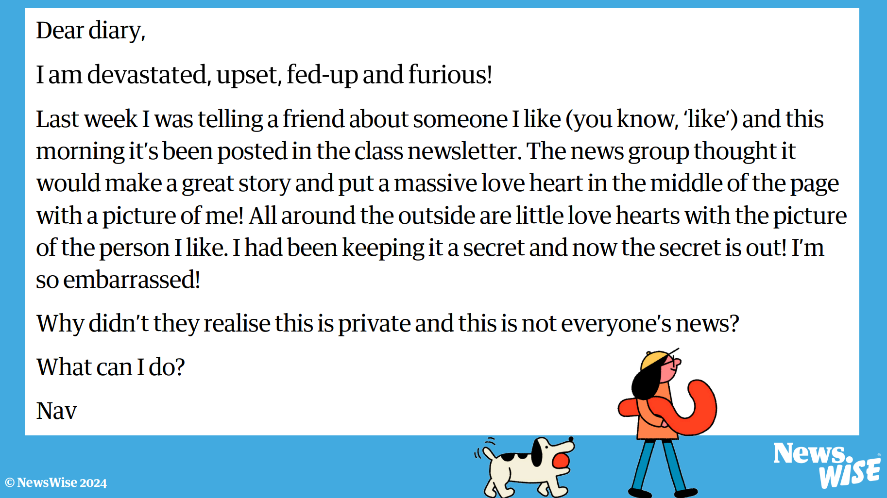

Slide 17
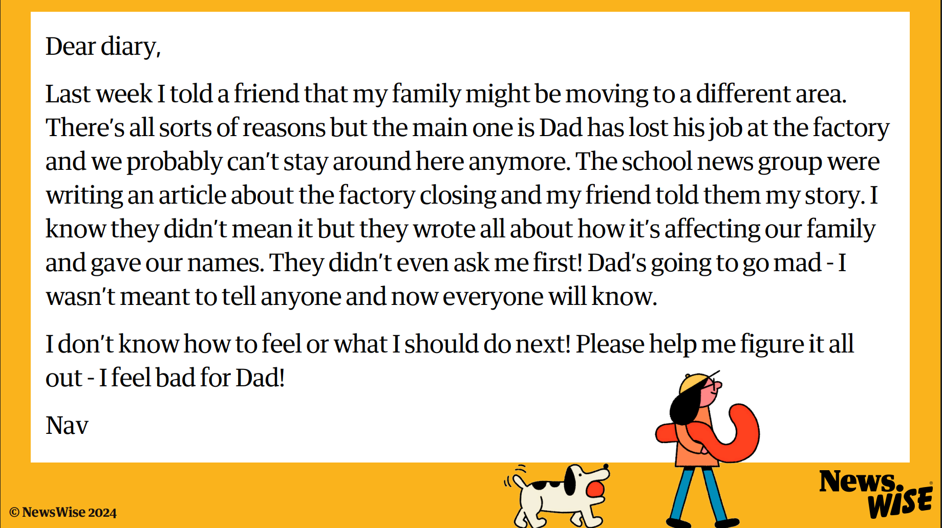
Notes:
The links below are for the stories that each of these statements are based on. These are for your reference only and it is not expected that these be shared with your class.
Mount Fuji fence: https://www.bbc.co.uk/newsround/68904168
Malaria vaccine: https://www.bbc.co.uk/newsround/articles/c4ng4wd4n68o
Hawaii train stations:
https://www.newsweek.com/hawaii-huge-milestone-rail-construction-project-hart-skyline-rapid-transit-1941045
Bear climbing fence: https://apnews.com/article/bear-climbs-fence-connecticut-governors-mansion-3b1aaf00afa14dc1c7e12ac0faf9d1b4
Mexico elects first woman president: https://www.bbc.co.uk/news/articles/cp4475gwny1o

Slide 18
Questions to think about
  Was it fair to share this information about Nav in a news story?
  What effect has this had on Nav/others (including on their feelings)?
  What should the news group have done instead?
  What should Nav do now?
  What’s the difference between a personal story and a public news story?

Slide 19
Let’s discuss
How can we be responsible news reporters?
We are going to write a class Code of Conduct for being a responsible news reporter.
  What does it mean to be ‘responsible’?
  What sort of things will will include?
Notes:
The links below are for the stories that each of these statements are based on. These are for your reference only and it is not expected that these be shared with your class.
Last coal power plant closes:
https://www.theguardian.com/business/2024/sep/30/end-of-an-era-as-britains-last-coal-fired-power-plant-shuts-down
Astronauts stuck in space:
https://www.bbc.co.uk/newsround/articles/cv2gydjy683o
Oil spill in Singapore:
https://www.bbc.co.uk/newsround/articles/cyjj9rx7l4po
Record number of sea turtle nests:
https://www.theguardian.com/environment/2024/sep/28/its-hugely-moving-record-numbers-of-sea-turtle-nests-recorded-in-greece
Rare plants on military base:
https://www.theguardian.com/science/2024/oct/16/plantwatch-military-training-ground-offers-surprise-haven

Slide 20
Extension
Imagine that Nav has written in to an advice page in the newspaper. Can you write back to Nav with some help and advice for managing the situation?
Remember there is no one ‘right’
way to feel about a news story and people manage their feelings in different ways.
Always talk to a trusted adult if you are worried or scared about something.

