Slide 1

Vocabulary to pre-teach
Newsworthy
A story that is important or interesting enough to be reported.
News criteria
The guidelines that journalists use to decide if a story is important enough to report on.
News conference
A meeting where journalists and editors come together to discuss the top news stories of the day.
Lead story
This is the first and most important news report in a newspaper.

Slide 2

Lesson 2
Identifying newsworthy stories

Slide 3

Learning objective
To know what makes a story newsworthy.
Journalist training school
Journalists must be able to identify newsworthy stories that will be interesting and informative for their audience.

Slide 4

Learning outcomes:
  Identify the main categories of news.
  Explain how news stories are chosen by desk editors.
  Use news criteria to justify why a news story is newsworthy.

Slide 5
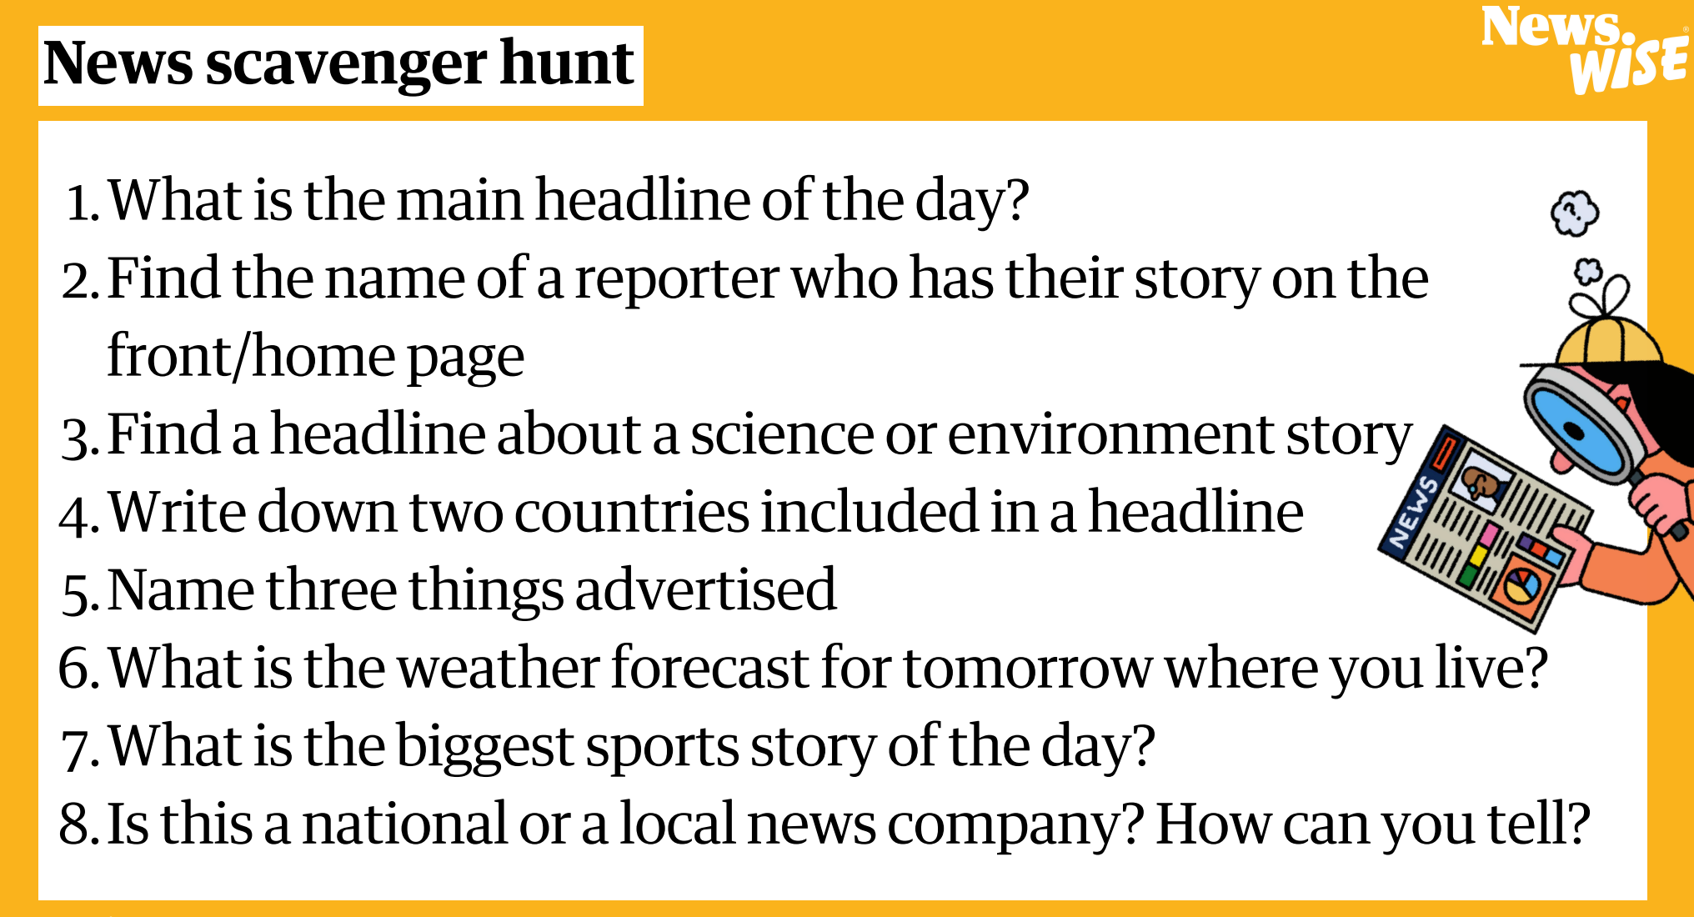

Slide 6
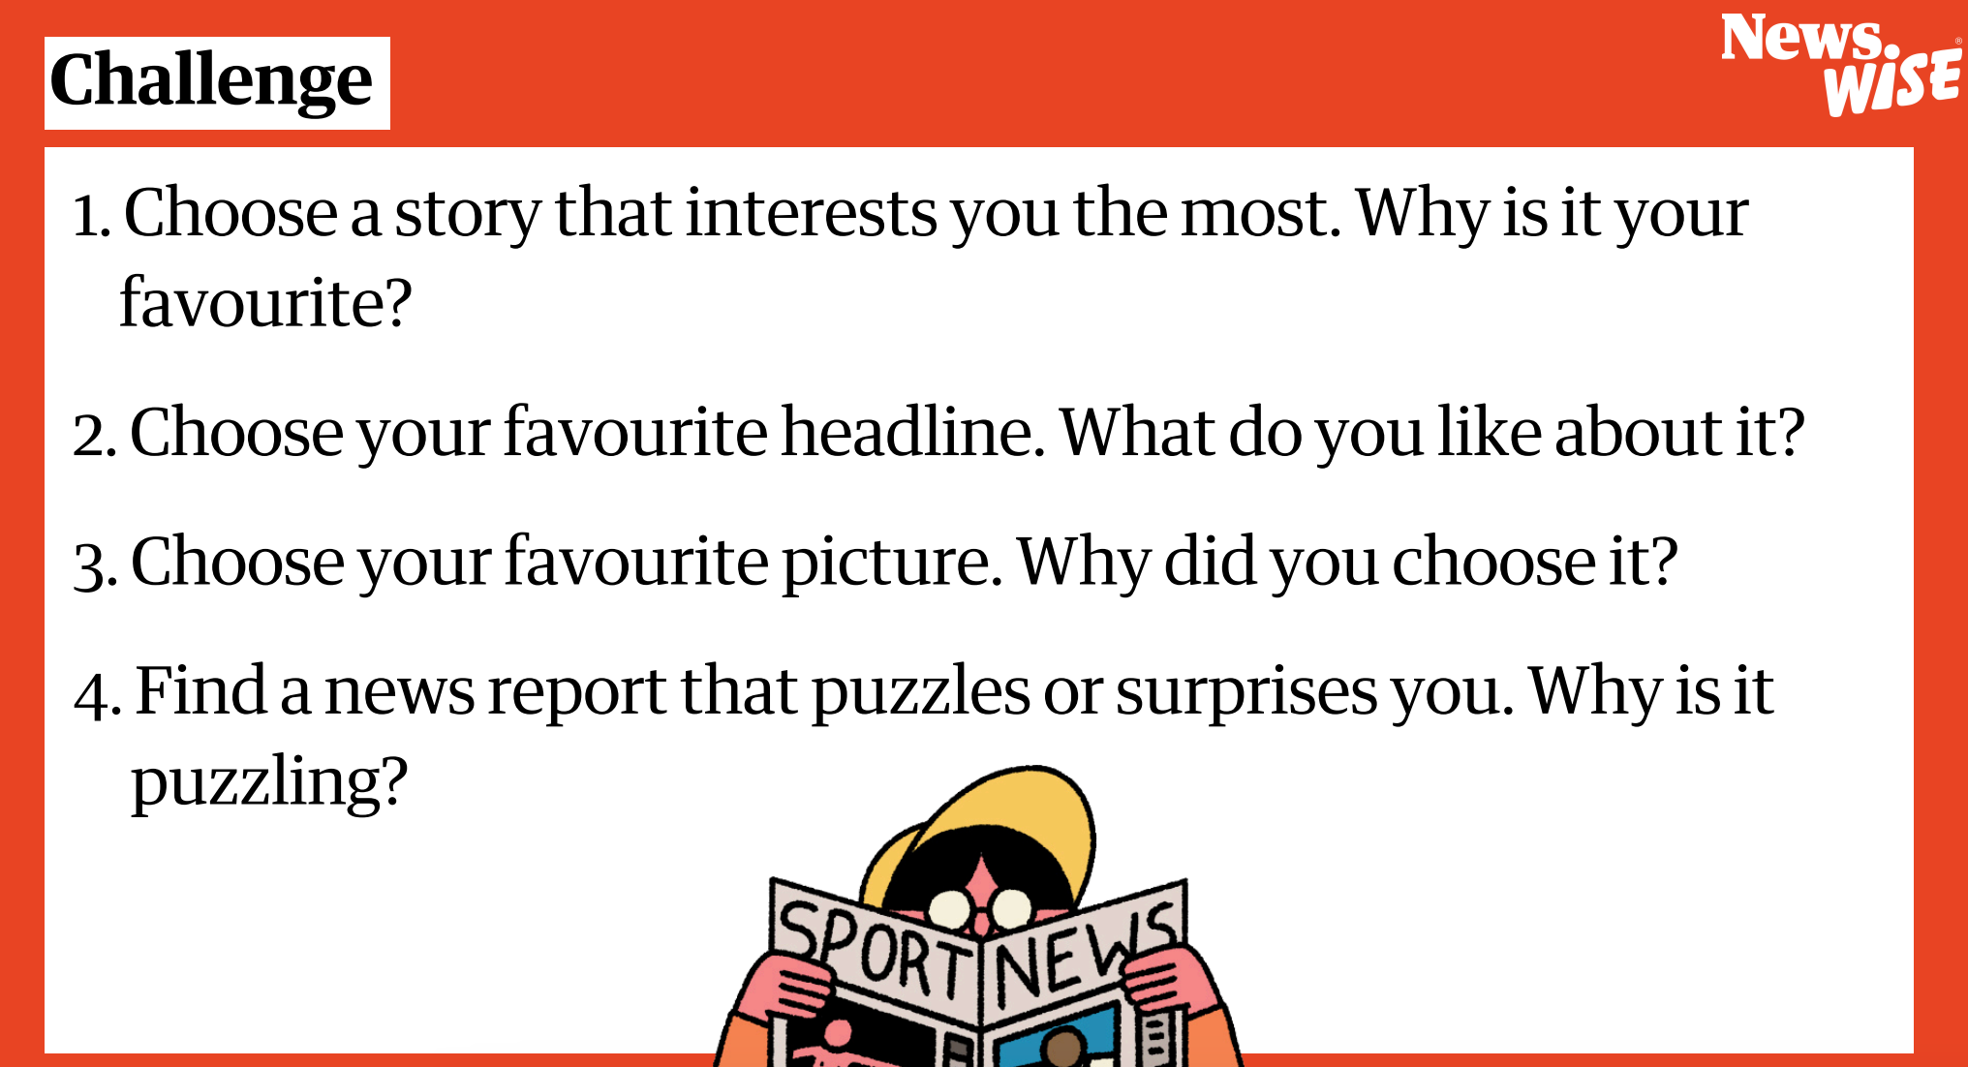

Slide 7

We are going to become desk editors.
What type of publication are we?
School
Newspaper
Community
Newspaper
It is our job to decide on the newsworthiness of potential stories to publish in the news.
National/
International
news

Slide 8

1
In your group, you will be allocated a section of our news publication: National, International, Science & Environment, Entertainment & Culture or Sport.

Slide 9

Categories of news
Some of the different categories of news you might see include...
national
Stories happening in your home country (eg the UK).
InTernational
News stories happening in other countries around the world.
SCIENCE
News stories about topics like: space, animals, plants, technology, environment.
Entertainment
News stories about topics like: TV, video, films, artists, dance, plays, books, video games, music.
Sport
News stories about any type of sport, including match reports and news about players.

Slide 10
1
In your group, you will be allocated a section of our news publication: National, International, Science & Environment, Entertainment & Culture or Sport.
2
Choose three stories from your list of stories that you think are newsworthy enough to report on in your section of our news publication.
3
Use the news criteria to help justify your choices and be ready to share.

Slide 11
News criteria
Subject
Who is the story about?
A story is more newsworthy if it is about lots of people, an important/famous person or a surprising person (e.g. young, old, from the local area).
Surprising
Will the story surprise people?
A story is more newsworthy if it is unexpected or surprising, or if it informs people about something they didn’t already know.

Slide 12
News criteria
Place
Where did the story happen?
A story is most newsworthy to the people closest to it. A story happening in your area will probably be more interesting to you than to people living in another town/region/country.
Time
When did the story happen?
A story is more newsworthy if it has only just happened or if it is the first time it has happened.

Slide 13

National news
  A new discount shop has opened in our high street.
  A woman was fined £500 after leaving furniture outside for people to take for free.
  The UK has elected a new Prime Minister.
  A climate protester has been sentenced to five years in prison.
  A rare Roman mosaic has been discovered in a village.
Notes:
The links below are for the stories that each of these statements are based on. These are for your reference only and it is not expected that these be shared with your class.
New discount shop: https://www.kidderminstershuttle.co.uk/news/24608786.kidderminster-new-shop-brands4less-opens-town-centre/
Woman fined £500: https://www.bbc.co.uk/news/articles/c9qvvpe9rw4o
UK elects new prime minister:
https://www.bbc.co.uk/newsround/articles/cxx2pd3r538o
Climate protester sentenced to five years:
https://www.theguardian.com/environment/article/2024/jul/18/five-just-stop-oil-supporters-jailed-over-protest-that-blocked-m25
Rare Roman mosaic found:
https://www.bbc.co.uk/newsround/articles/ceq599eqxdro

Slide 14
International news
  A fence has been put up to stop tourists taking too many pictures of Mount Fuji in Japan.
  A new vaccine for malaria could save lives in Ivory Coast.
  Six new train stations will be built in Hawaii.
  A bear has been spotted climbing over a fence in the USA.
  Mexico has elected its first woman president.
Notes:
The links below are for the stories that each of these statements are based on. These are for your reference only and it is not expected that these be shared with your class.
Mount Fuji fence: https://www.bbc.co.uk/newsround/68904168
Malaria vaccine: https://www.bbc.co.uk/newsround/articles/c4ng4wd4n68o
Hawaii train stations:
https://www.newsweek.com/hawaii-huge-milestone-rail-construction-project-hart-skyline-rapid-transit-1941045
Bear climbing fence: https://apnews.com/article/bear-climbs-fence-connecticut-governors-mansion-3b1aaf00afa14dc1c7e12ac0faf9d1b4
Mexico elects first woman president: https://www.bbc.co.uk/news/articles/cp4475gwny1o

Slide 15
Science & environment news
  The last coal power plant in the UK has been shut down.
  Two astronauts are stuck in space after problems with their spaceship.
  Some beaches in Singapore have turned black after a massive oil spill.
  Record numbers of sea turtle nests have been recorded in a Greek island.
  Many rare plants have been found in an army
training base.
Notes:
The links below are for the stories that each of these statements are based on. These are for your reference only and it is not expected that these be shared with your class.
Last coal power plant closes:
https://www.theguardian.com/business/2024/sep/30/end-of-an-era-as-britains-last-coal-fired-power-plant-shuts-down
Astronauts stuck in space:
https://www.bbc.co.uk/newsround/articles/cv2gydjy683o
Oil spill in Singapore:
https://www.bbc.co.uk/newsround/articles/cyjj9rx7l4po
Record number of sea turtle nests:
https://www.theguardian.com/environment/2024/sep/28/its-hugely-moving-record-numbers-of-sea-turtle-nests-recorded-in-greece
Rare plants on military base:
https://www.theguardian.com/science/2024/oct/16/plantwatch-military-training-ground-offers-surprise-haven

Slide 16
Entertainment & culture news
  Patrice Lawrence has been named the new children’s laureate.
  A local theatre has closed down after running out of money.
  Bafta awards will be given to children’s TV shows from next year.
  Taylor Swift has donated $5 million to charities after a hurricane caused major damage in the USA.
  A piece of art featuring 125 inflatable penguins will
  go on display.
Notes:
The links below are for the stories that each of these statements are based on. These are for your reference only and it is not expected that these be shared with your class.
Cottrell Boyce named children's laureate:
https://www.theguardian.com/books/article/2024/jul/02/frank-cottrell-boyce-new-childrens-laureate
Local theatre closes down:
https://www.bbc.co.uk/news/articles/cy9xp5x5ekgo
Bafta awards for children's TV:
https://www.theguardian.com/tv-and-radio/2024/sep/22/cbeebies-at-the-baftas-awards-aim-to-revive-magic-of-kids-tv
Taylor Swift donates to charity:
https://www.theguardian.com/music/2024/oct/10/taylor-swift-donates-5m-hurricane-relief-efforts-helene-milton
Art installation with 125 inflatable penguins:
https://www.theguardian.com/artanddesign/2024/oct/10/frieze-london-art-fair-penguins

Slide 17
Sport news
  Paralympic swimming champion visits local primary school.
  16-year-old darts player has reached the final of the world championship.
  Football fans are complaining about pigeon poo at their football team’s stadium.
  An American woman won the Gloucestershire cheese-rolling competition for the second time .
  Nearly 2,000 runners attended a parkrun* event
on its 20th anniversary.
*a free 5 km fun run that takes place every Saturday in parks all over the world
Notes:
The links below are for the stories that each of these statements are based on. These are for your reference only and it is not expected that these be shared with your class.
Paralympic swimming champion: Based on real event, but no published news report available.
16-year-old reaches darts final: https://news.sky.com/story/luke-littler-16-year-old-reaches-world-darts-championship-final-with-victory-over-rob-cross-13041063
Football fans complain about pigeon poo:
https://www.bbc.co.uk/news/articles/cvg318x7zzlo
American woman wins second cheese-rolling title:
https://www.theguardian.com/uk-news/article/2024/may/27/gloucestershire-cheese-rolling-race-coopers-hill-international-appeal
2,000 runners attend parkrun anniversary event:
https://www.theguardian.com/lifeandstyle/2024/oct/05/parkrun-at-20-years-old-how-a-gentle-jog-turned-into-a-5km-saturday-morning-obsession

Slide 18
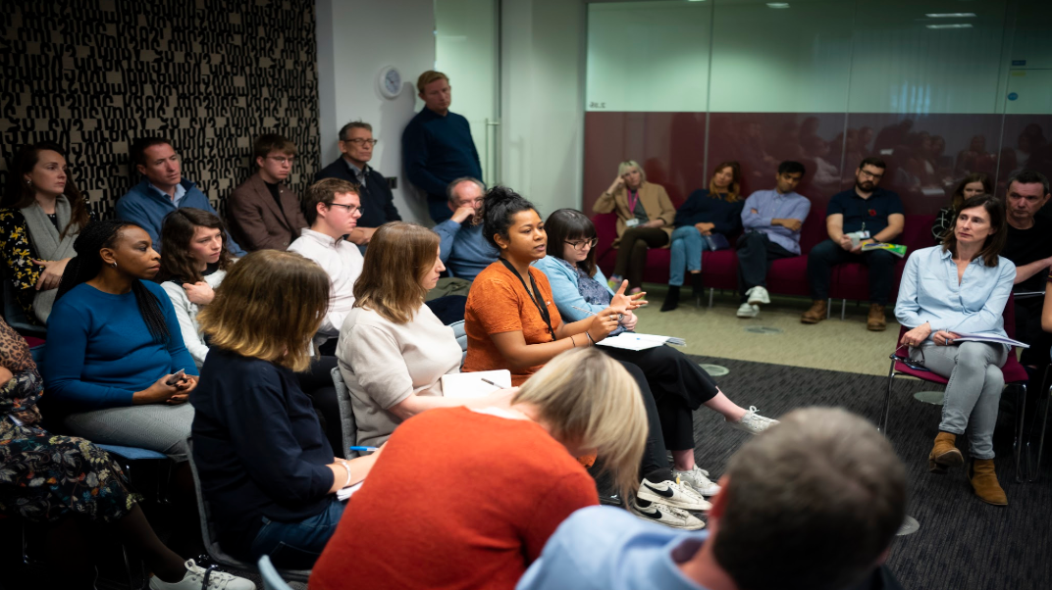

News conference
Every day in the newsroom, journalists and editors meet to discuss what stories they are going to report on that day.
Journalists in conference at The Guardian

Slide 19


News conference
It’s time to share your chosen stories!
What is the story informing your audience about?
Why would this story be interesting for your audience?
What is the purpose of the story?
Which of your stories should feature as the lead story on the front page?

Slide 20
Let’s discuss
  What would the world be like without news?
  What would happen if news companies didn’t exist?
  What would happen without news?
  What would people no longer be able to find out?

