Slide 1

Vocabulary to pre-teach
Page furniture
Everything on a news page that isn’t the report or photos, eg headlines, captions.
Headline
A phrase that summarises the main point of the article. Headlines are in large print and aim to catch the attention of the reader.
Caption
A brief description of a photograph.
Redundant words
Not needed or no longer needed.
Puns
Using words with multiple meanings to make jokes. Often used in headlines.
Powerful verbs
Action words that are descriptive and exciting.
Byline
The name of the person who wrote the report.
Standfirst
a very short summary of the story. It goes underneath the headline and includes a few more details than the headline.

Slide 2
Lesson 15
Producing a finished news report

Slide 3

Learning objective
To publish a news report with ‘page furniture’
Journalist training school
Pictures and ‘page furniture’ make people want to read a news report and add more information. They must be truthful, fair, balanced and interesting.

Slide 4

Learning outcomes:
  Write a headline for a news report.
  Select interesting pictures and write captions to add further information.
  Present a finished news report to peers, reflecting on skills and knowledge learned.

Slide 5


Headlines
A headline goes at the top of a news story and summarises the story in an interesting way. Headlines are often designed to encourage a reader to read the full story.

Slide 6
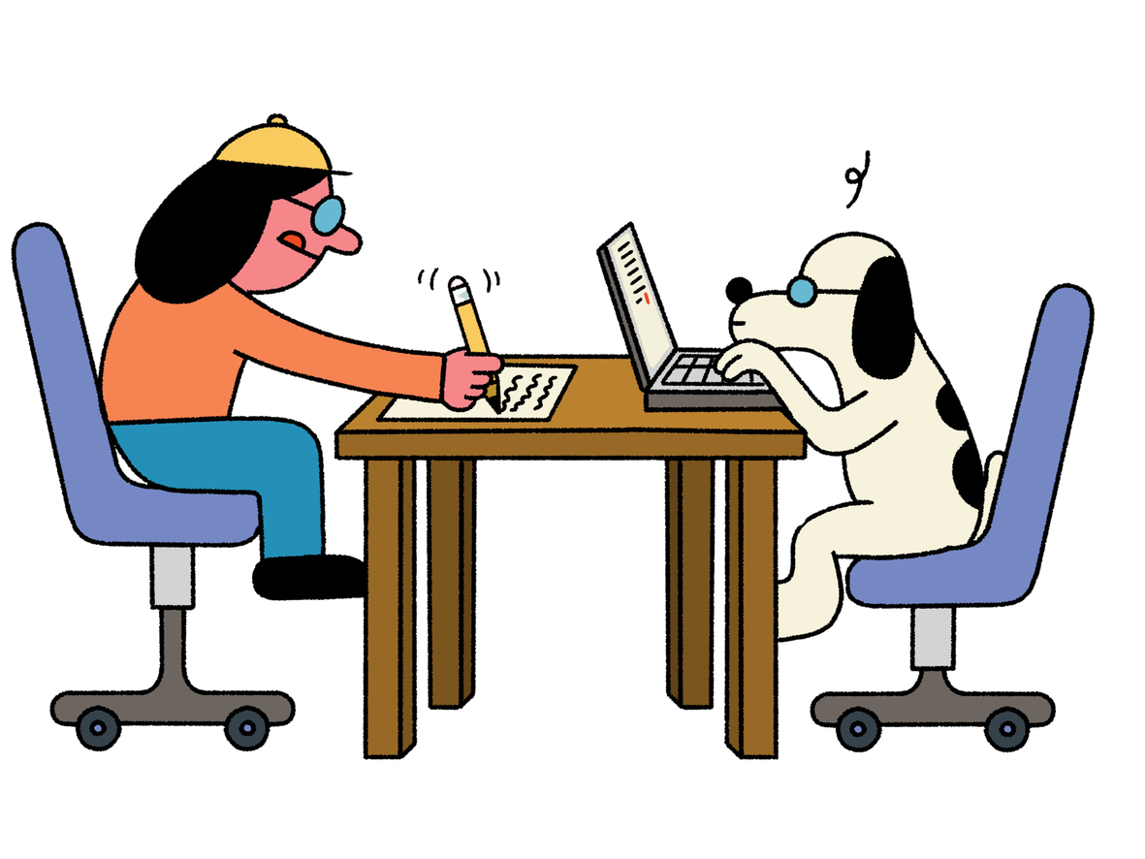
Headline editing
Read these news stories and choose a
the best headline for each one.
  Which is the best headline and why?
  Does it summarise the story in a fair and balanced way?
  Does it create interest in the story?

Slide 7
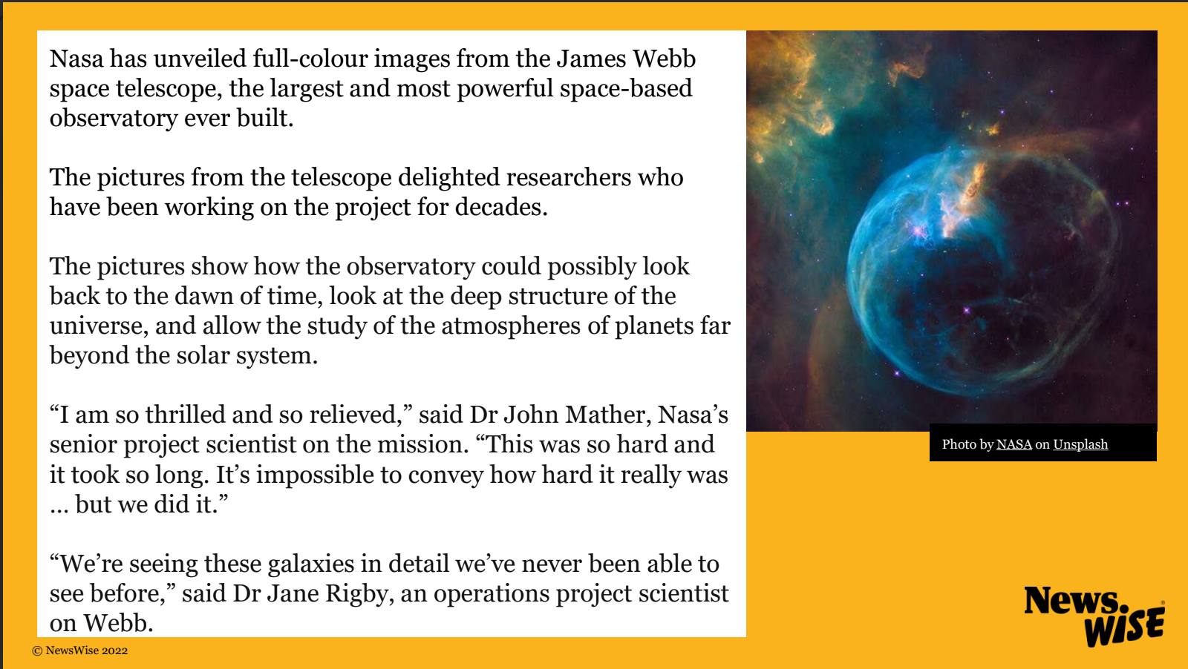

Slide 8
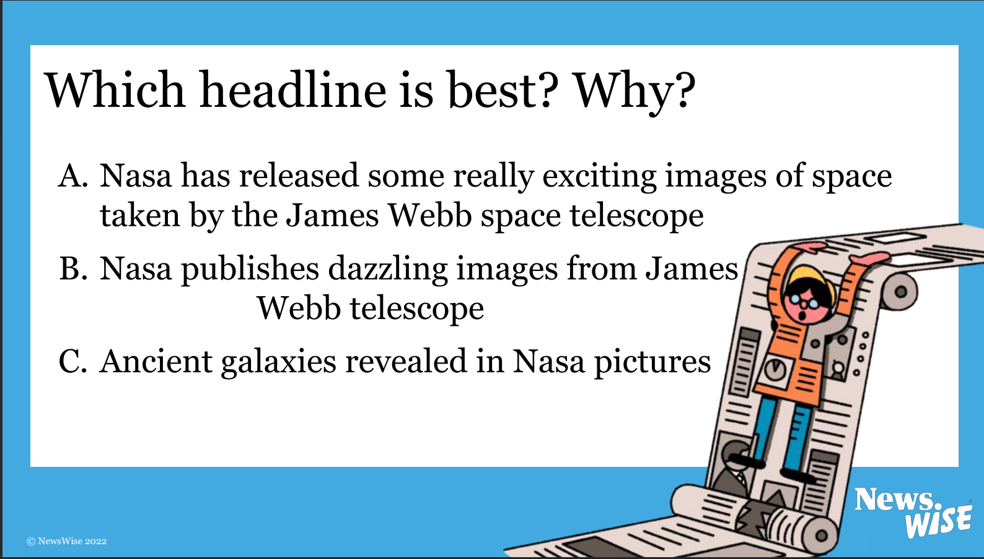

Slide 9


Slide 10
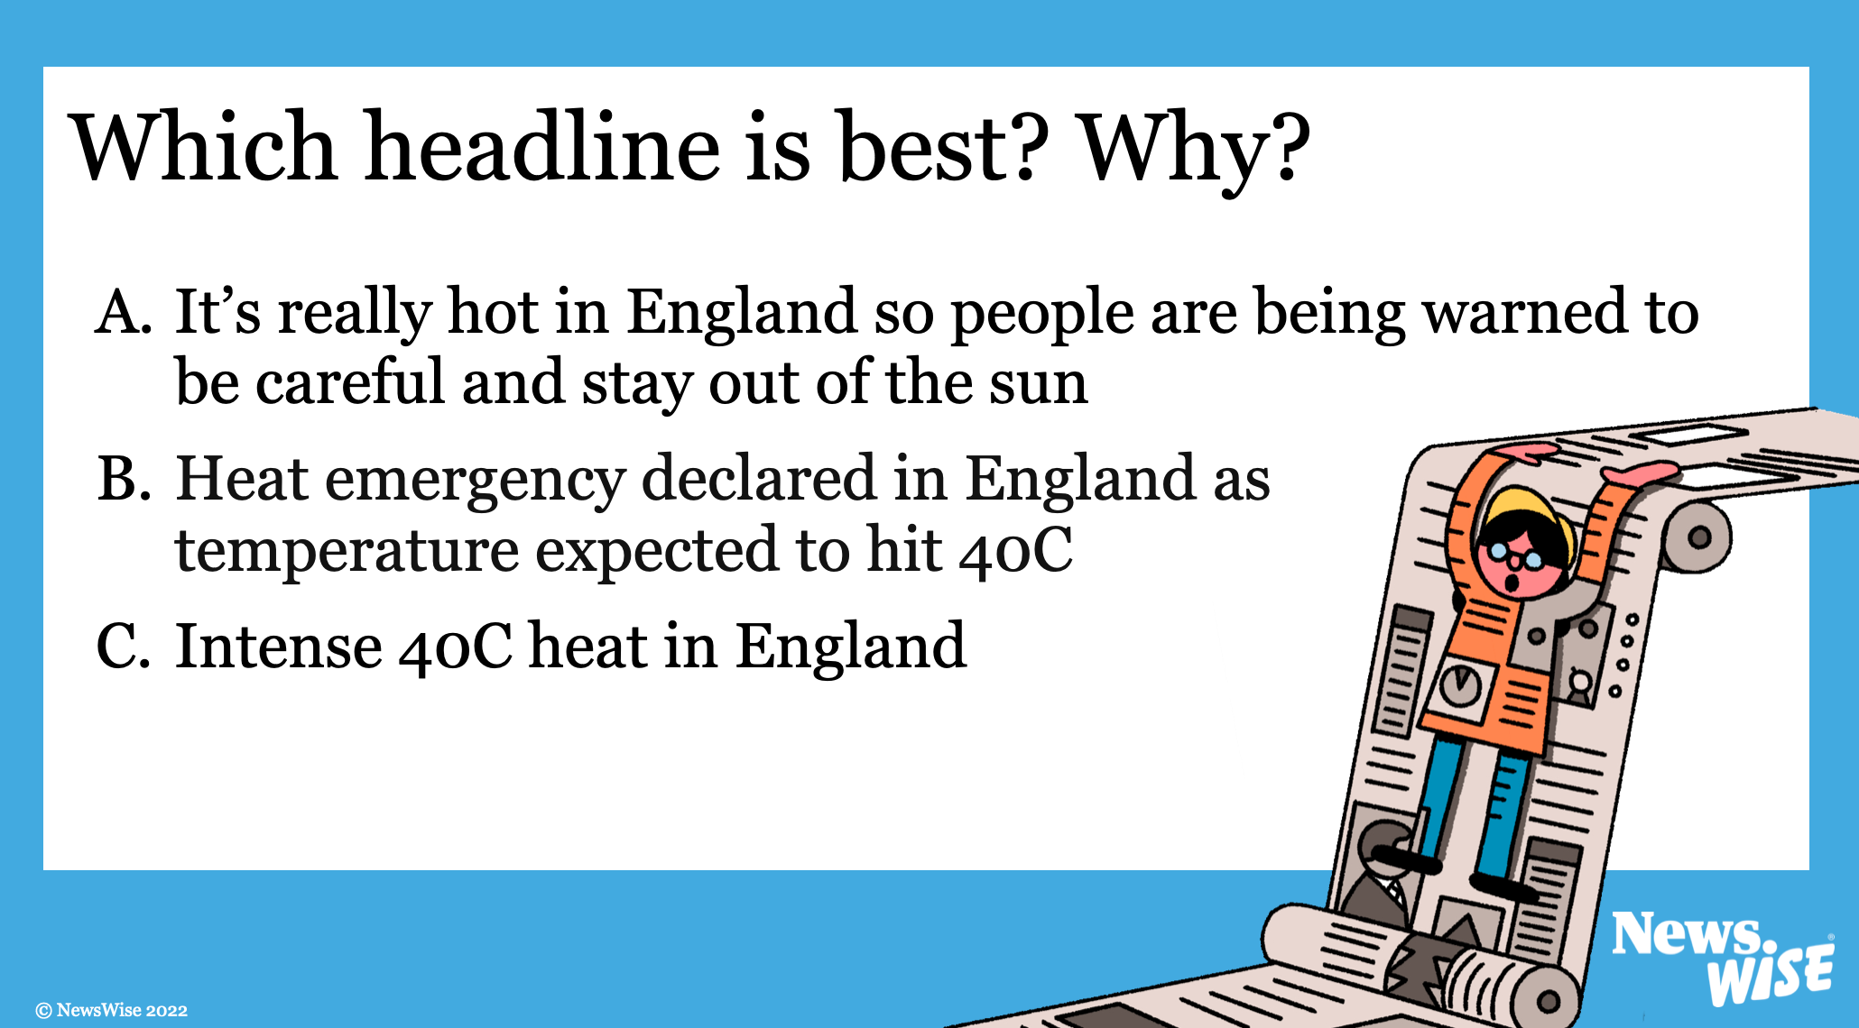

Slide 11
The language of headlines
Headlines can use different language techniques to summarise a story and make it sound interesting.
Some of these are:
  Using subject-verb-object
  alliteration
  puns
  powerful verbs

Slide 12
Subject-verb-object
Subject
verb
object
Man
walks on
moon
Primary school
stops
homework
Boy
eats
500 eggs

Slide 13
Alliteration
Travelling turtles take the train
Seven seals swim to safety
Amazing artist wins award
Can you come up with an alliterative headline?

Slide 14
Puns
Baa-rilliant sheep win competition
Hat-trick footballer has a ball
Farmer reveals berry good news
Can you come up with a headline with a pun?

Slide 15
Stun
Win
Powerful verbs
Crash
Grab
Announce
Claim
Climb
Launch
Reveal
Smash
Defeat
Boost
Rise
Can you come up with more powerful verbs?

Slide 16
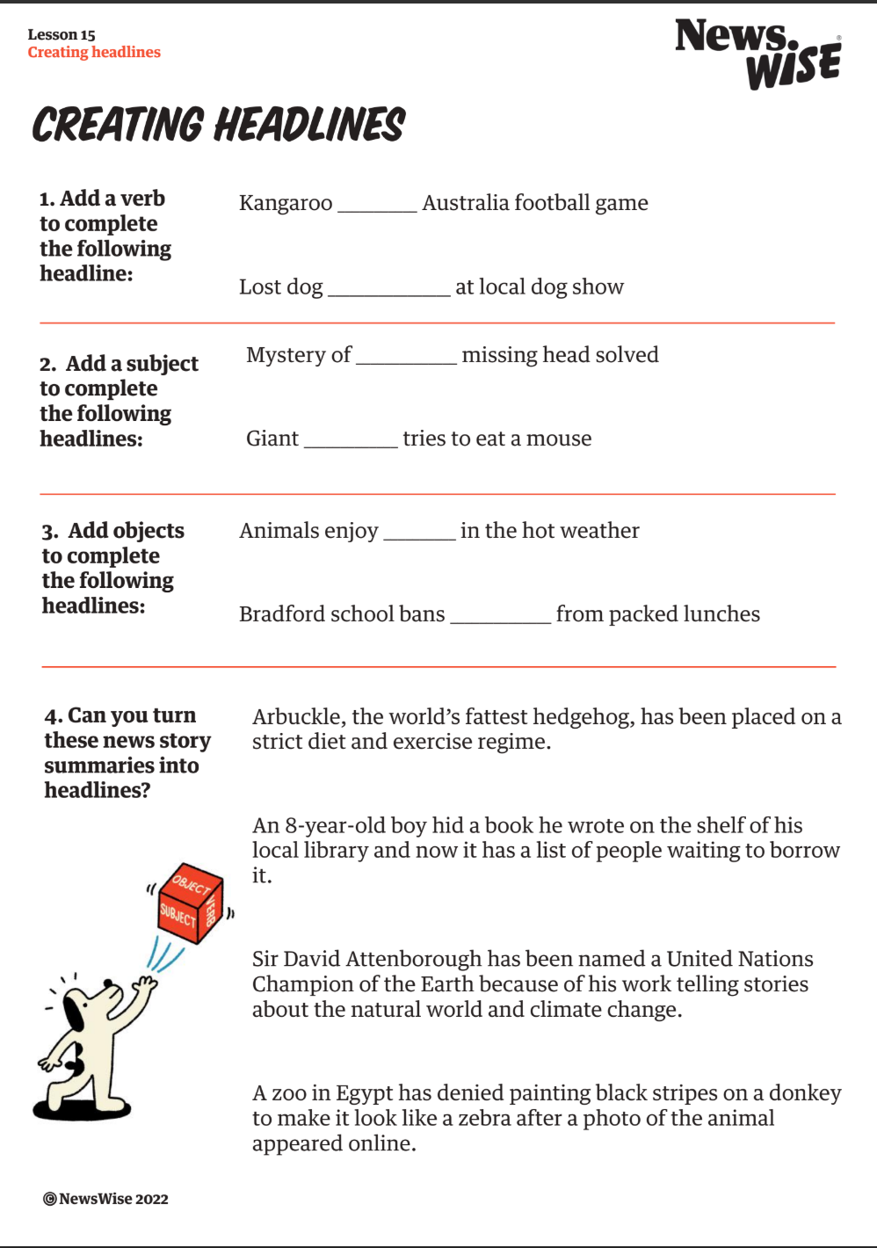
Your turn!

Slide 17
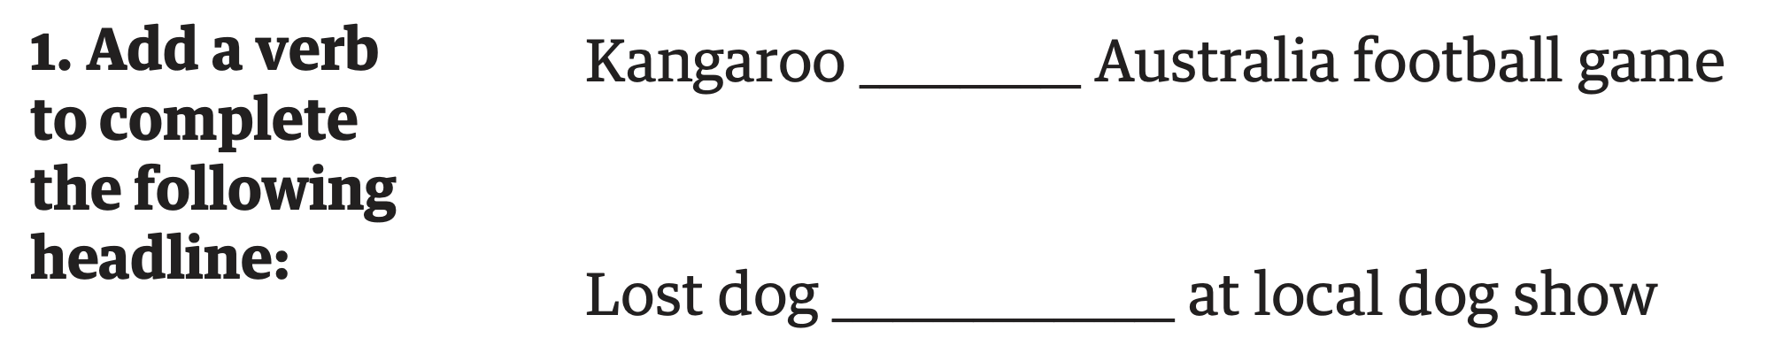
Your turn!

Slide 18
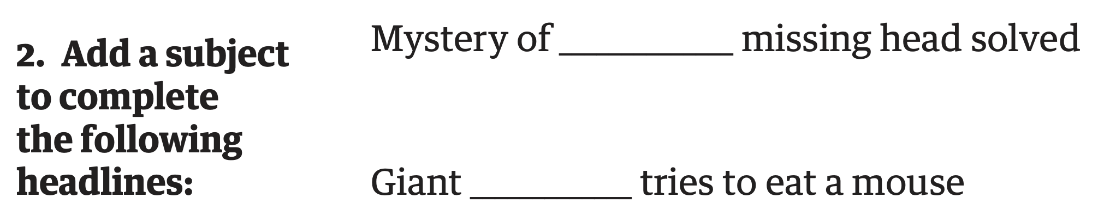
Your turn!

Slide 19
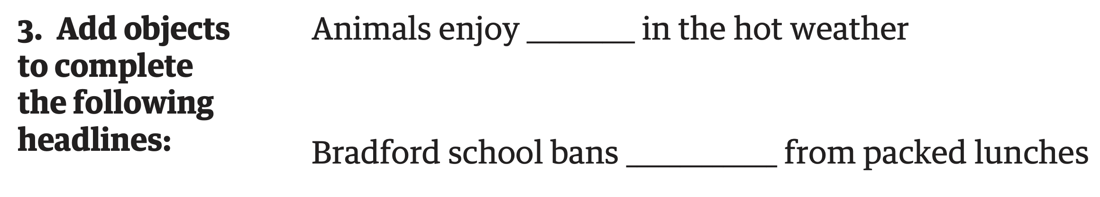
Your turn!

Slide 20
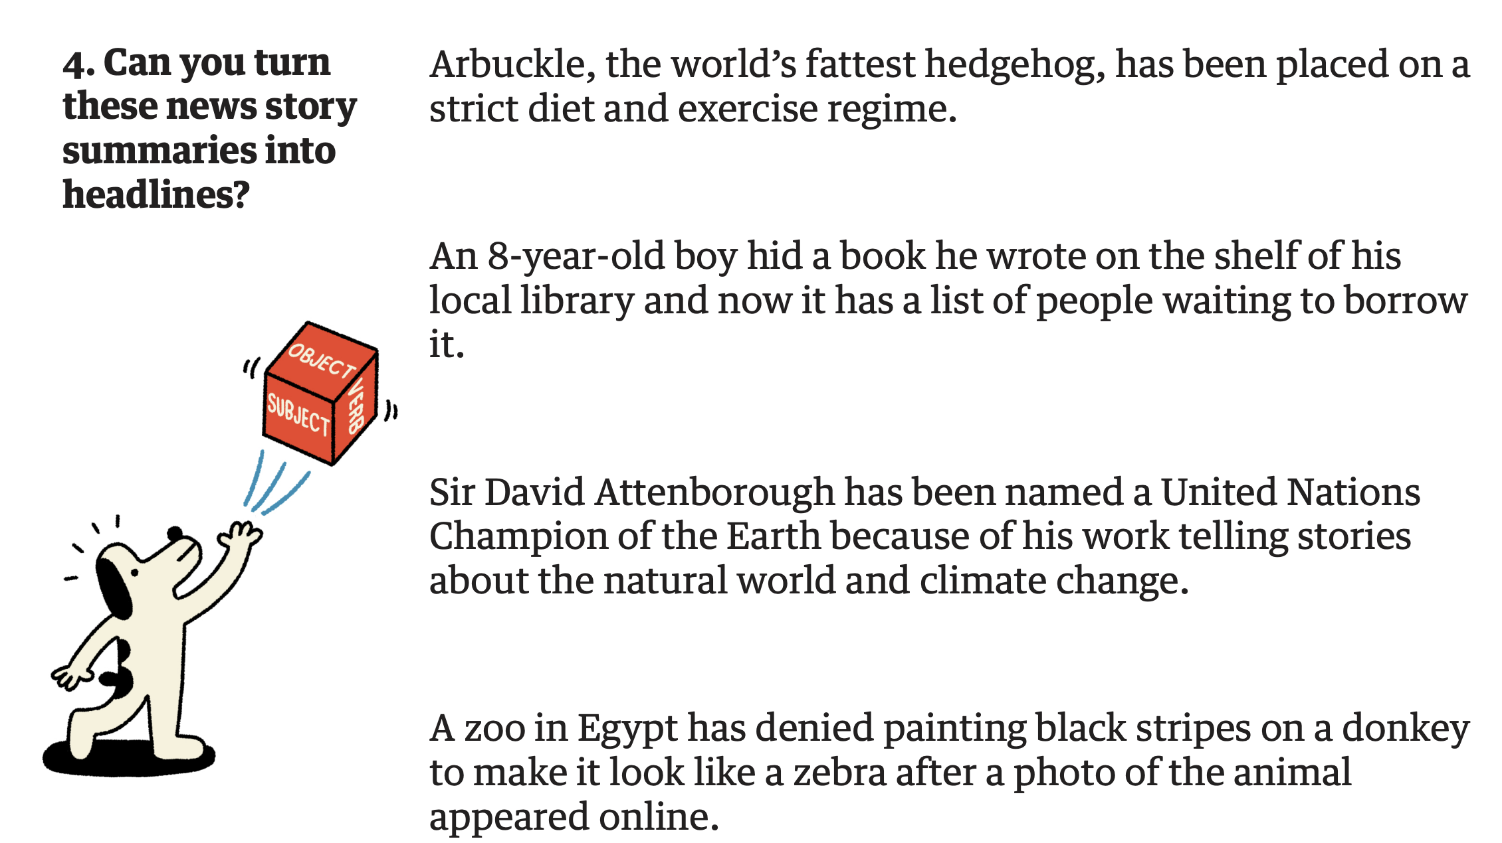
Your turn!

Slide 21
Page furniture
Now you’ve written your report, it’s time to add the page furniture!
Page furniture is all the extra bits that go into a news report to make it really look like a news report.
Page furniture also means journalists can add more information to their reports.
In the newsroom, the page furniture is always added last, after the report has been written and edited.

Slide 22


Page furniture
Masthead (the name of the newspaper/ news organisation)
Date
Headline
Byline (the journalist’s name)
Picture
Caption
Report

Slide 23
Top tips!
Headlines
Headlines should draw attention to the report and tell us what the story is about. The headline should make us want to find out more
Pictures
The picture should tell us a bit more about the story and makes the report more interesting. Pictures with people in are more interesting for the reader.
Captions
Picture captions are an opportunity to tell us a bit more about the story - you can squeeze in a few extra words! Avoid just describing the picture and tell us what is happening in it.

Slide 24
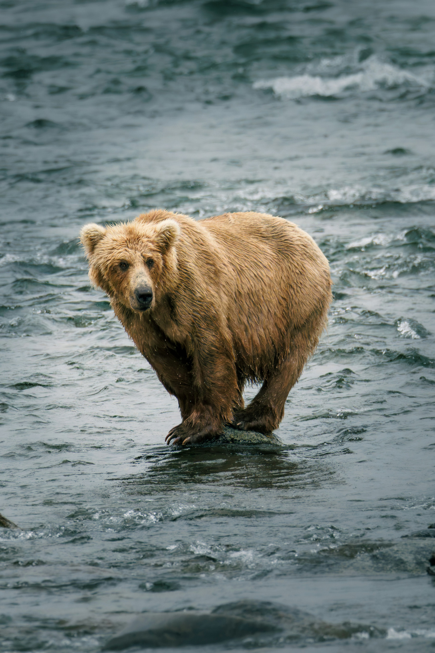
Pictures and captions
Which caption is best?
1
A picture of a bear standing on a rock
2
A bear waits patiently to hunt salmon before hibernation
Photo by Cal Rollins on Unsplash

Slide 25
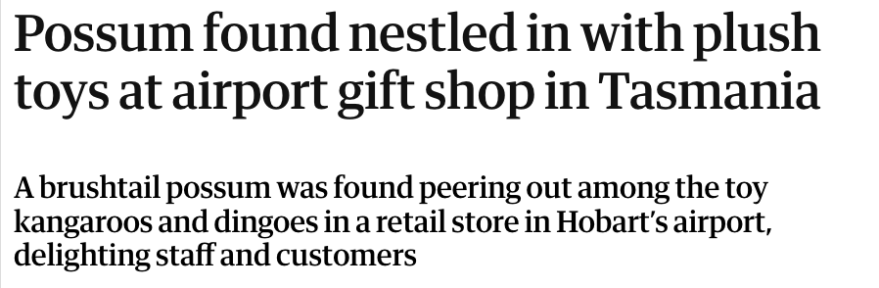
Challenge!
Standfirsts
A standfirst is a very short summary of the story. It goes underneath the headline and includes a few more details than the headline.
Headline
Standfirst

Slide 26

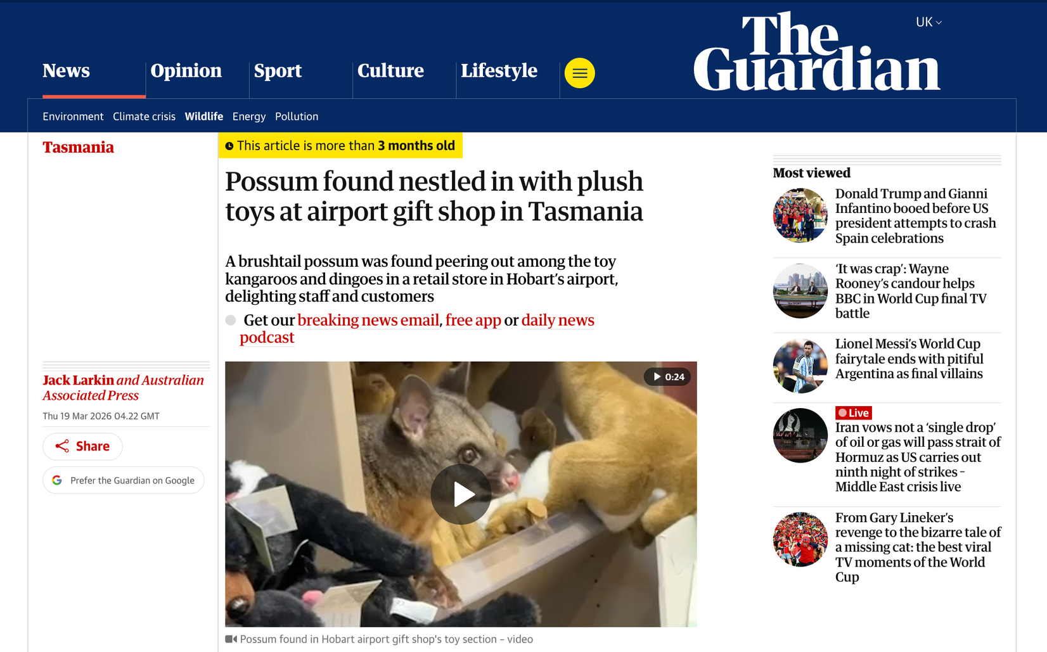
Masthead
Headline
Byline
Standfirst
Date
Picture/ video
Caption

Slide 27
Your turn!
Add your page furniture

Slide 28
Turn and talk
Swap your news report with a partner.
Give feedback on each other’s page furniture.
  Is the headline catchy?
  Are there any redundant words in the headline?
  Is the headline balanced and truthful?
  Does the picture grab people’s attention?
  Do the picture captions add extra, interesting information about the story?

Slide 29
Let’s discuss
Well done on completing your news report!
Share your news reports as a class
  What are you most proud of?
  How did you ensure that your story was truthful, fair, balanced and interesting?
  How do you think your readers will react to your stories?
  What would you do differently if you were to do this again?

Slide 30

Let’s discuss
  What are you most proud of?
  How did you ensure your story was truthful, fair, balanced and interesting?
  How do you think readers will react to your stories?
  What would you do differently if you were to do this again?

Slide 31

Congratulations!
Mission complete!

