Slide 1

Vocabulary to pre-teach
Nose the story
Identify the newsworthy facts of a story
Redundant words
Not needed or no longer needed
Subediting
The process of checking, correcting, and improving a draft news report. Double-checking the facts, and writing headlines and captions
Redrafting
Improving, changing, and polishing a first piece of journalism to make it clearer, more engaging, and factually correct.
Proof reading
The process of carefully checking a piece of writing to find mistakes, correct errors and improve clarity

Slide 2
Lesson 14
Subediting
news reports

Slide 3

Learning objective
To edit and redraft a news report
Journalist training school
Subeditors play an important role in news publishing. Without them, reports could be boring and confusing, or full of mistakes and things that aren’t true!

Slide 4
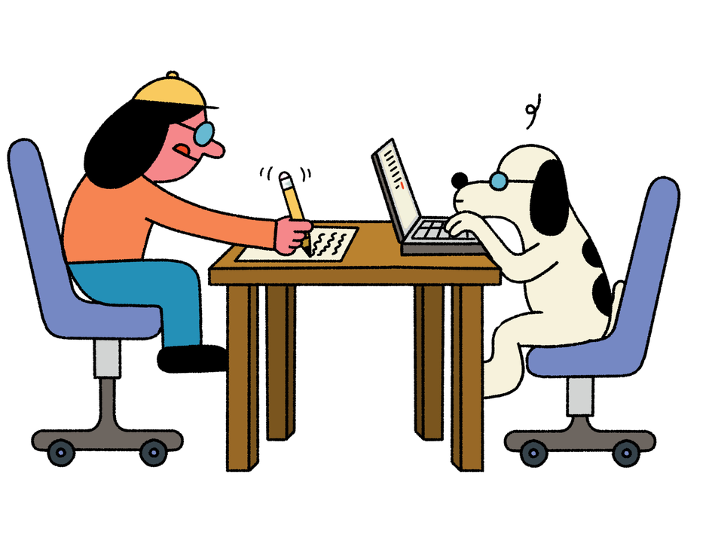
Learning outcomes:
  Proofread a news report for spelling, grammar and punctuation errors.
  Identify whether the first paragraph of a news report includes all of the key information.
  Redraft a news report, making changes to improve the effectiveness of writing.

Slide 5

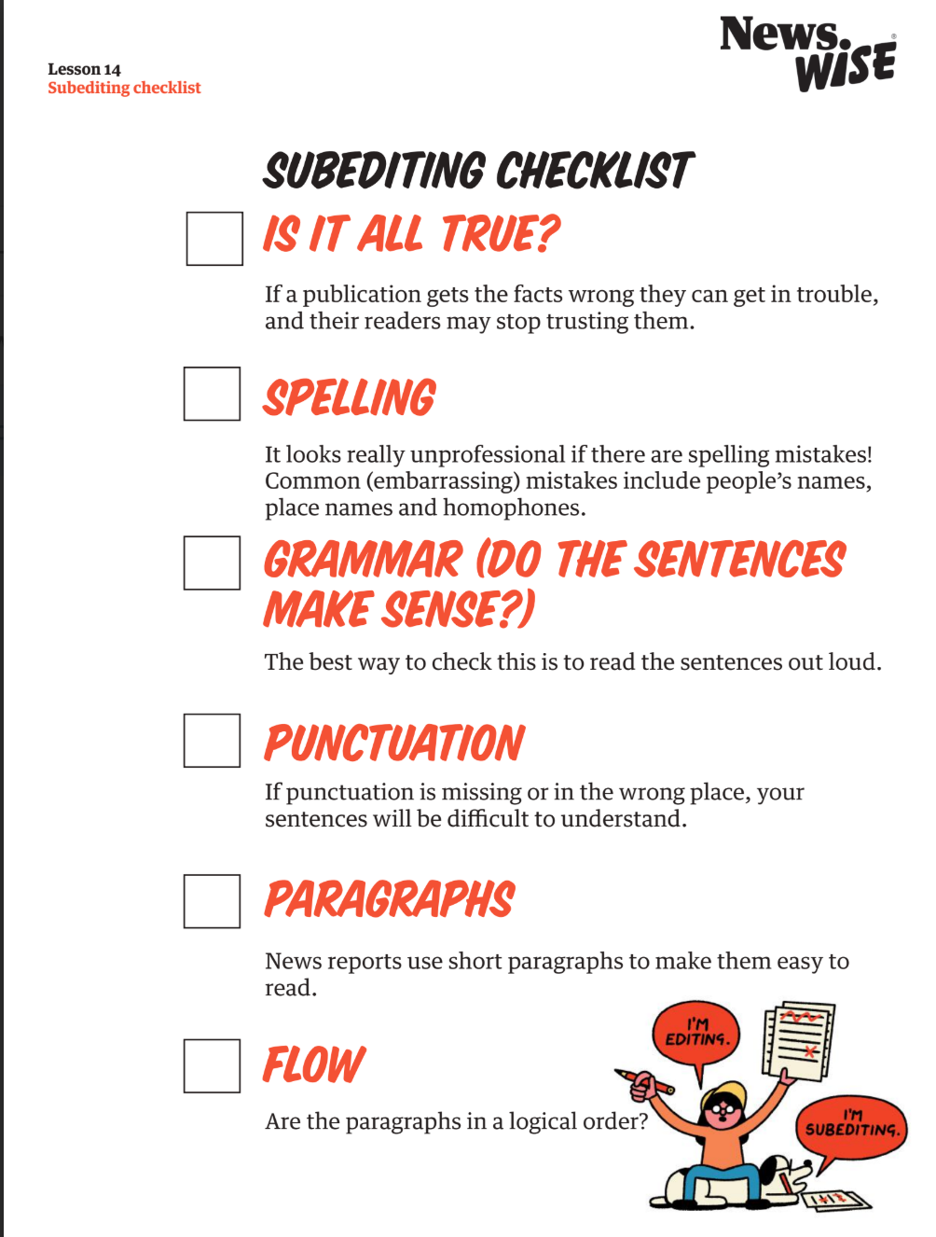
Peer subediting
You are a subeditor.
A subeditor first checks a news report through carefully for accuracy and readability.
Using the subediting checklist, read through a partner’s news report. Highlight or underline anything you notice and discuss this with them.

Slide 7
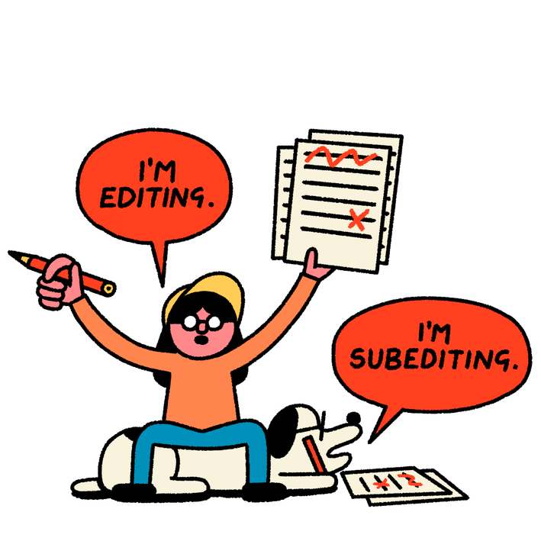
Nose the story
‘Nosing the story’ means identifying the most important and interesting piece of information, and making sure it is the first thing mentioned in the report.
This usually means the story will start with the ‘Who’ or the ‘What’ of the story (never the date - ‘On Monday 11 June …’ is not the most interesting thing!)

Slide 8
Nose the story
Read your first paragraph aloud to your partner.
As you listen, think about these questions and give feedback to your partner:
  Do they tell the reader all the key information they need to know?
  Do they contain each of the 5 Ws?
  Do they mention the most interesting thing first (the ‘who’ or the ‘what’ of the story)?
  Does it make the reader want to find out more?

Slide 9
Concise writing
Concise writing is about keeping to the point and avoiding unecessary words. This is a key skill for a journalist!
Read the original story and compare it to the improved version.
What did they change and why?

Slide 10
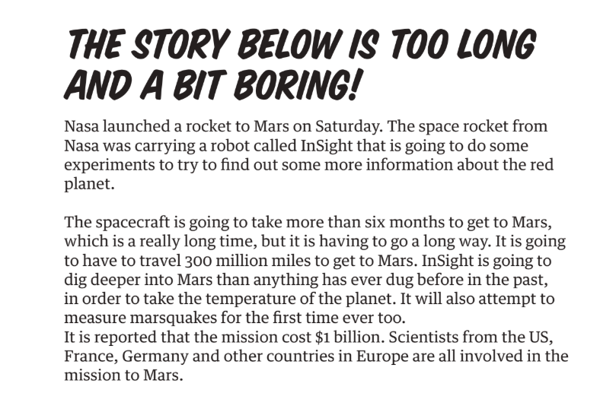
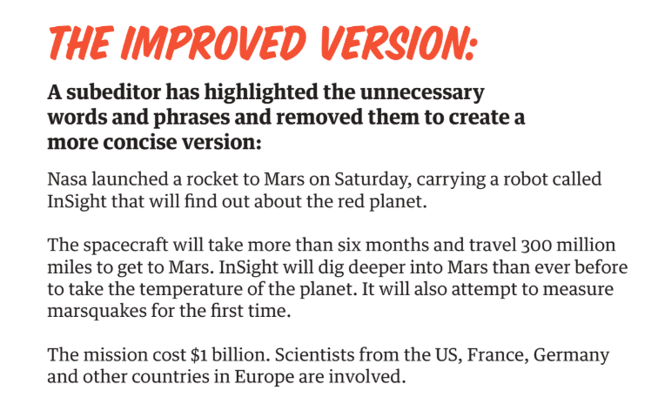
What did the subeditor change and why?

Slide 11
Your turn!
Read your report and remove any redundant words

Slide 12
Writing your final report!
Now it’s time to write up your final news report!
Remember all the changes you made when you subedited your report.
Don’t add your headline, picture, caption, byline or date yet - you will add all these features (page furniture) in the next lesson

Slide 13
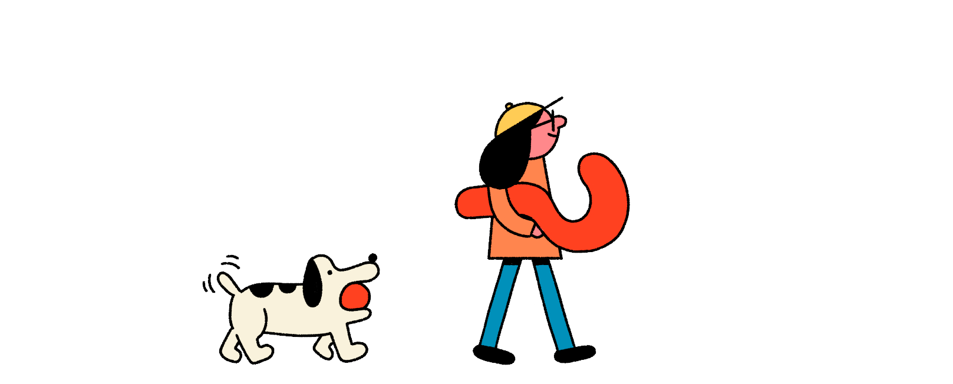
Let’s discuss
  Who found at least one mistake in the work they were subediting?
  How has your writing improved now that it has been subedited
  Why is subediting an important process of writing news stories?

