Slide 1

Vocabulary to pre-teach
Relative clauses
A type of subordinate clause that adds extra information about a noun, usually starting with a relative pronoun like who, which, that, or where
Subordinating conjunctions
Words like because, although, and, if, that link a main clause to a subordinate clause
Formal language
Using serious, objective, and factual vocabulary instead of casual, everyday speech
Concise
Short and clear
Direct speech
The actual words of the speaker.
Reported speech
A speaker’s words paraphrased by a reporter, eg ‘He said that he was happy’.

Slide 2
Lesson 13
Writing
news reports

Slide 3

Learning objective
To inform and engage an audience with the first draft of our news reports
Journalist training school
Reporters should aim to write news reports which are truthful, fair, balanced and interesting. They must use the evidence that they have collected during interviews and within their research. They also have to meet their deadline!

Slide 4

Learning outcomes:
  Write a first draft of a news report, using the structural and language features of news reports
  Explain how a news report meets the four NewsWise values
  Evaluate a peer’s news report, providing feedback on the language and structural features used

Slide 5
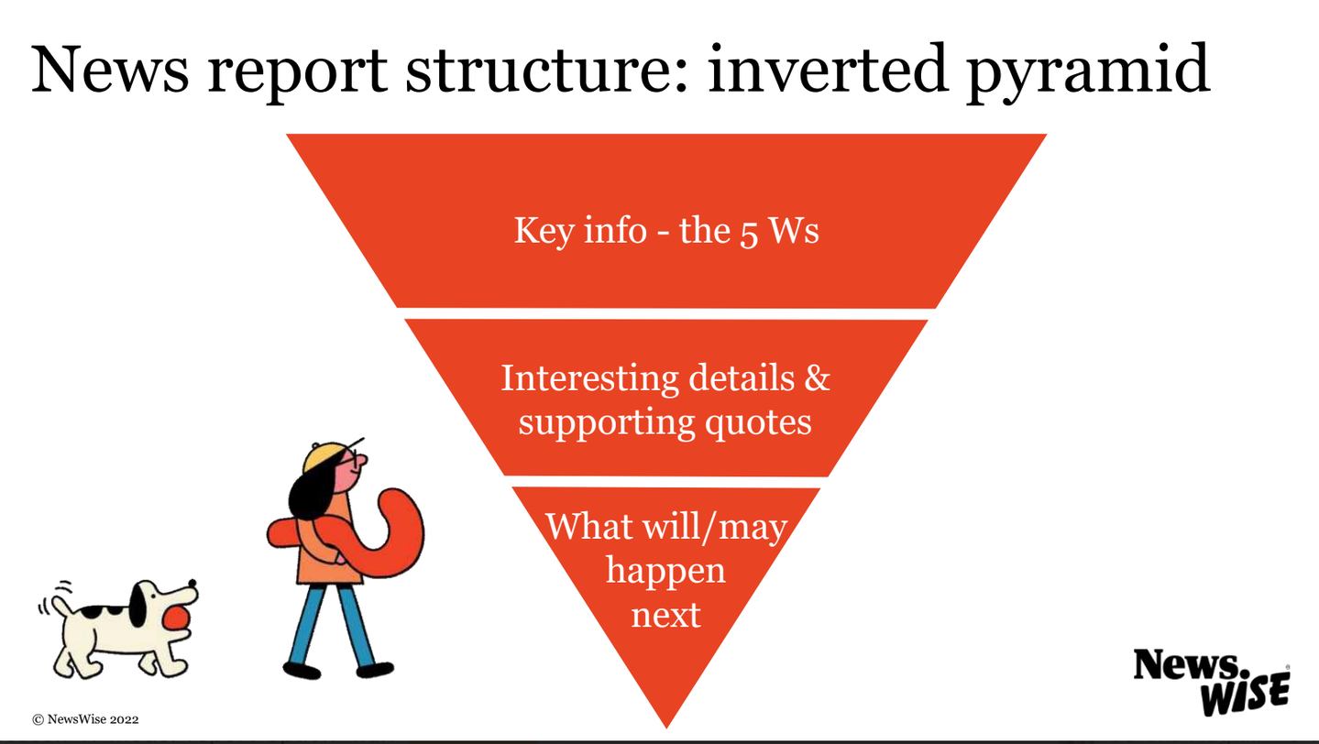

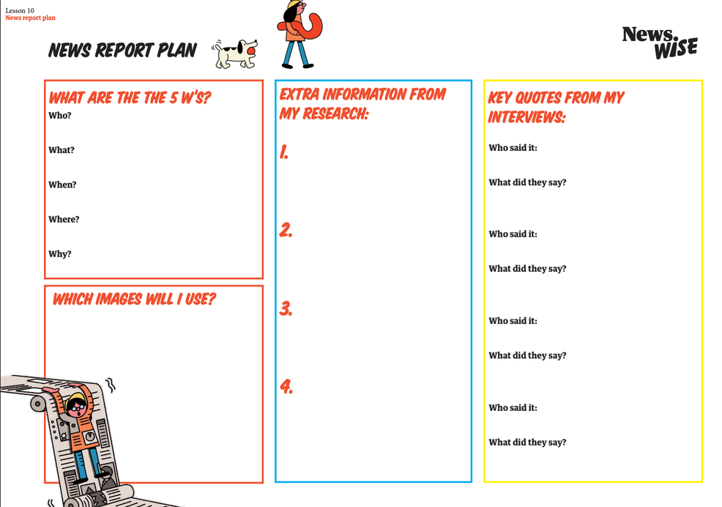
Review the inverted pyramid structure and your news report plan.
Do you have all the information you need for your news report?

Slide 6
Features of a news report
  What are the structural and language features of a news report?
  How will you begin your news report?
  Which information will you include in the middle section?
  How many quotes will you include?
  How will you end your report?
  What do you need to remember about using paragraphs in news reports?

Slide 7
Write the first draft of your news report

Slide 8
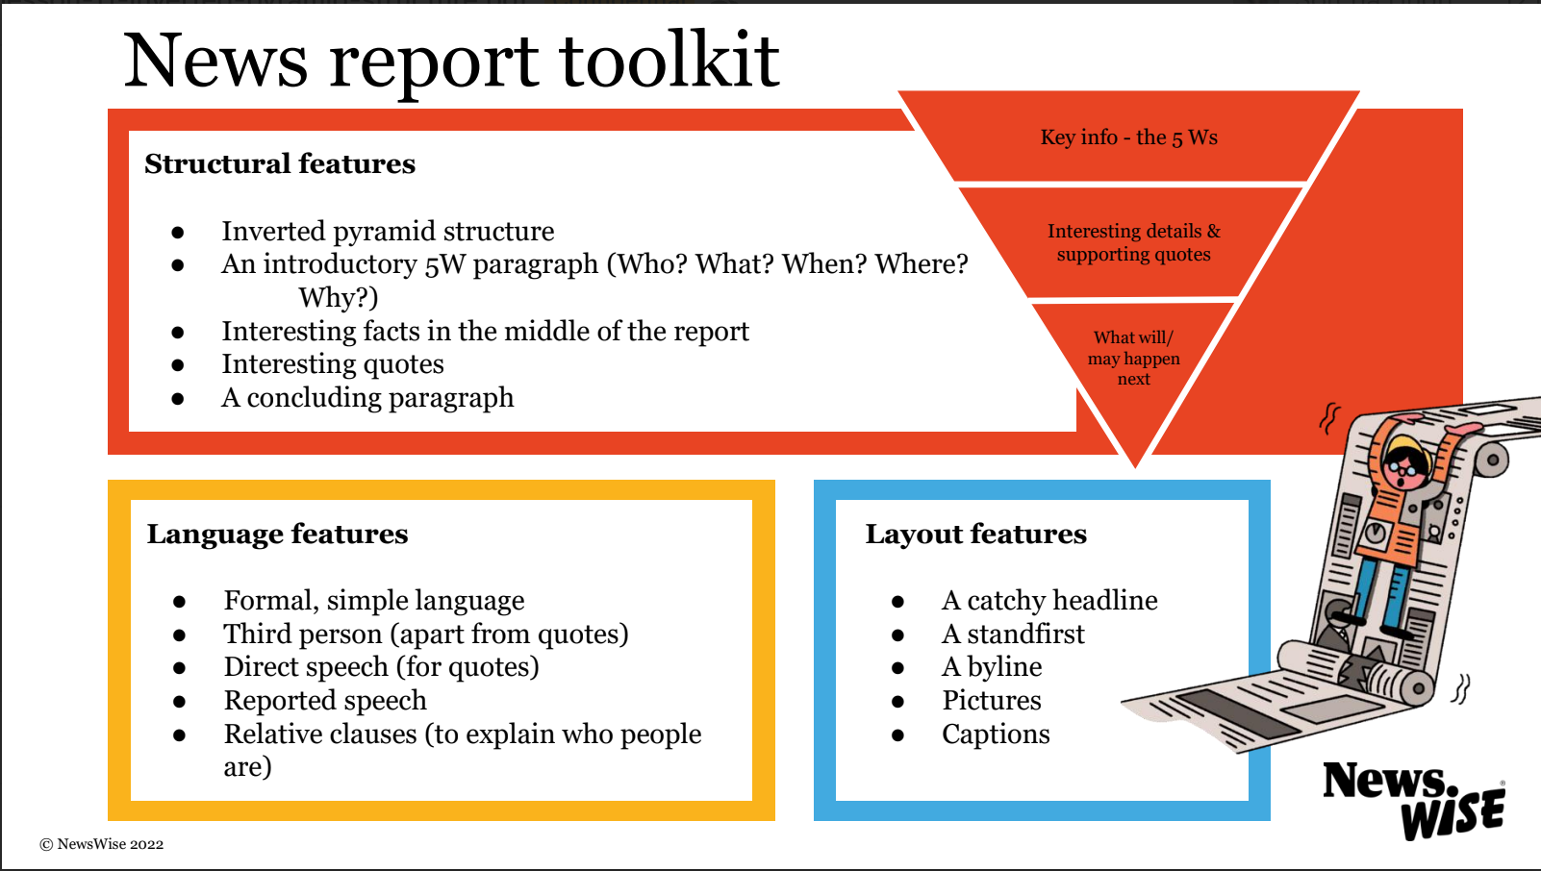

Slide 9
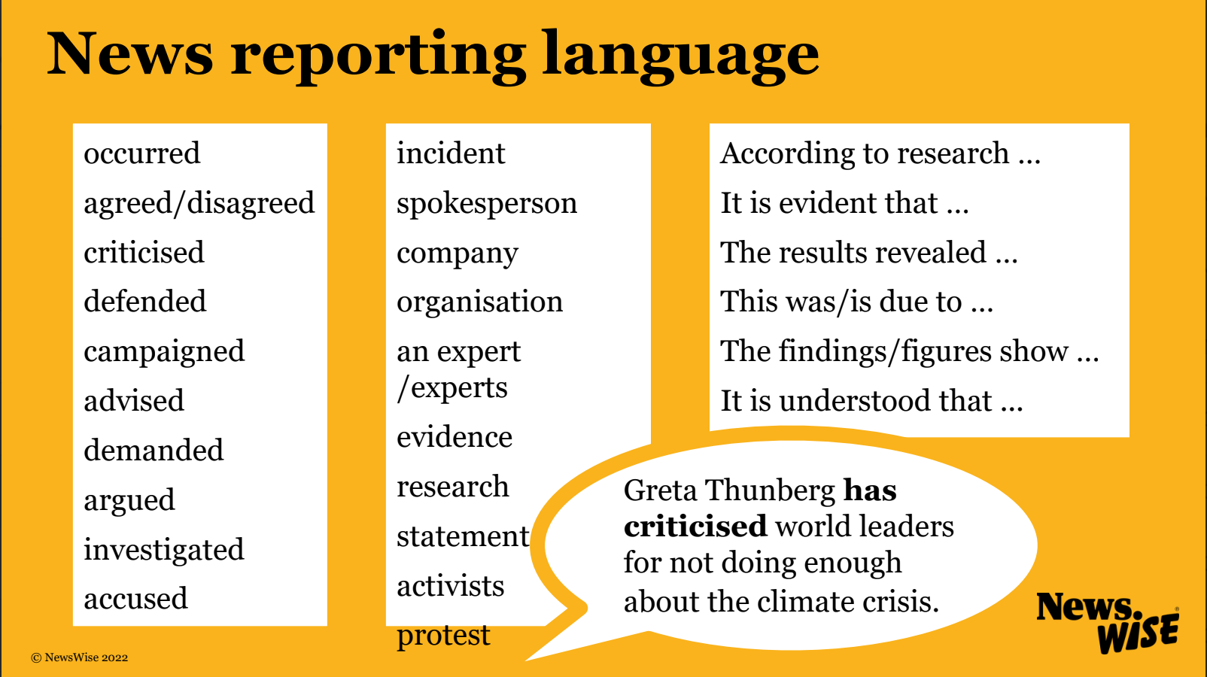

Slide 10
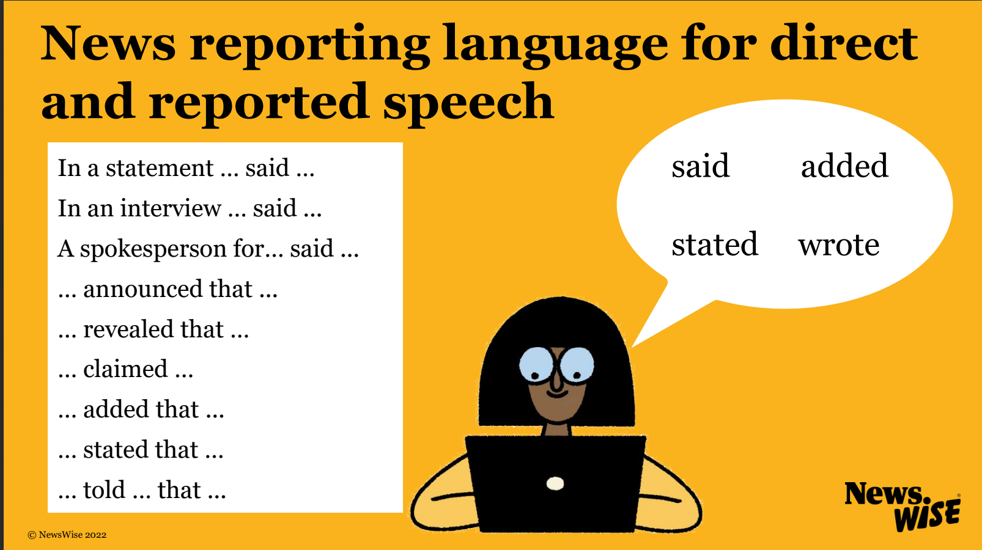

Slide 11
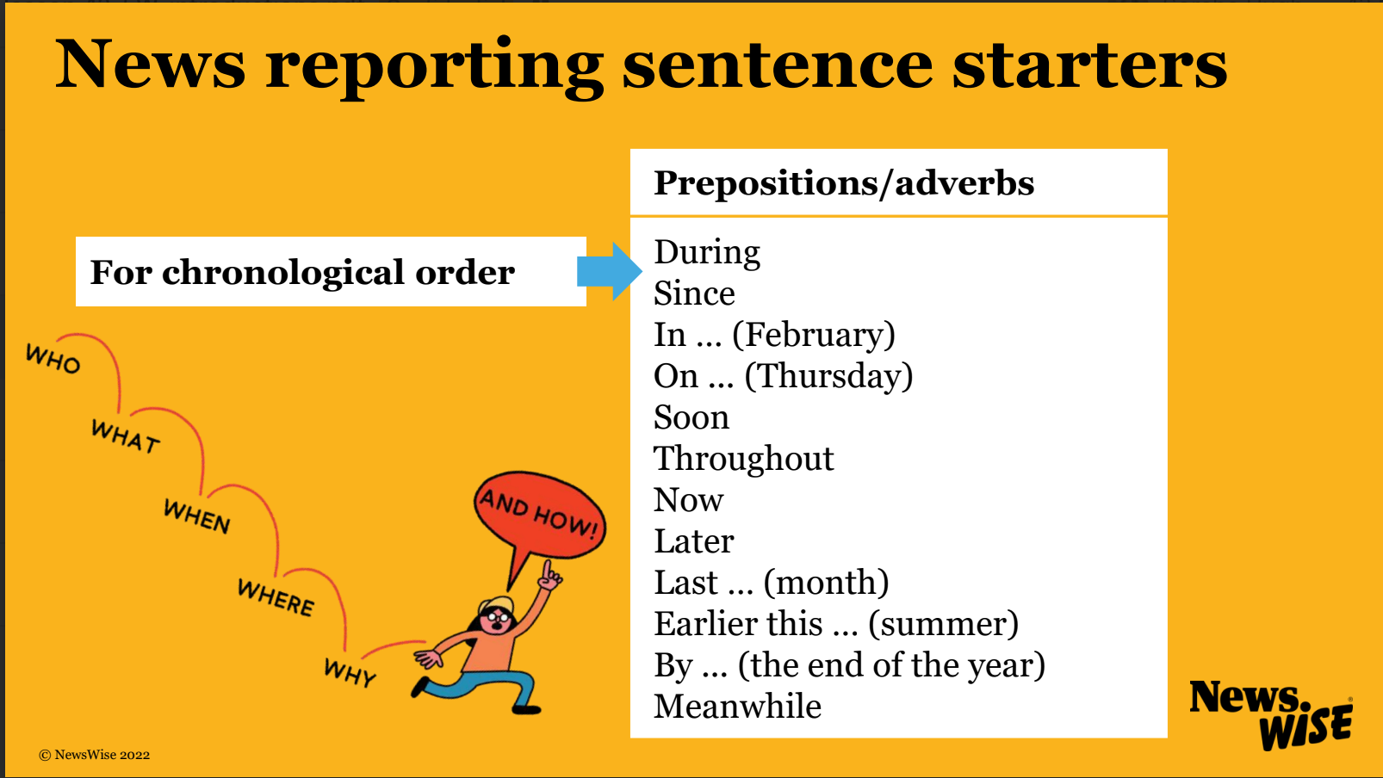

Slide 12
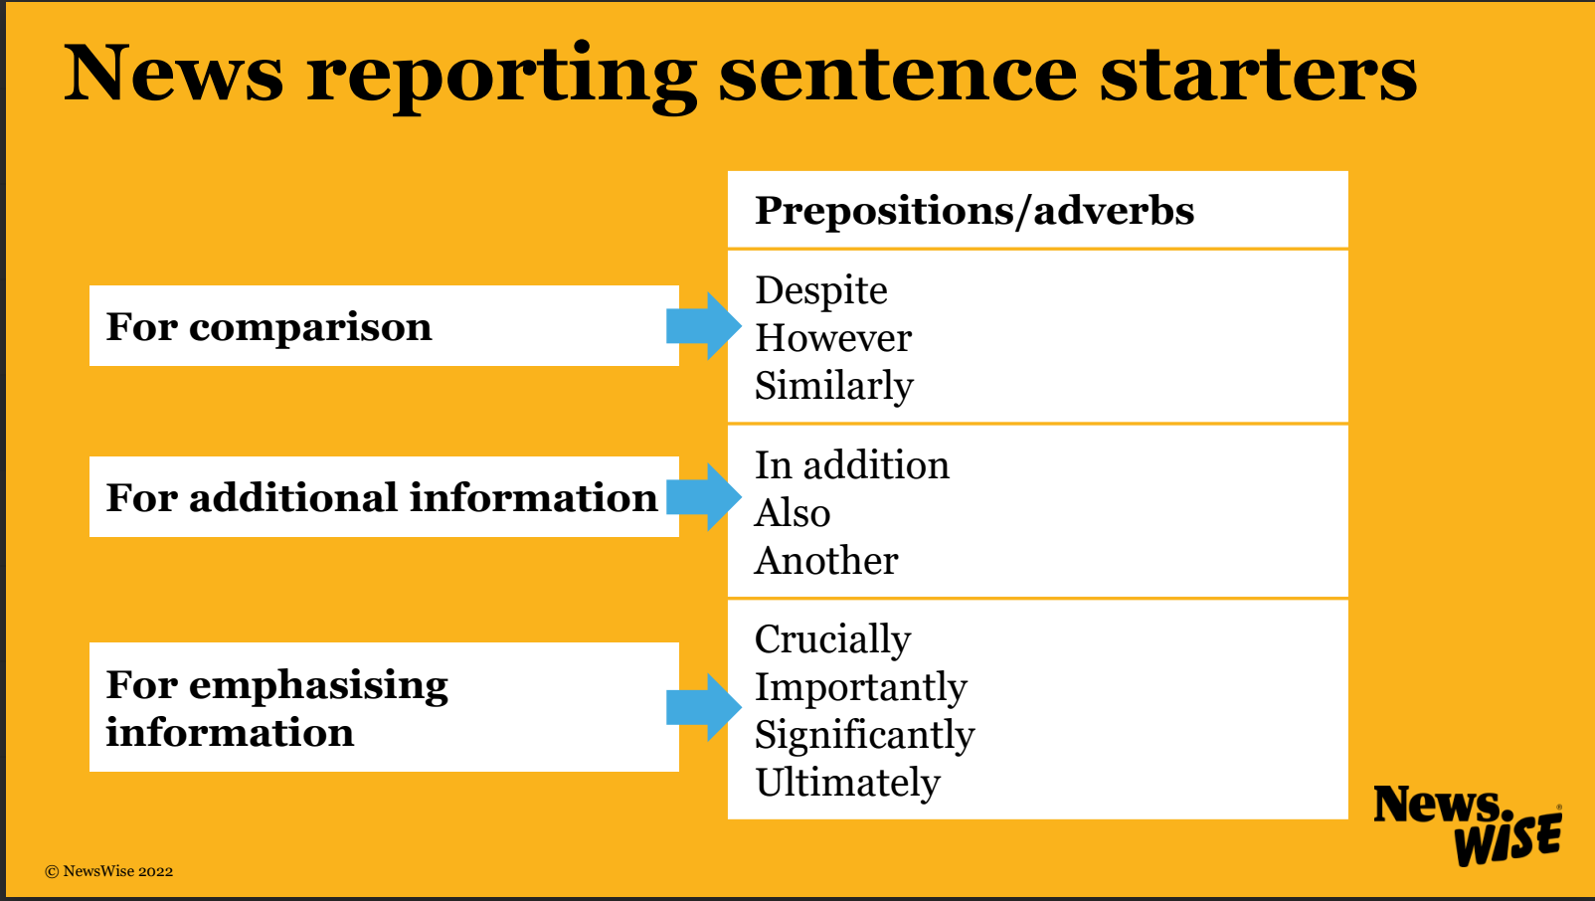

Slide 13
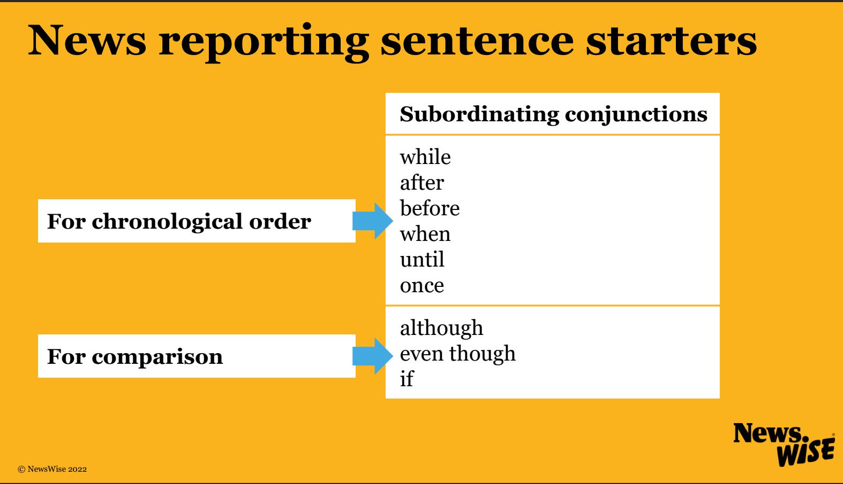

Slide 14
Let’s discuss
Read or listen to your partner read their draft news report.
  Which language features have they included in their news report? Have they begun their news report with a 5 W introduction?
  Have they included interesting information?
  Have they started a new paragraph for every new point?
  Is the news report balanced?
  Do you think it is a truthful and fair report? Why?

