Slide 1

Vocabulary to pre-teach
Relative clauses
A type of subordinate clause that adds extra information about a noun, usually starting with a relative pronoun like who, which, that, or where
Subordinating conjunctions
Words like because, although, and, if, that link a main clause to a subordinate clause
Formal language
Using serious, objective, and factual vocabulary instead of casual, everyday speech
Concise
Short and clear
Direct speech
The actual words of the speaker.
Reported speech
A speaker’s words paraphrased by a reporter, eg ‘He said that he was happy’.

Slide 2
Lesson 12
Recognising news report language

Slide 3


Learning objective
To identify and use the language of news reporting
Journalist training school
Journalists need to use formal and concise language to present factual information clearly to their readers

Slide 4
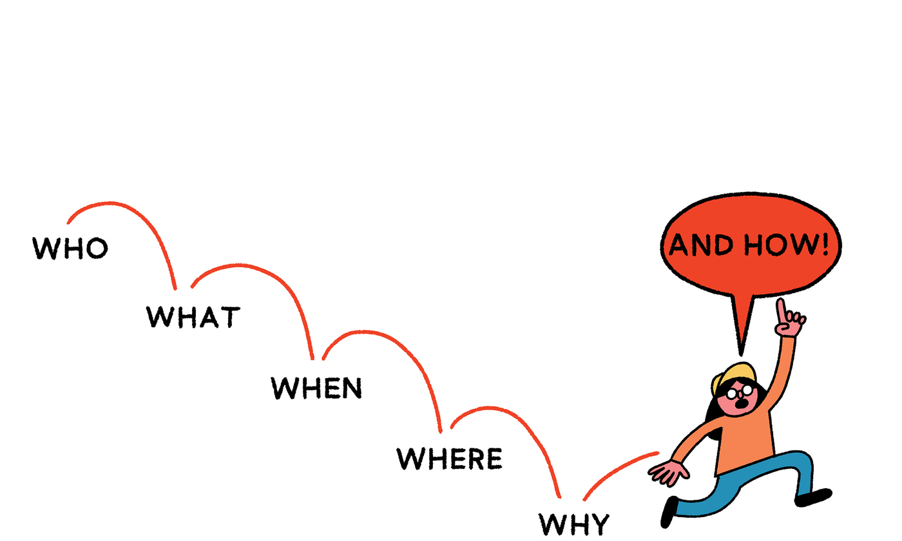
Learning outcomes:
  Identify and write an effective 5W introduction
  Identify the language features of a news report, explaining the purpose of each
  Use formal and concise language to convey information

Slide 5
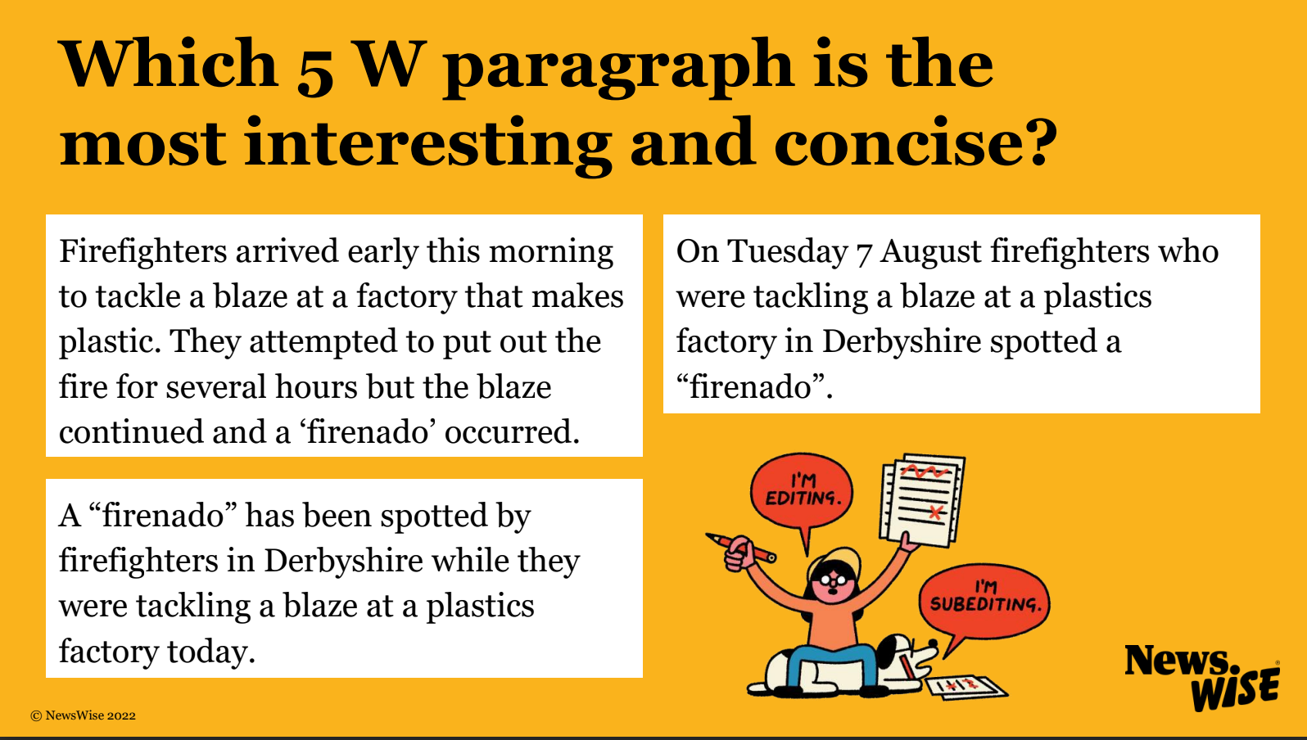

Slide 6

It includes all of the 5 Ws in one short, clear sentence and starts with the most interesting W (what)!
A “firenado has been spotted by firefighters in Derbyshire while they were tackling a blaze at a plastics factory today.
what
where
who
why
when

Slide 7
Write the opening paragraph to your news report using the 5Ws.
Don’t forget to start with the most interesting and important information!

Slide 8
Spot the news report
Read these different accounts of the same story. Which is written in the style of a news report?
  How do you know?
  How is the news report different to the others?
  Which words or phrases sound like news report language?

Slide 9
Spot the news report: Account 1
After a lovely morning stroll, the three bears arrived back at their peaceful cottage, eager to fill their rumbling tummies with their delicious homemade porridge. But when Mrs. Bear opened the front door, she was greeted by a disturbing sight. She immediately froze to the spot. “Oh my!” she cried, “What on earth has happened? Where has our breakfast gone? What has happened to our chairs?”
In a panic, Mr. Bear and baby bear charged through the front door and ran straight towards the breakfast table. “Where has my porridge gone?” yelled Baby Bear. “I’m so hungry!”
“Shhhhhhh,” whispered Mr. Bear, “I think there must be somebody in the house!”

Slide 10
Spot the news report: Account 2
Goldilocks Golding, an 11 year old girl, was arrested yesterday in Fairy Forest for burglary and damage to private property.
At 11am yesterday morning, the Three Bears arrived home at their cottage in Fairy Forest to discover evidence of an intruder. Mrs Bear said: ‘I thought something was wrong as soon I arrived home. Our breakfast had vanished and our chairs were broken.’ The bears immediately called Fairy Forest Police, who discovered 11-year-old Goldilocks Golding asleep in the bears’ bedroom.

Slide 11
Spot the news report: Account 3
I had the shock of my life when I opened the front door. I couldn’t believe it! Our whole kitchen was in a mess: our breakfast bowls were empty, there was porridge splattered all over the floor and our lovely wooden chairs were broken. At first I couldn’t work out what had happened, but as soon as Mr. Bear said he thought someone was in the house, I realised our home had been broken into. I have lived in Fairy Forest my whole life and nothing like this has ever happened before. I have never needed to lock the front door when I went out. I knew and trusted everyone who lived nearby. I can’t work out why Goldilocks broke into our home. Why would she want to steal our food and damage our precious things?

Slide 12
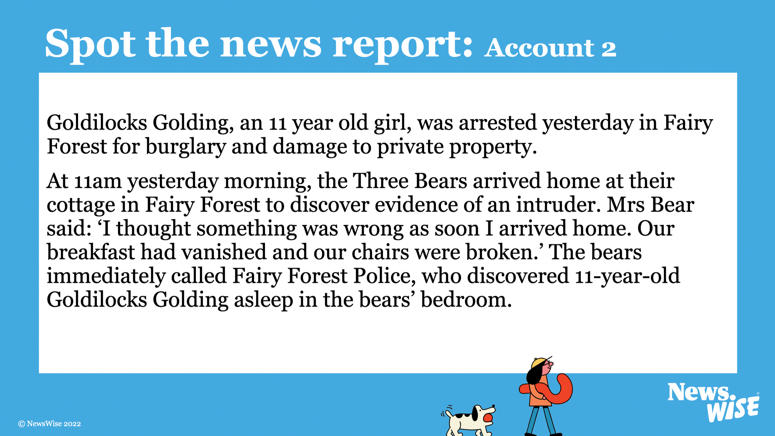
How was the news report different to the others?
Which words or phrases sound like news report language?

Slide 13
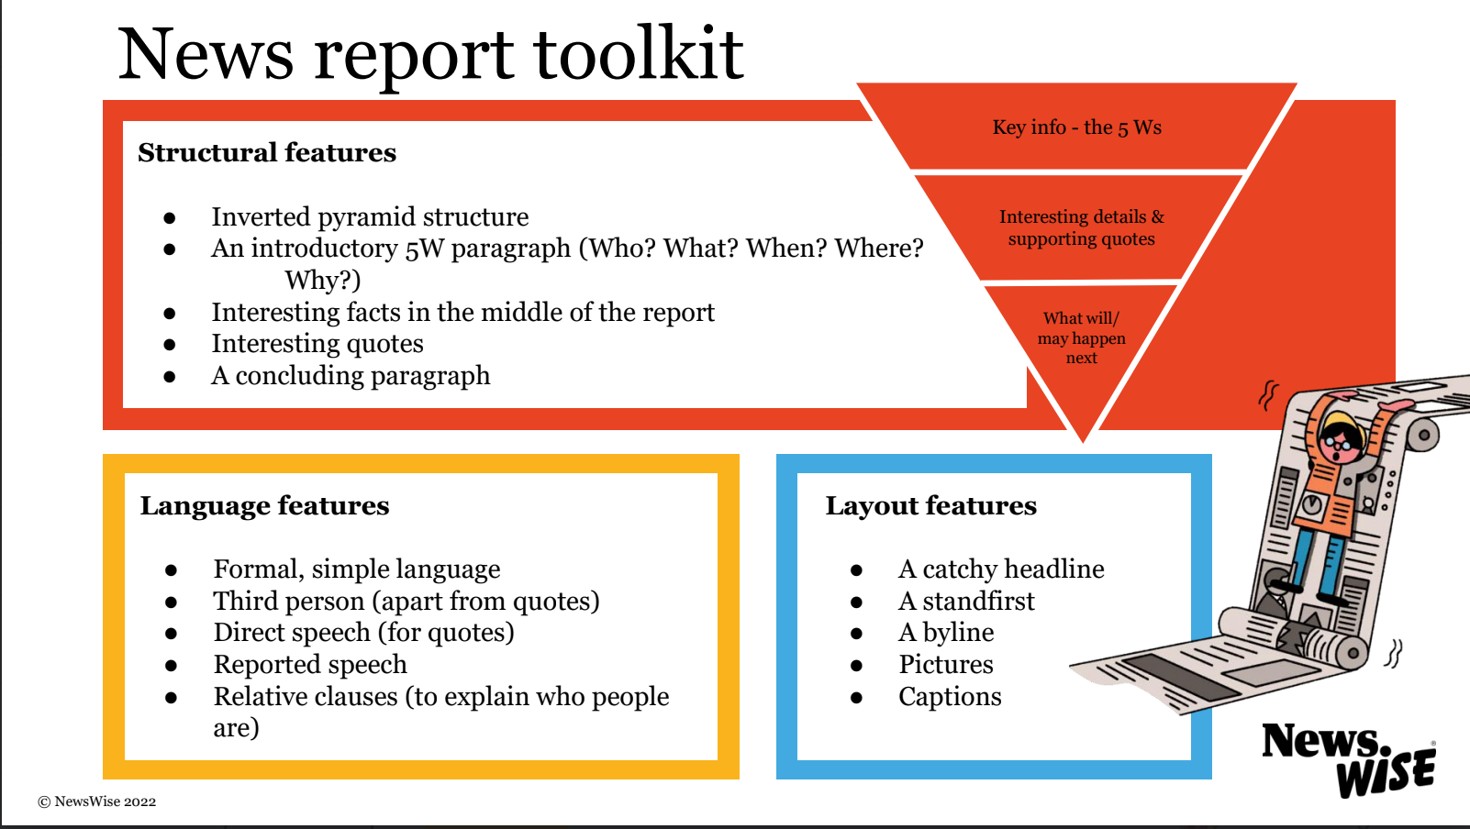

What are the language features of a news report?
Add the language features to your news report toolkit

Slide 15
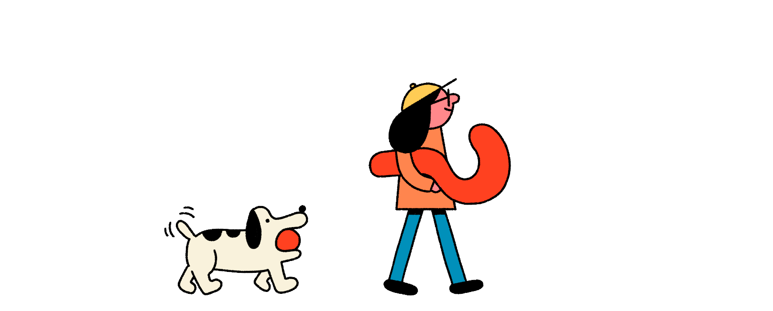
Challenge
What is the purpose of each language feature?
How do the language features help the reader to understand the information?

Slide 16
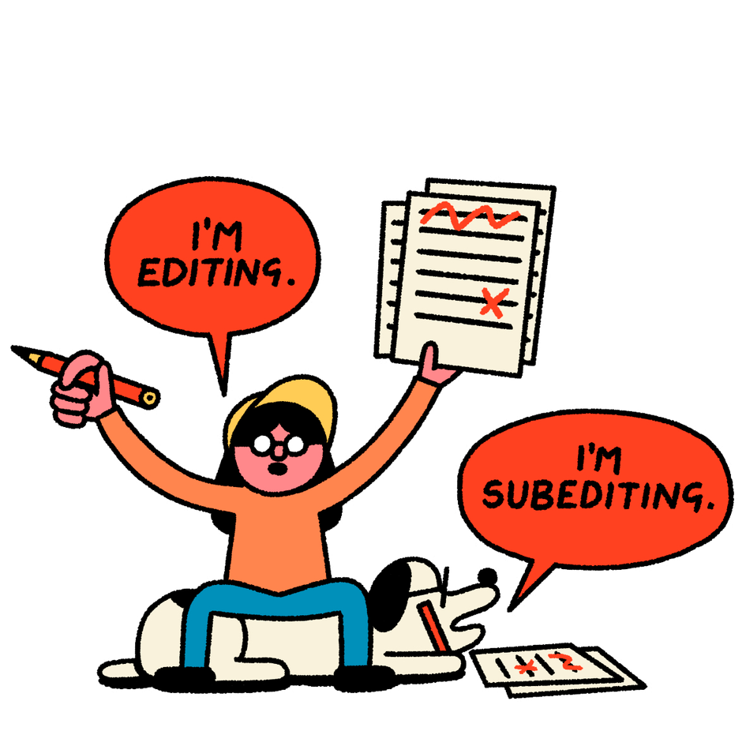
Nav has written a news report, but it is too informal, too long and too descriptive!
First, find the informal words that Nav has used.
Then, rewrite each paragraph using formal and simple news report language.

Slide 17
News reporting language
occurred
agreed/disagreed
criticised
defended
campaigned
advised
demanded
argued
investigated
accused
incident
spokesperson
company
organisation
an expert /experts
evidence
research
statement
activists
protest
According to research …
It is evident that …
The results revealed …
This was/is due to …
The findings/figures show …
It is understood that ...
Greta Thunberg has criticised world leaders for not doing enough about the climate crisis.

Slide 18

News reporting language
In a statement … said …
In an interview … said ...
A spokesperson for… said ...
… announced that ...
… revealed that …
… claimed …
… added that ...
… stated that …
… told … that ...
said added
stated wrote

Slide 19
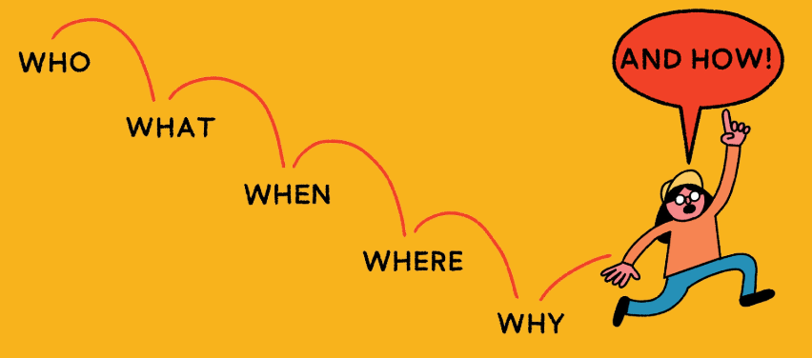
News reporting sentence starters
Prepositions/adverbs
For chronological order
During
Since
In … (February)
On ... (Thursday)
Soon
Throughout
Now
Later
Last … (month)
Earlier this … (summer)
By ... (the end of the year)
Meanwhile

Slide 20
News reporting sentence starters
Prepositions/adverbs
Despite
However
Similarly
For chronological order
In addition
Also
Another
For additional information
Crucially
Importantly
Significantly
Ultimately
For emphasising information

Slide 21
News reporting sentence starters
Subordinating conjunctions
while
after
before
when
until
once
For chronological order
although
even though
if
For comparison

Slide 22
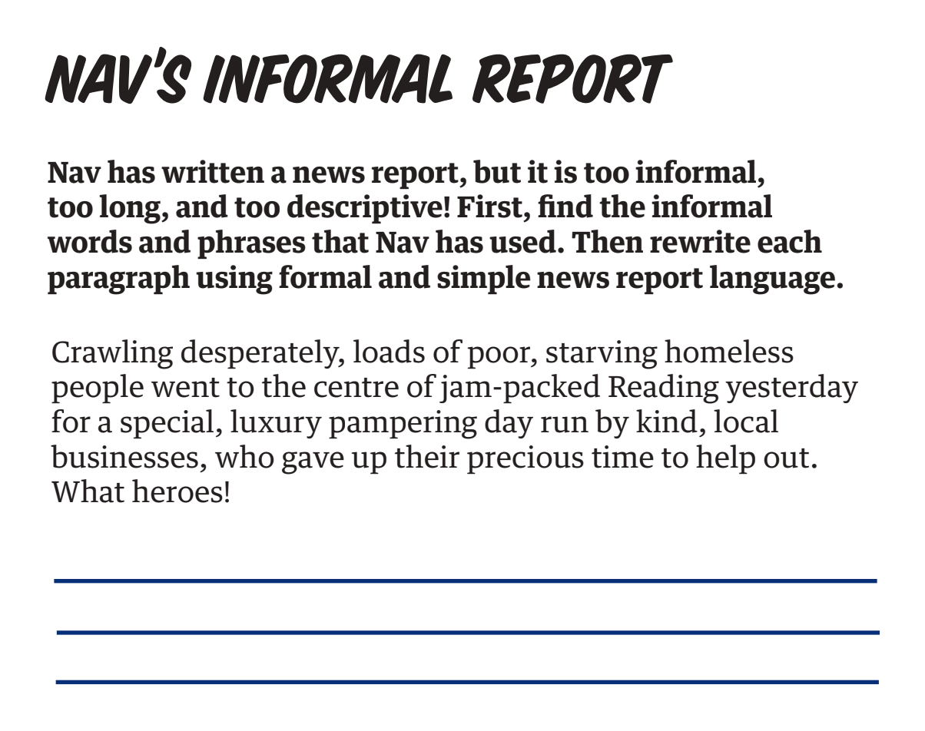

Slide 23
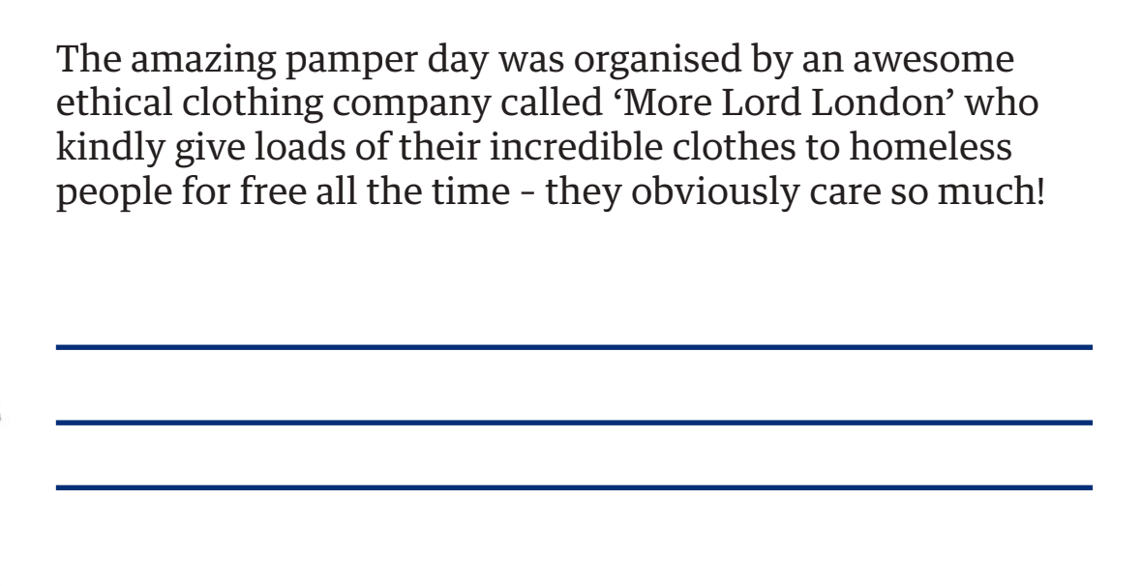

Slide 24
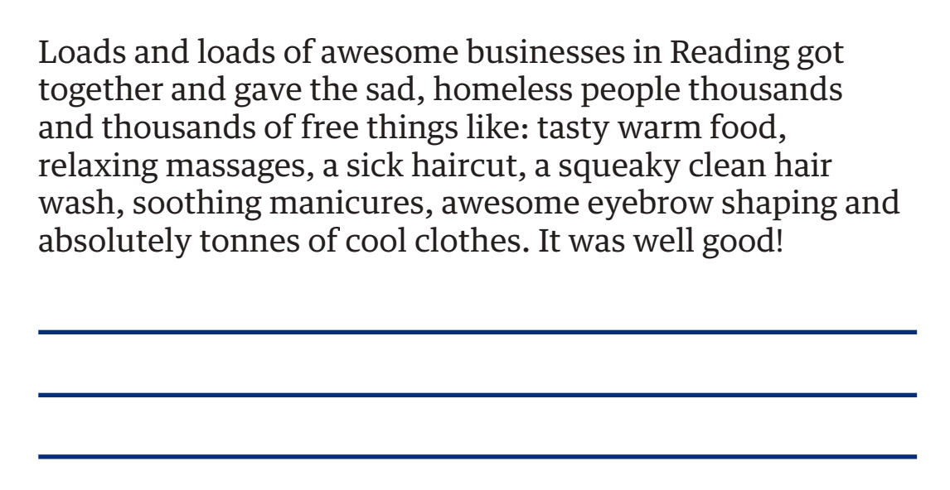

Slide 25
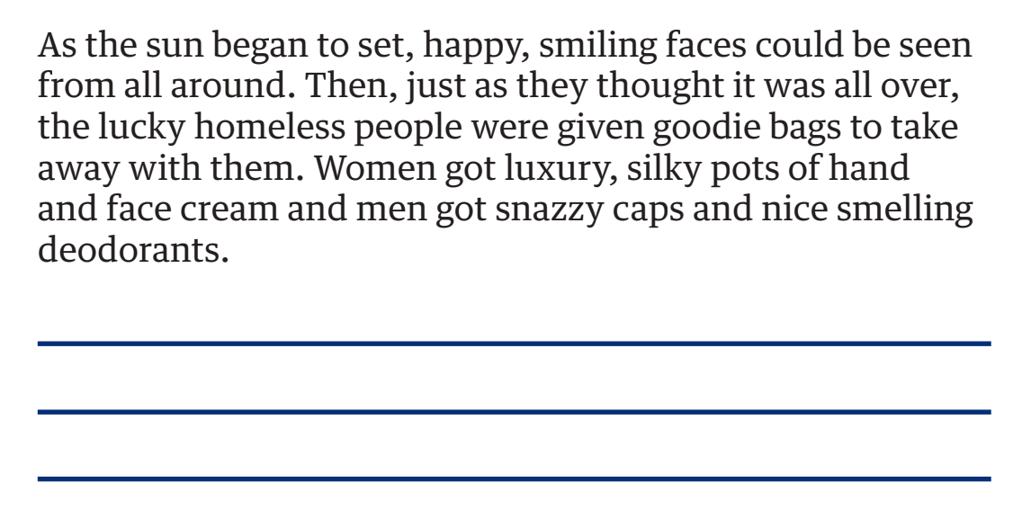

Slide 26
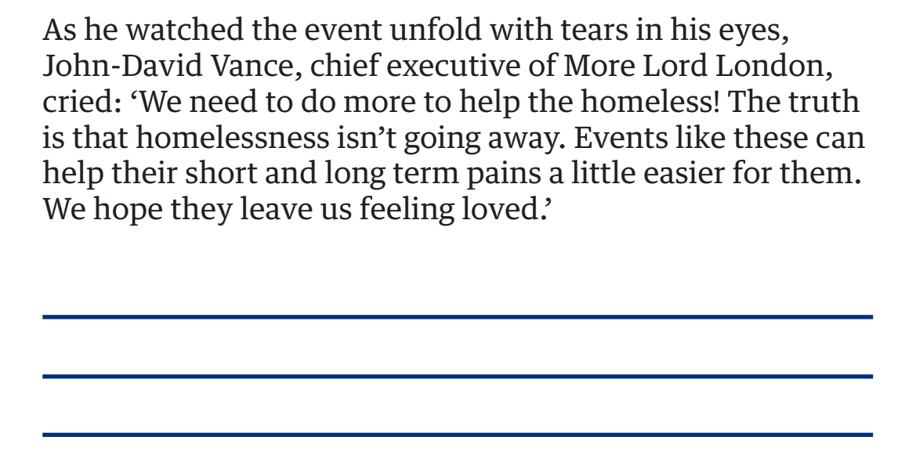

Slide 27
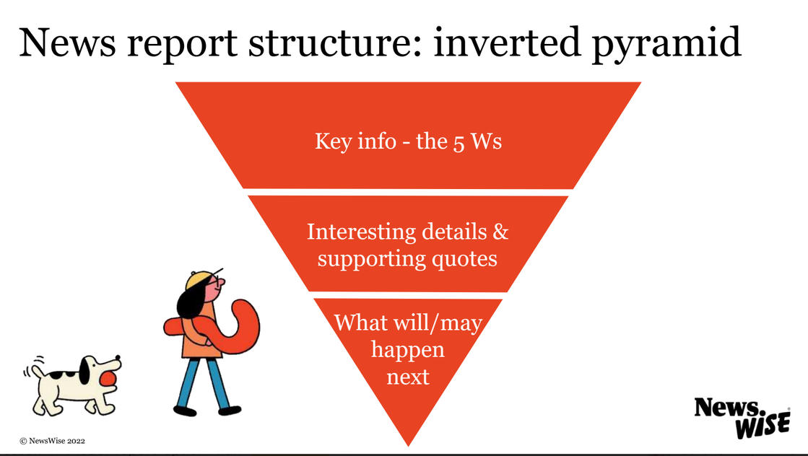
Let’s discuss
1
Select a key point from the middle of your pyramid plan
Draft a sentence for your own news report
2
Swap sentences with a partner and read them aloud
3
Give feedback whether it uses formal and concise language.
4

Slide 28
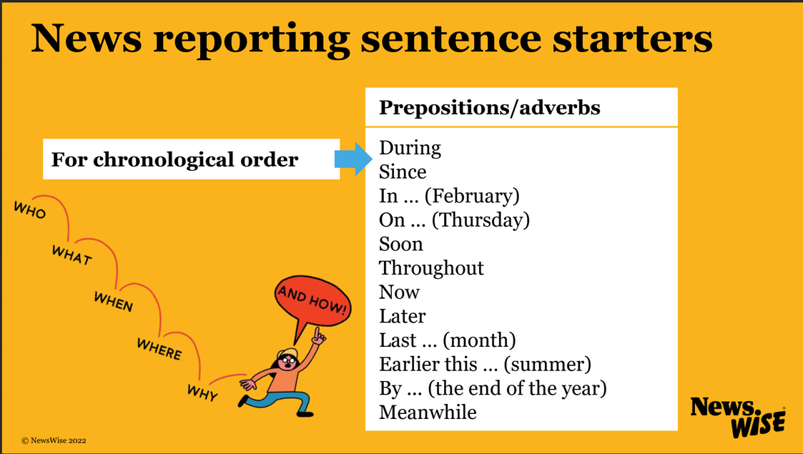
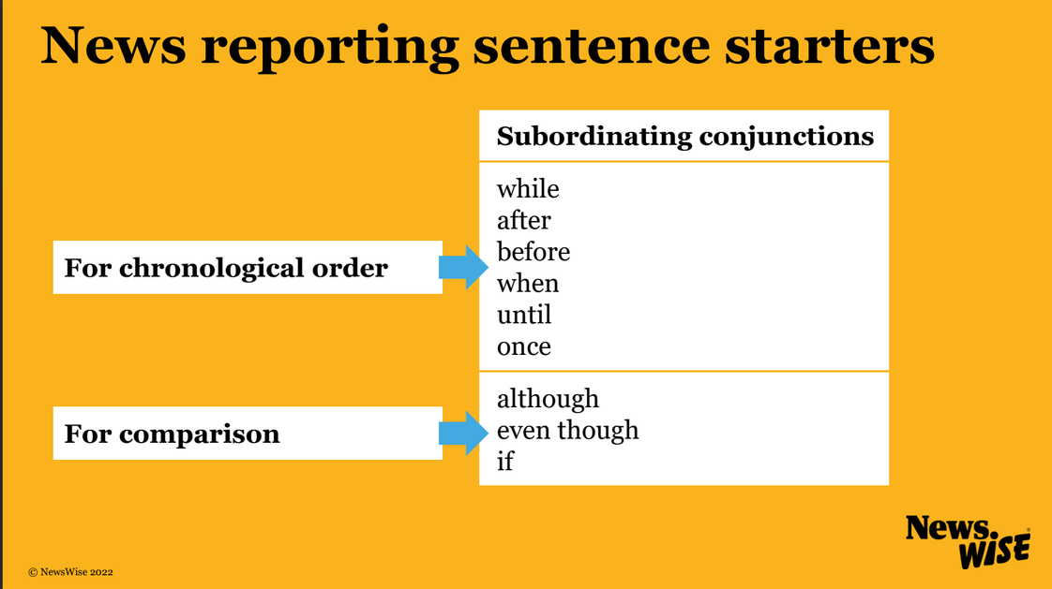
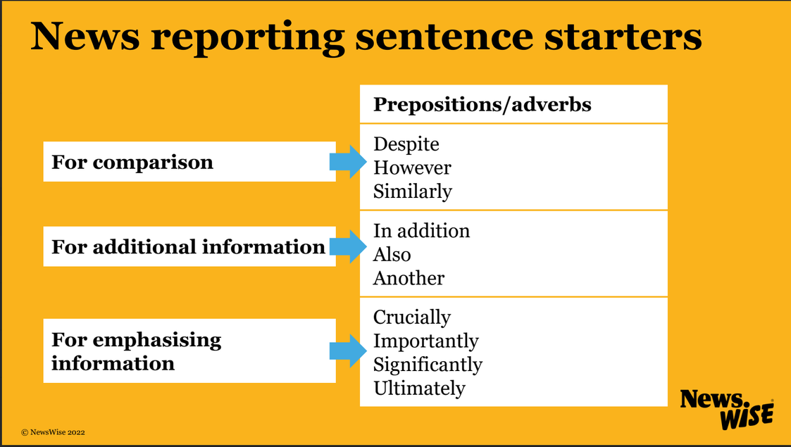
Challenge
Is your chosen sentence adding contrasting, additional, or chronological information?
Rewrite your sentence. Use:
  An appropriate sentence starter
or
  a complex sentence
  an appropriate subordinating conjuction

Slide 29
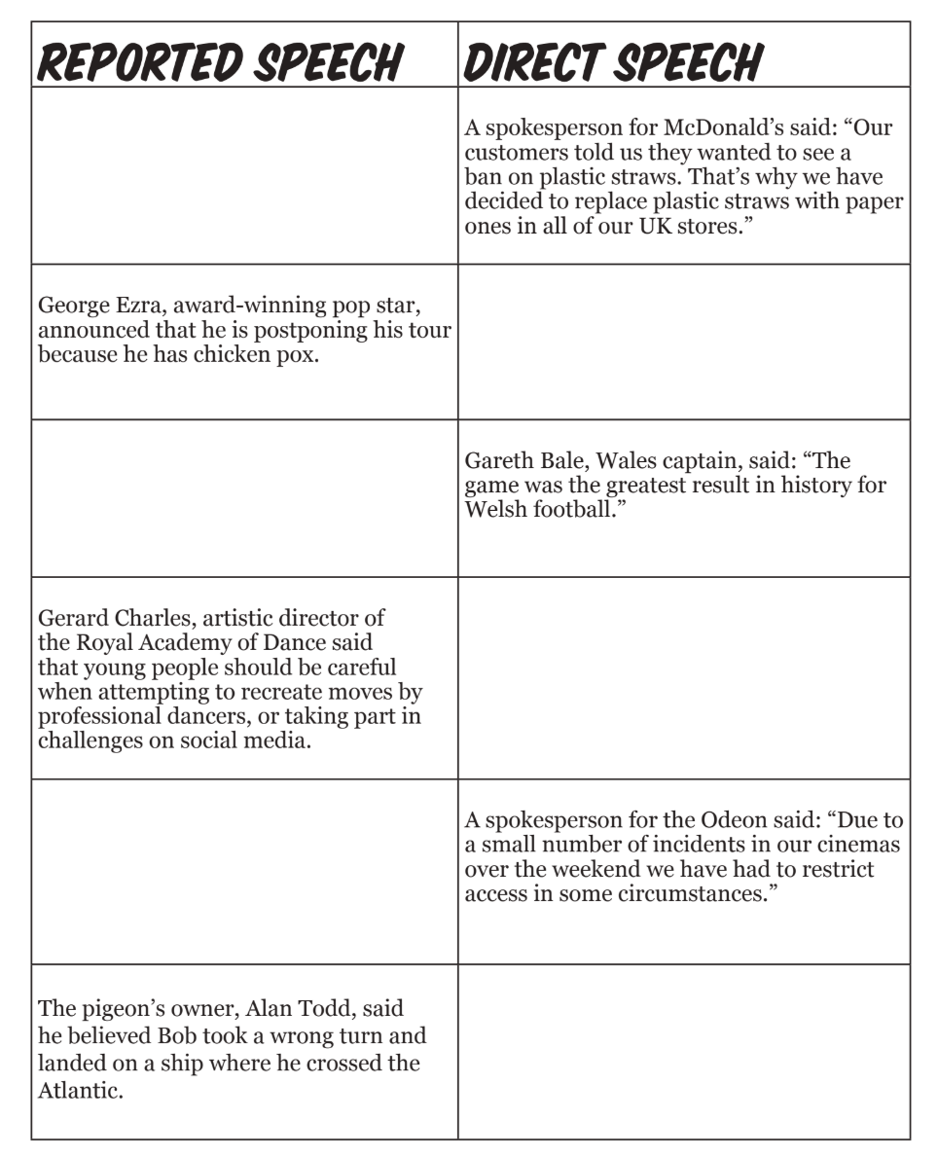
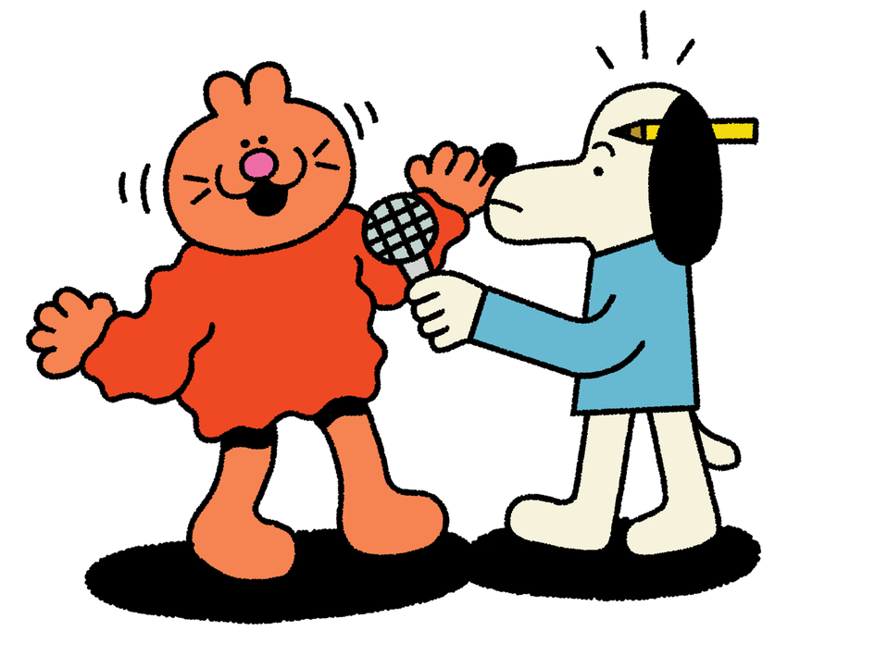
Extension 1
News reports use reported speech and direct speech. Can you fill-in the missing reported speech and direct speech boxes here?

Slide 31
Reported speech
Direct speech

Slide 32
Extension 2
1
Use quotes from your interviews to practise writing reported and direct speech
Swap sentences with a partner and read them aloud
2
3
Give feedback on your partner’s quotes

Slide 33
News reporting language
In a statement … said …
In an interview … said ...
A spokesperson for… said ...
… announced that ...
… revealed that …
… claimed …
… added that ...
… stated that …
… told … that ...
said added
stated wrote

Slide 34
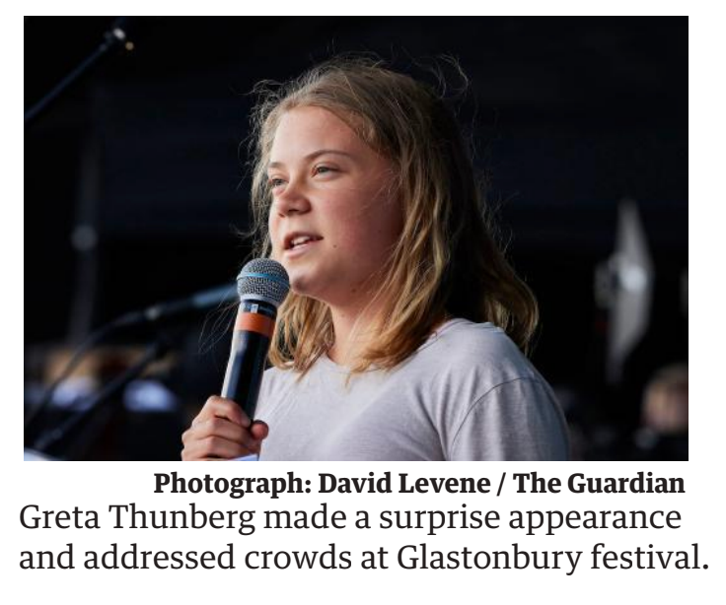
Extension 3
Relative clauses are parts of sentences that can be added after nouns to give the reader more information.
They are inserted into a sentence in between commas.
They are used in news reports to tell us more about the people featured in quotes.
Greta Thunberg, young climate activist, made a surprise appearance at Glastonbury Festival.

Slide 35
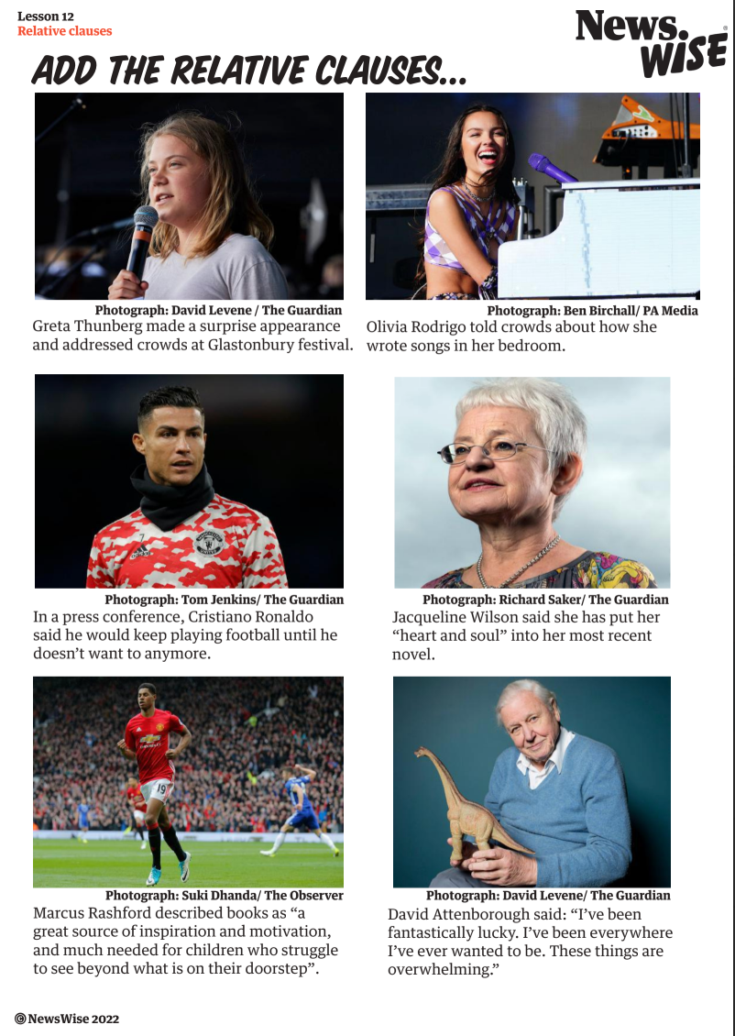
Can you add relative clauses to these examples?
Can you add a relative clause to a sentence in your news report?

