Slide 1

Vocabulary to pre-teach
Structure
The newspaper structure, the headline, byline, the lead, the body, and the tail.
Inverted pyramid
News article structure with the most important information in the first few sentences.
Conjunction
Words that join ideas together, like 'and', 'but', 'because'
Contrasting
Highlights clear differences, opposing viewpoints
Chronological
A story told in the order that events happened, starting with the first event and ending with the most recent one.
Page furniture
Everything on a news page that isn’t the report or photos, eg headlines, captions.

Slide 2
Lesson 11
Structuring news reports

Slide 3

Learning objective
To analyse the structure of a news report
Journalist training school
The structure and layout of a news report is important as it ensures that readers can find the most important information quickly.

Slide 4
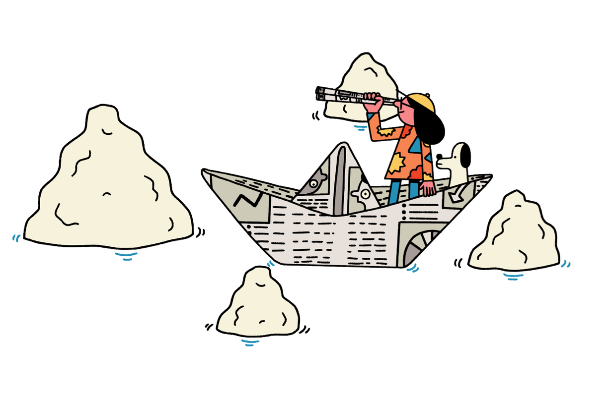

Learning outcomes:
  Explain why news reports follow the inverted pyramid structure
  Order a news report using the inverted pyramid structure
  Plan the order of a news report including paragraphing

Slide 5
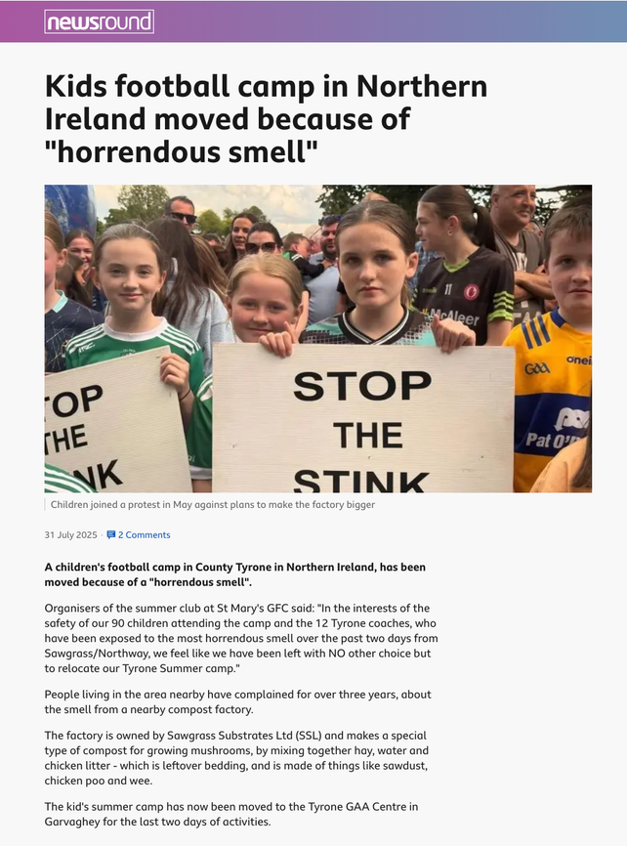

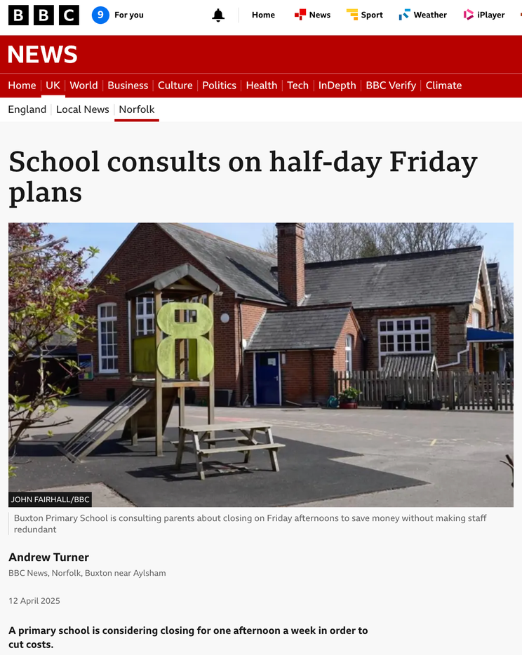
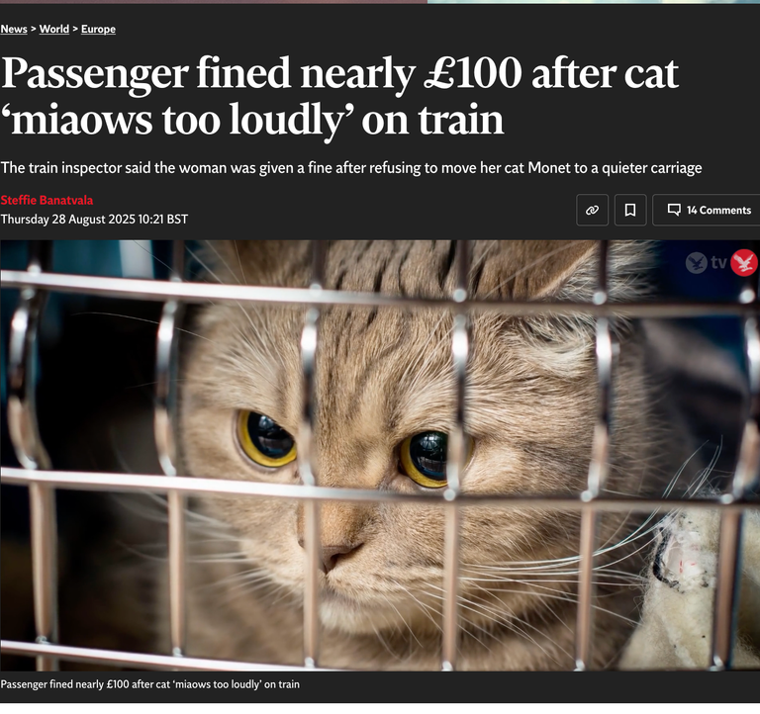
Read the news report.
  What did you read or see first in the report?
  Which parts did you read or look at the most?

Slide 6
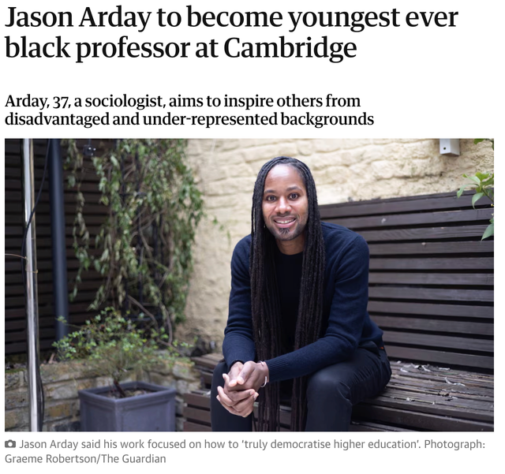
What did you notice?
Did you notice....
  The first paragraph (the 5W paragraph) is the most important. People might not read to the end of the report, so they need all the information early!
  The headline and picture add more information and grab our attention

Slide 7
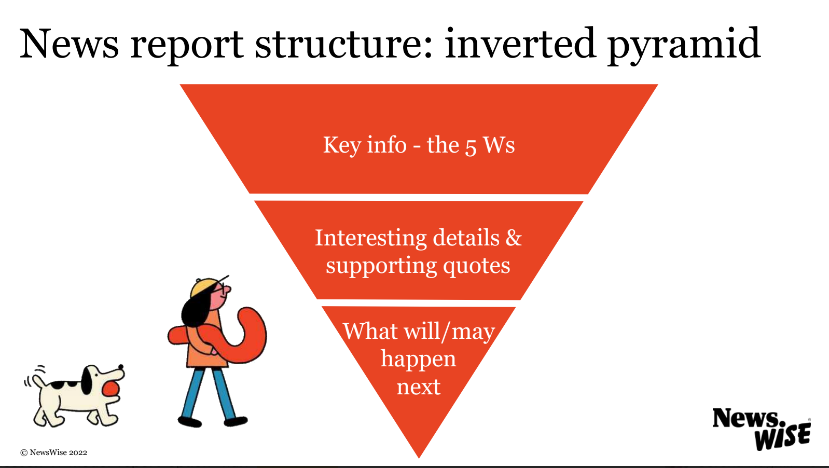

Slide 8
Why do news reports provide the reader with all of the key information at the very beginning?
How is this different to other kinds of writing?

Slide 9
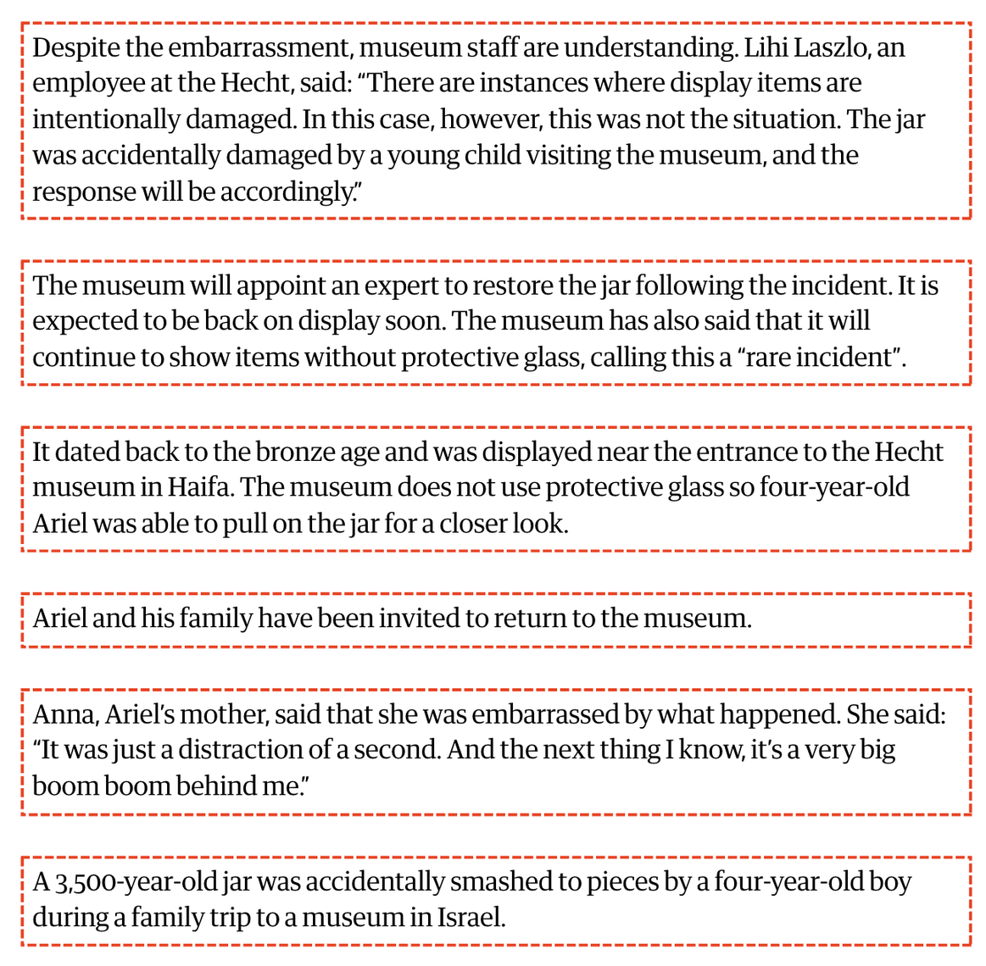
The different parts of a news report have become mixed up!
Use the inverted pyramid structure to put them back into the right order.

Slide 10
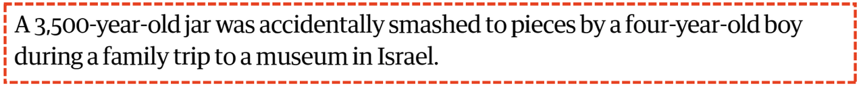
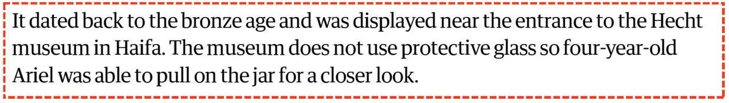
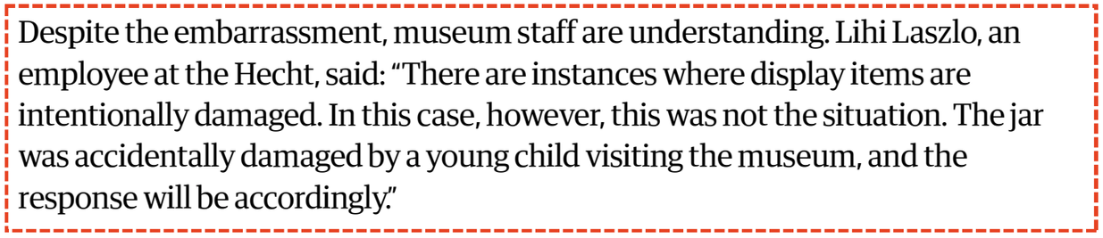
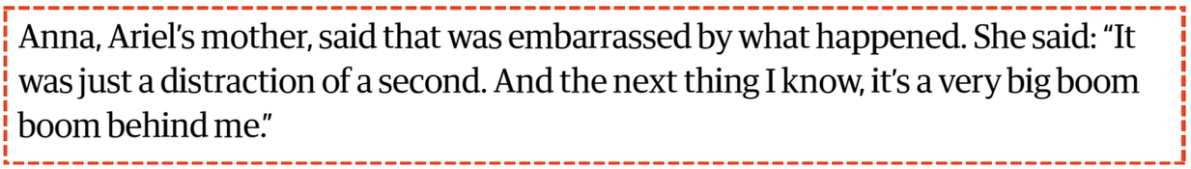
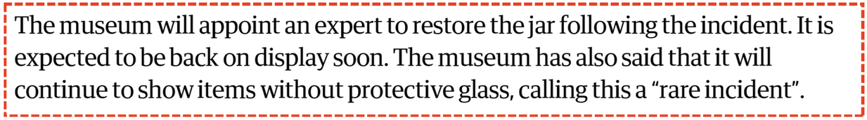
  How did you identify the introduction?
  Which of the 5 Ws does it begin with
  How did you find the conclusion paragraph?
  How did you identify that this was the final paragraph?
  What do you find in the middle section of a news report?
  What helped you to order the paragraphs?
  How do the paragraphs begin?
  What do you notice about each paragraph?

Slide 11
Challenge
Are there any language clues that helped you decide which order the paragraphs went in?
You might have found:
  Conjunctions to show a new point, or the next step in the story. For example, ‘despite’.
  Pronouns that are used to avoid repeating a word. For example, ‘it’ replacing ‘the vase’.
  Quotes, which have to go in the middle or end of a news report

Slide 12
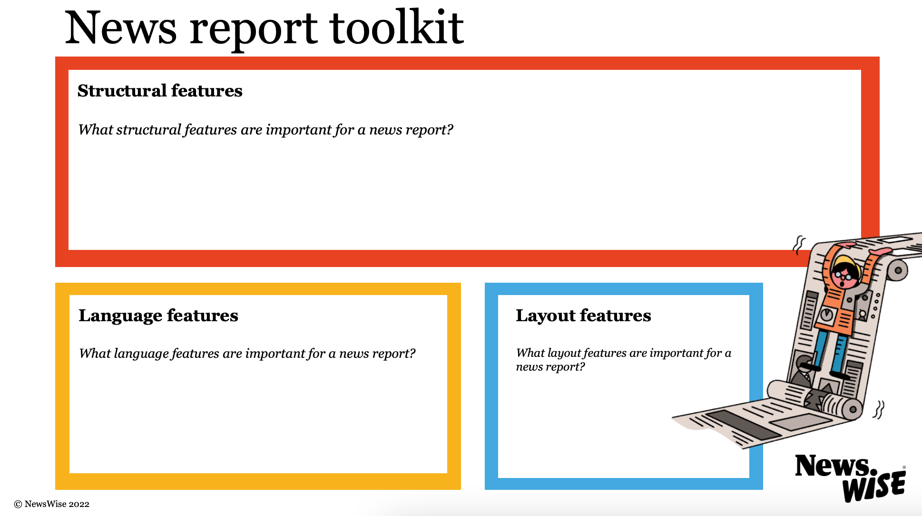
What are the key features to include in your news report? Add them here.

Slide 13
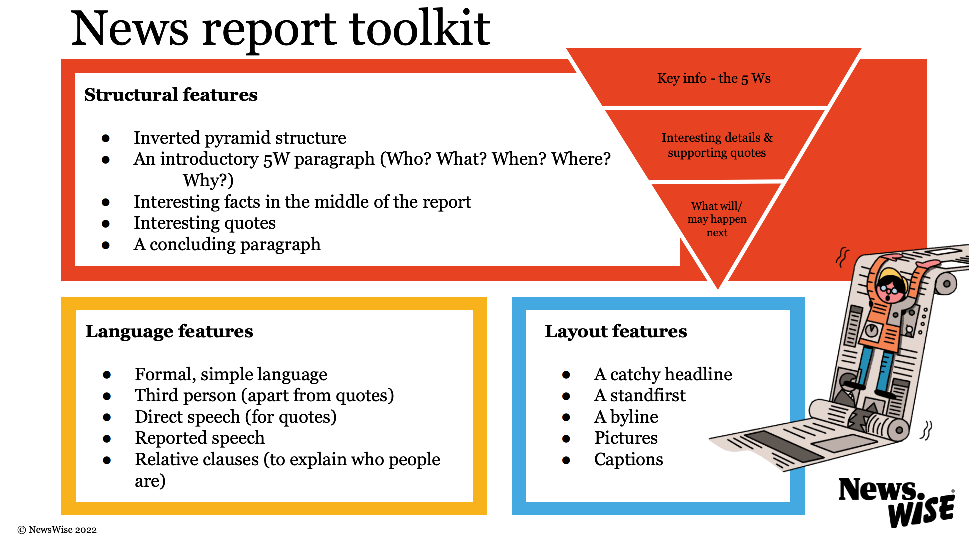

Slide 14
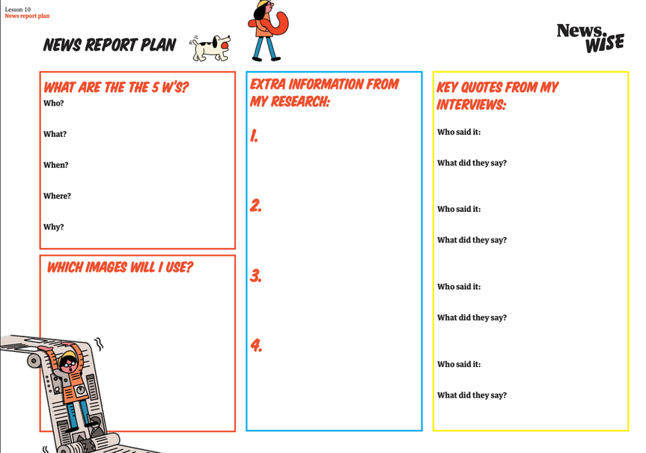
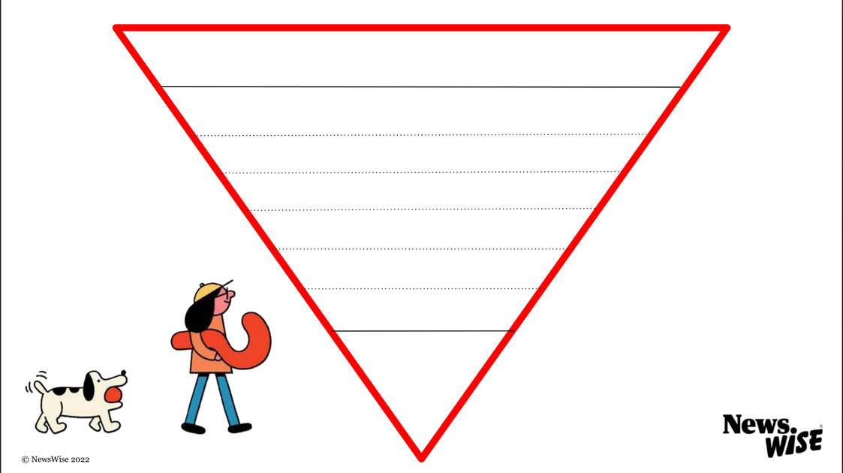

Planning the structure of your report
Put the information from your news report plan into the inverted pyramid structure.
Start a new paragraph every time a new piece of information is given.
  Which of the 5 Ws will you mention first in your introduction?
  Why is this the most interesting or important information?
  What will you include in your conclusion?

Slide 15
Let’s discuss
Paragraph puzzle
Read the news report
1
Mark where each new paragraph should begin
2

Slide 16
1
Read the news report
Mark where each new paragraph should begin
2
Remember!
  A new paragraph should start for every new piece of information in the story, including quotes.
  It is normal for news report paragraphs to be very short. They might be only one sentence long!

Slide 17
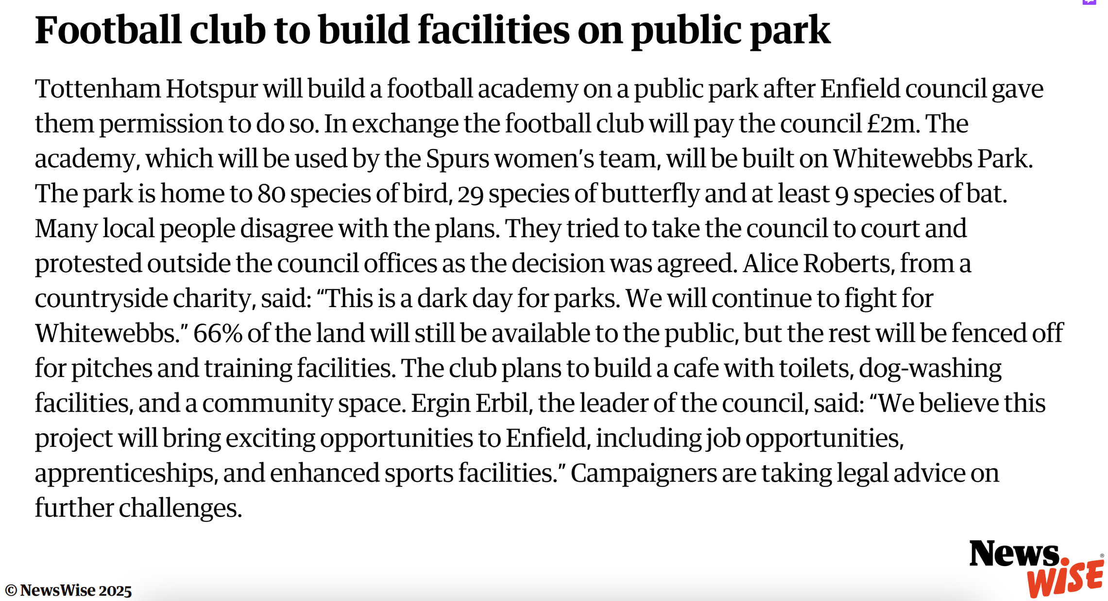

Slide 18
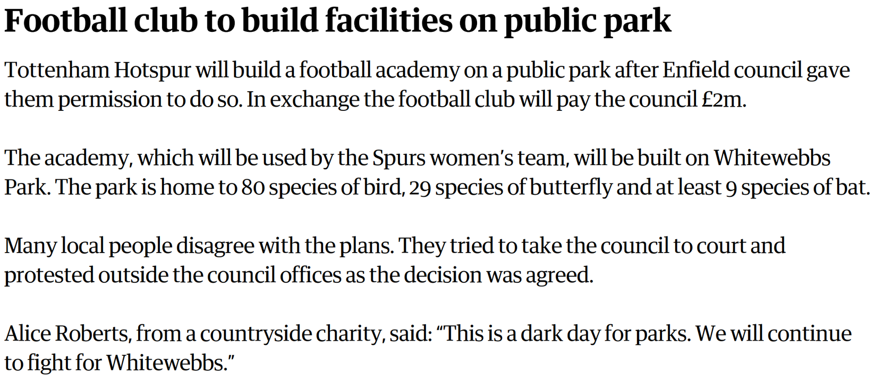
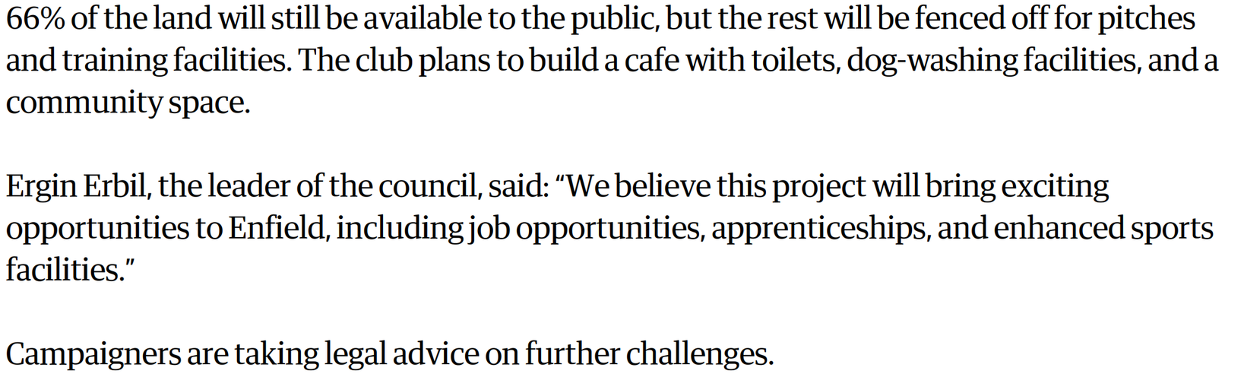

Slide 19
Let’s discuss
Look at your pyramid plan.
Have you planned your news report so that every new point is in a new paragraph?

