Slide 1

Vocabulary to pre-teach
Interview
A structured set of questions (planned in advance) that you ask a guest.
Interviewee
The person being interviewed.
Open question
A question where there could be lots of possible ways to answer and which is likely to receive a longer answer than just ‘yes’ or ‘no’.
Issue
An issue is an important topic, problem, or challenge that people talk about, debate, or work together to solve.
Research
The careful process of searching for information, asking questions, and studying facts to discover new answers or learn more about a topic.
Reported speech
A speaker’s words paraphrased by a reporter, eg ‘He said that he was happy’.

Slide 2
Lesson 10
Reporting real news stories

Slide 3

Learning objective
To identify and plan a real news story to report
Journalist training school
Journalists must find interesting and newsworthy stories to report. They also have a responsibility to be fair to the people in their stories. When planning their reports, journalists should always consider how to make them truthful and balanced.

Slide 4
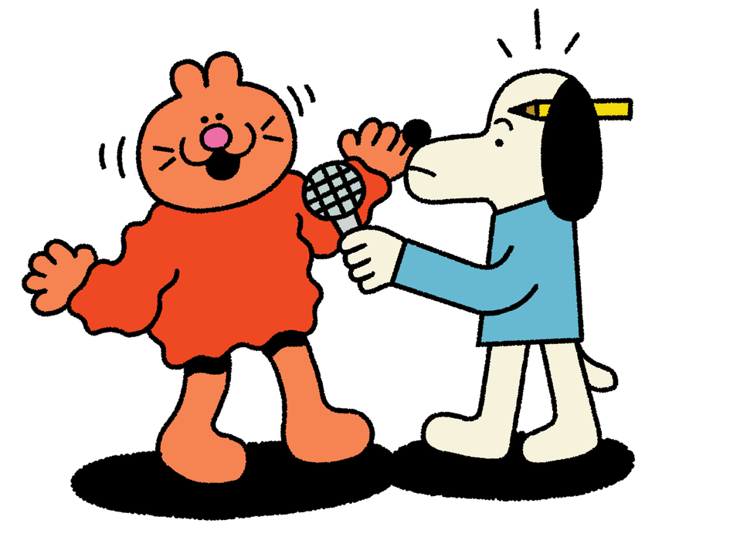
Learning outcomes:
  Explain what bias means
  Identify examples of biased language in a news report
  Evaluate how a writer uses language to influence their reader

Slide 5


Finding a news story
Your first step is to find a suitable news story to report on! This could be a local issue affecting your school or something happening in your local community or area.
Mindmap some ideas with a partner or group.

Slide 6
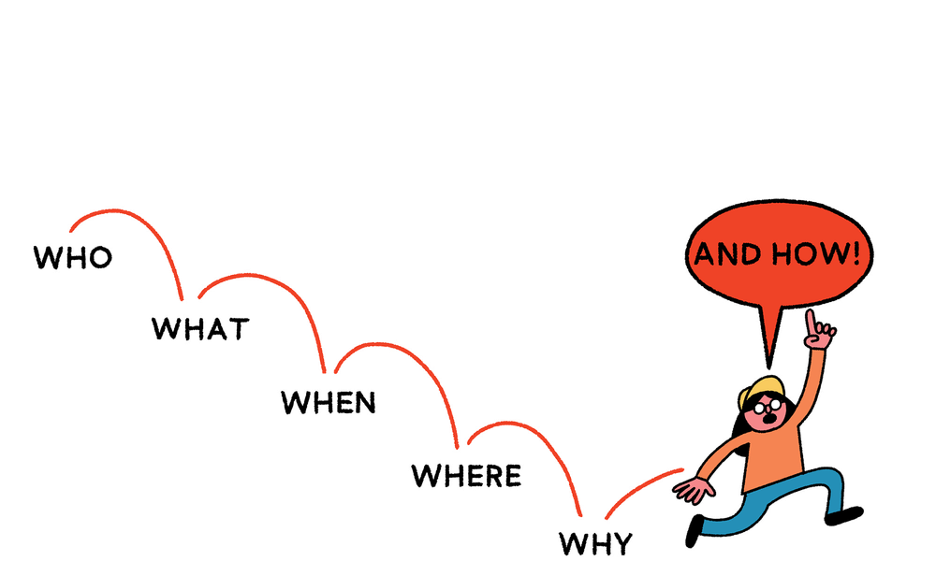
News criteria
Subject
Surprising
Who is the story about?
Will the story surprise people?
A story is more newsworthy if it is about lots of people, an important/ famous person or a surprising person (eg young, old, from the local area).
A story is more newsworthy if it is unexpexted or surprising, or if it informs people about something they didn’t already know.

Slide 7
News criteria
Place
Time
Where did the story happen?
When did the story happen?
A story is most newsworthy to the people closest to it. A story happening in your area will probably be more interesting to you than to people living in another town/ region/ country.
A story is more newsworthy if it ihas only just happened or if it is the first time it has happened.

Slide 8
Sharing ideas
Let’s discuss our ideas! Think about:
  Is this an interesting story for our audience?
  What is this story informing our audience about?
  Is this story fair to share; will the people involved be happy for us to share this information?
  Will we be able to report this story in a balanced way?

Slide 9

Choosing your final story
Write down what you have chosen for your final news story.
Now your real work as a journalist begins!

Slide 10

Identify the 5 Ws of your story.
Write the 5 Ws on your news report plan
Who?
Who is the story about?
What?
What is happening?
When?
When did it happen?
Where did it happen?
Where?
Why?
Why did it happen?

Slide 11
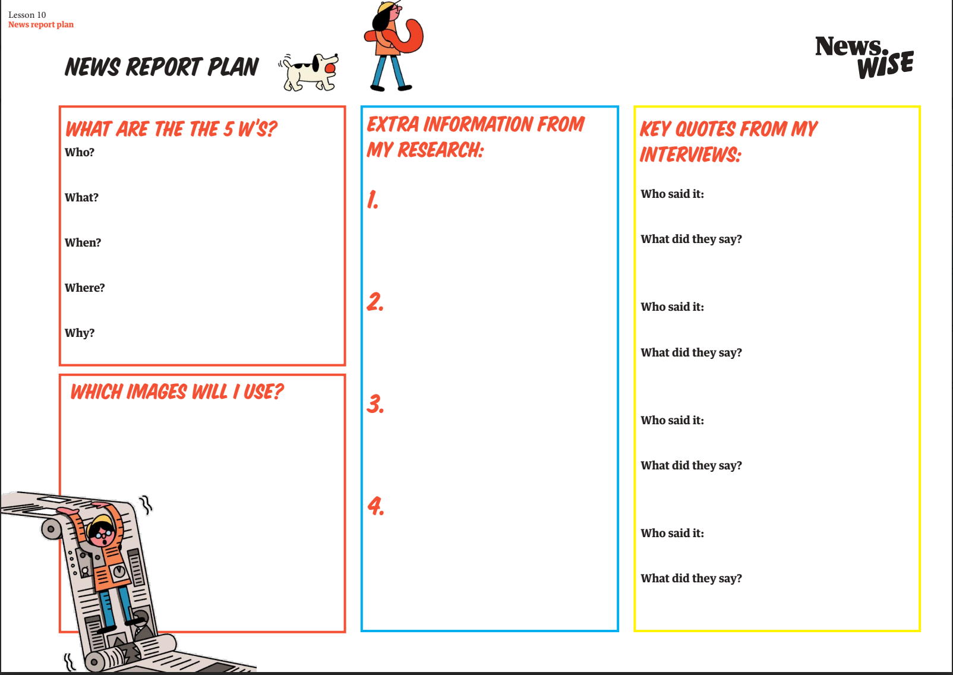

Slide 12
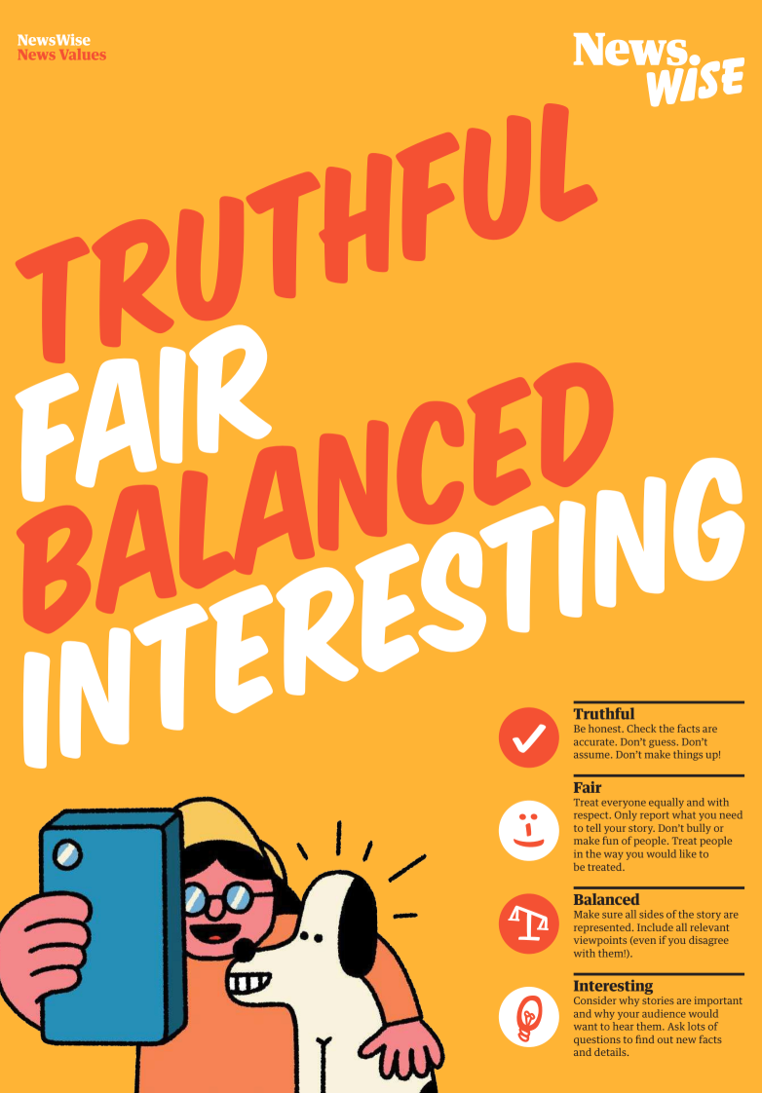
Researching your story
What information will you need to write your news story?
How will you ensure it is truthful, fair, balanced and interesting?

Slide 13
Researching your story
What information could you include in your story to make it informative and interesting for your audience?
Quotes
Similar news reports
Statements
Statistics
Photographs
Official reports

Slide 15
Let’s discuss
Who are you going to interview for your news report?
Remember!
Your news reports need to be balanced, so you will need to interview lots of different people to get different points of view about your story.

Slide 16
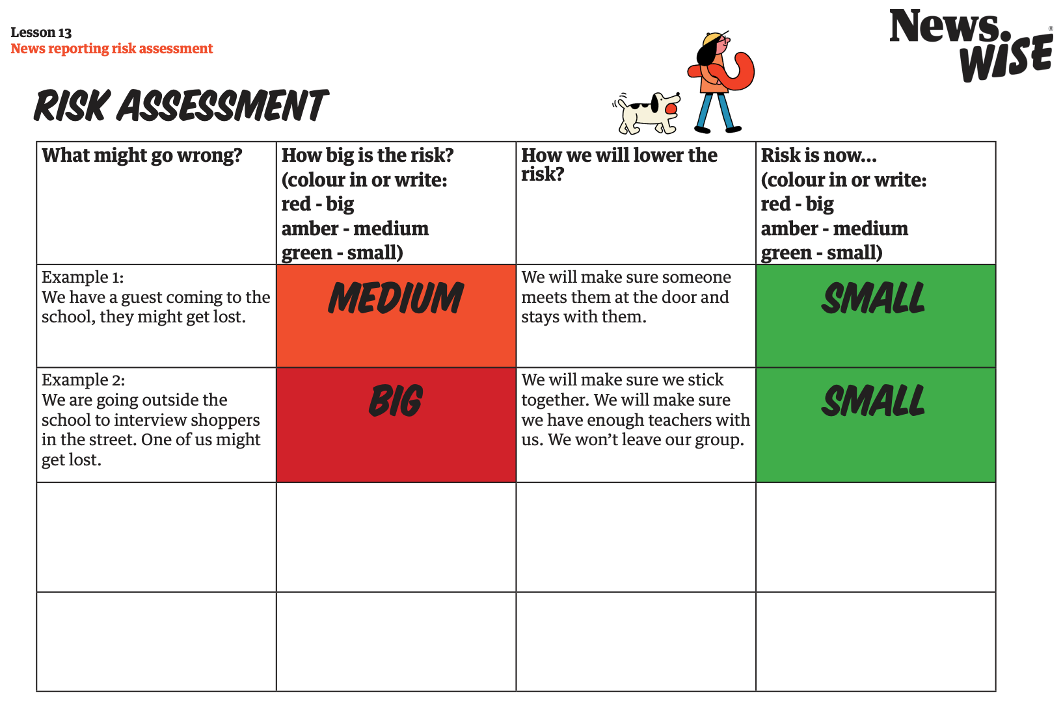
Extension 1
Complete a risk assessment for your interviews

Slide 17
Extension 2
Writing interview questions
Open questions
Closed questions
can be answered with detailed answers
can only be answered with
“yes” or “no”
“Did you go to school today?”
“Do you like carrots?”
“Do you like the colour blue?”
“Do you think the litter in our
town is a problem?”
“What do you think will happen next?”
“Why do you think that...”
“What do you think of...”
“Can you tell me more?”
Write out some questions to ask your interviewees.
Test them out on a partner! Which ones get the best responses, open or closed questions?

Slide 18

Extension 2
Writing interview questions
Open questions
Closed questions
can be answered with detailed answers
can only be answered with
“yes” or “no”
“Did you go to school today?”
“Do you like carrots?”
“Do you like the colour blue?”
“Do you think the litter in our town is a problem?”
“What do you think will happen next?”
“Why do you think that...”
“What do you think of...”
“Can you tell me more?”
Open questions are best for an interview!

Slide 19
Extension 3
Select the most useful and interesting information from your interviews.
Write a bank of direct quotes and reported speech to use in the reports.

Slide 20
Extension 4
Carry out additional research online, or by visiting somewhere, to find out extra facts and details to include in your report.

