Slide 1

Vocabulary to pre-teach
News
Information which the audience/ reader either needs to know or wants to know.
Journalist
Someone who works to produce news reports. May be a reporter or an editor.
Newsroom
The place where journalists and editors work together to gather, write and check news stories.
Report
The piece of writing about a news story that is published in a newspaper or online, or spoken in a news broadcast on TV or radio.
Local news
News stories that are happening near to where you live, in your village, town or community.
National news
News stories that are happening in your home country.
International news
News stories that are happening around the world (outside of your home country).
Reporter
The person who researches and writes the news report.
Subeditor
The person who reads a news report (which has been written by someone else) and corrects mistakes. Also writes headlines and captions.
Picture editor
The person who chooses which pictures to use with a story.

Slide 2

Lesson 1
How is news produced?

Slide 3

Learning objective
To understand the purpose of news and how it is produced.
Journalist training school
Journalists report news stories to inform (and sometimes entertain) their audience. There are different types of journalists, who each have a different responsibility in news production.

Slide 4

Learning outcomes:
  Define what news is.
  Describe the different roles in a newsroom and the skills needed for those roles.
  Identify the main purpose of a news story.
  Summarise a news story using the 5 Ws.

Slide 5

Your mission

Slide 6
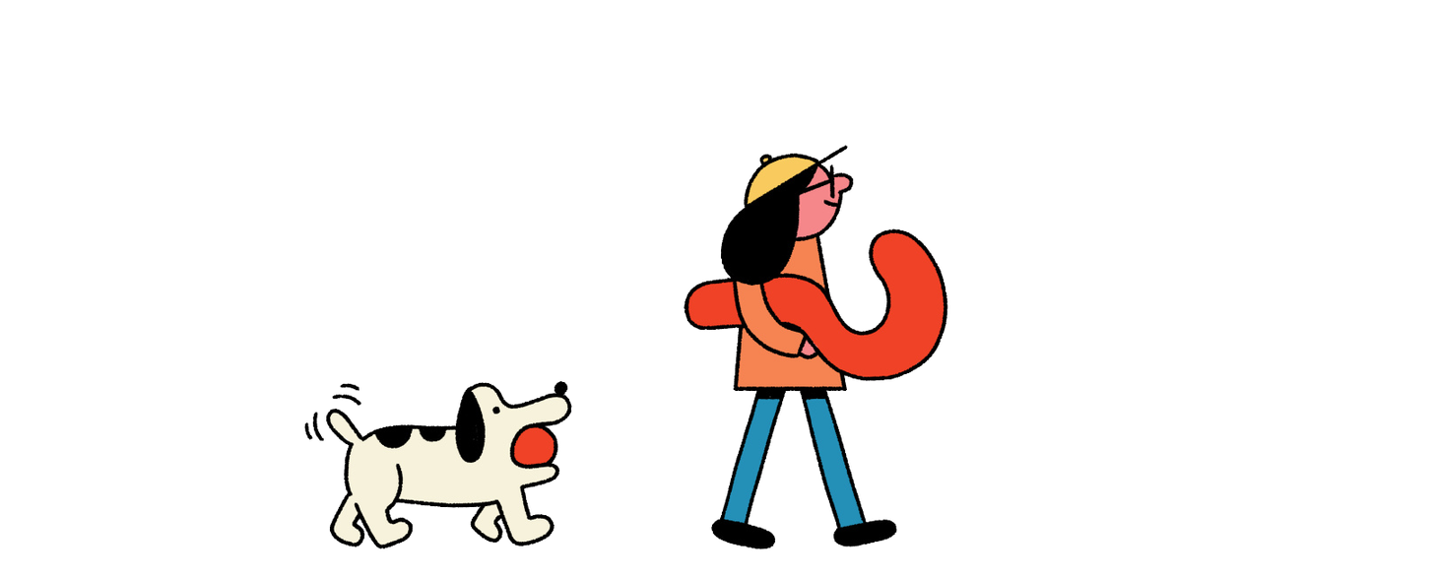
I went to the cinema yesterday and really enjoyed the film.
News or not?
Notes:
Pupils sort the headlines into ‘news’ or ‘not news’, considering the reasons for their choices.
• What counted as news and why?
• What didn’t count as news?
• How did you make your decision?
• Are things which happen to us individually ‘news’?
• Are there some headlines that might count as news for some people/audiences but not others?

Slide 7
Manchester City beat Arsenal 8-0.
News or not?

Slide 8
There are fish fingers for lunch today.
News or not?

Slide 9
A volcano has erupted.
News or not?

Slide 10
A new dinosaur has been discovered.
News or not?

Slide 11
Taylor Swift has cancelled her tour due to illness.
News or not?

Slide 12
There is a protest happening outside parliament.
News or not?

Slide 13
Celebrities are arriving in London for a film premiere.
News or not?

Slide 14
There has been a huge accident on a motorway.
News or not?

Slide 15
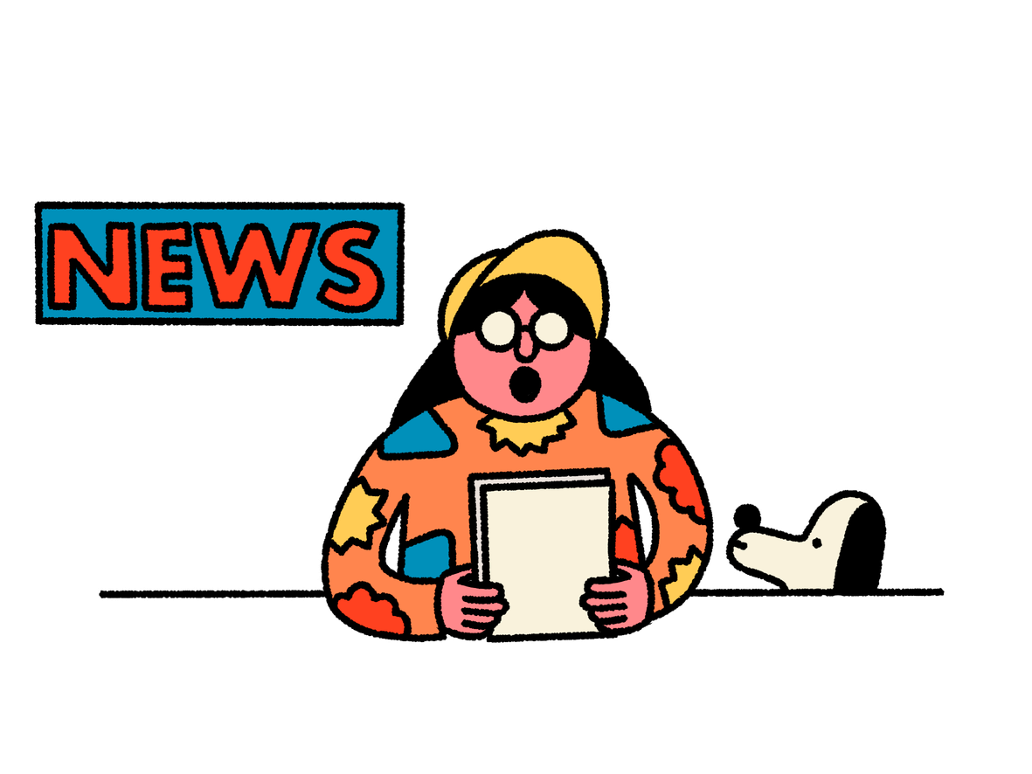
Let’s create a class definition for the news

Slide 16
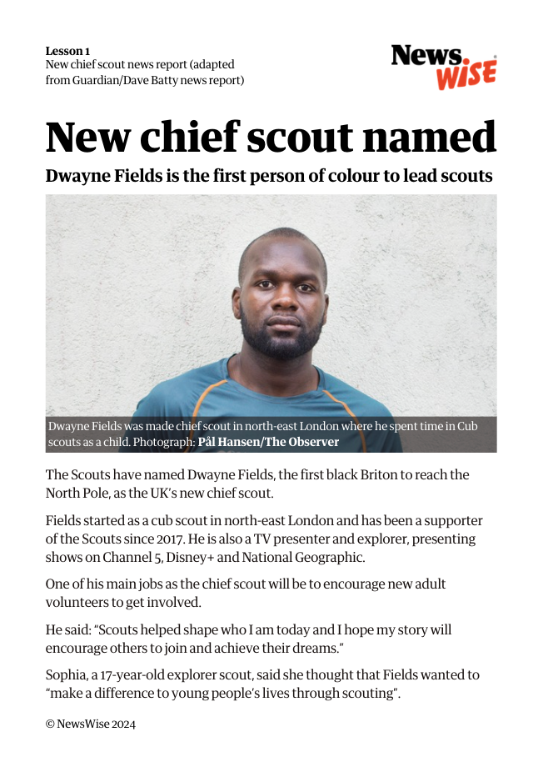
Can you find the 5Ws in this report?
Who
What
When
Where
Why

Slide 17

Can you describe the
main purpose of the story:
what is the report informing the reader about?
Challenge:
Why do you think the story’s main purpose is important for the reader
to know?

Slide 18
Roles in a newsroom
picture
Editors
Reporters
subeditors
  Decide who to interview to find out more information about the story.
  Write questions to gather the most interesting details.
  Choose the most informative and interesting pictures to accompany the news report, justifying why some pictures are better than others.
  Write captions for the chosen pictures.
  Proofread the report to find and correct spelling and punctuation errors.
  Write a subject-verb-object headline to highlight the most important and interesting information in the news report.

Slide 19
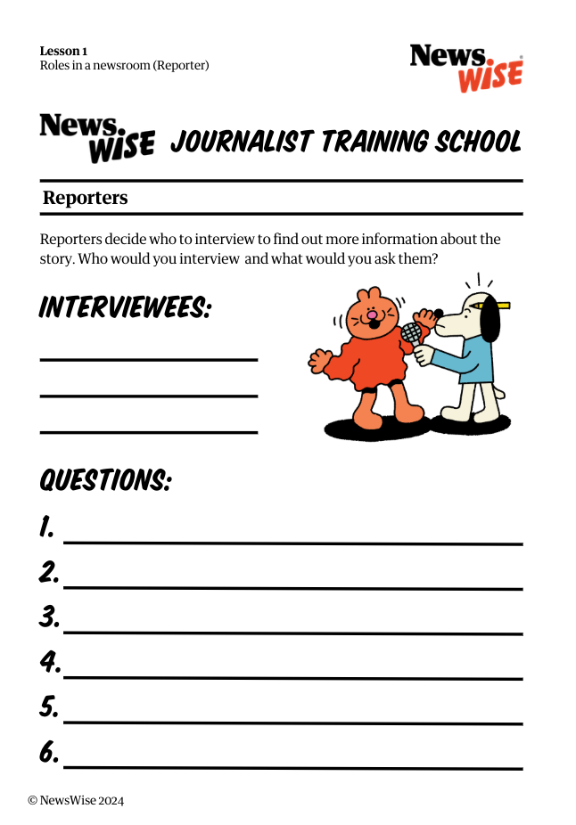
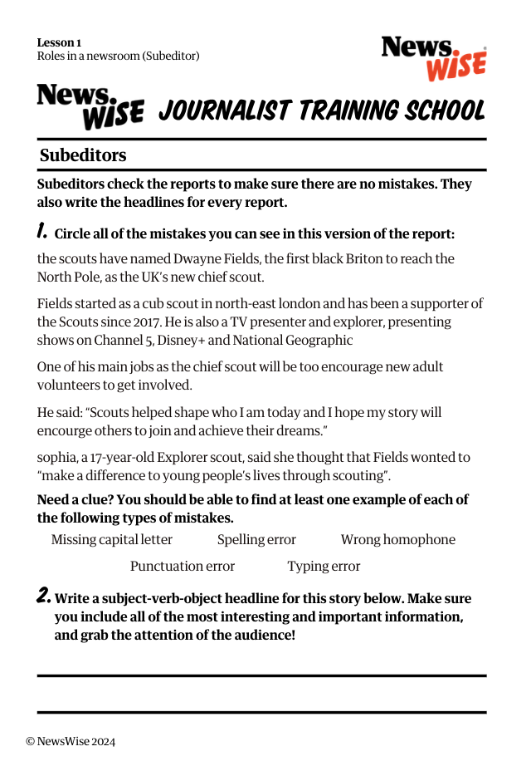
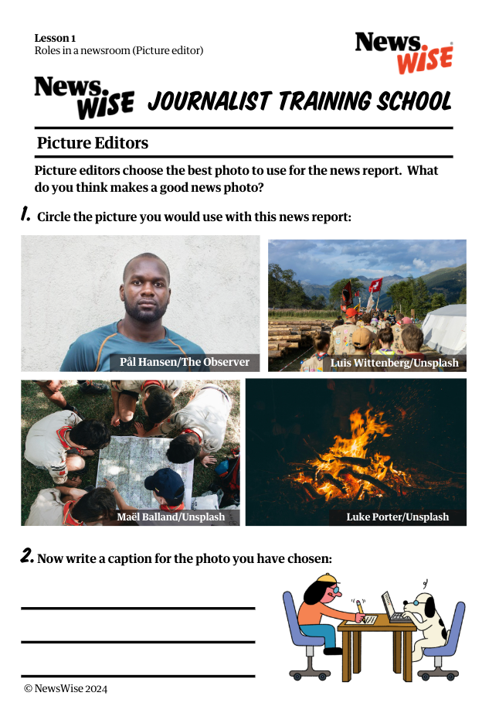
Let’s have a go at each of these roles!
Reporter
Subeditor
Picture Editor

Slide 20
Reporter
  Decide who to interview to find out more information about the story.
  Write questions to gather the most interesting details.

Slide 21
Subeditor
  Proofread the report to find and correct spelling and punctuation errors.
  Write a subject-verb-object headline to highlight the most important and interesting information in the news report.

Slide 22
Picture Editor
  Choose the most informative and interesting pictures to accompany the news report, justifying why some pictures are better than others.
  Write captions for the chosen pictures.

Slide 23
Let’s discuss
Why is it important that news stories are interesting?
Which role did you enjoy the most and why?
What skills do journalists need to learn?

